Slide 1


First discovery of Double Cabbibo-Suppressed decay: Λ_{c} → pK⁺π⁻
+ α
arXiv:1512.07366, submitted to PRL
Kiyoshi Tanida
(ASRC, JAEA)
Reimei Workshop @ASRC

Slide 2
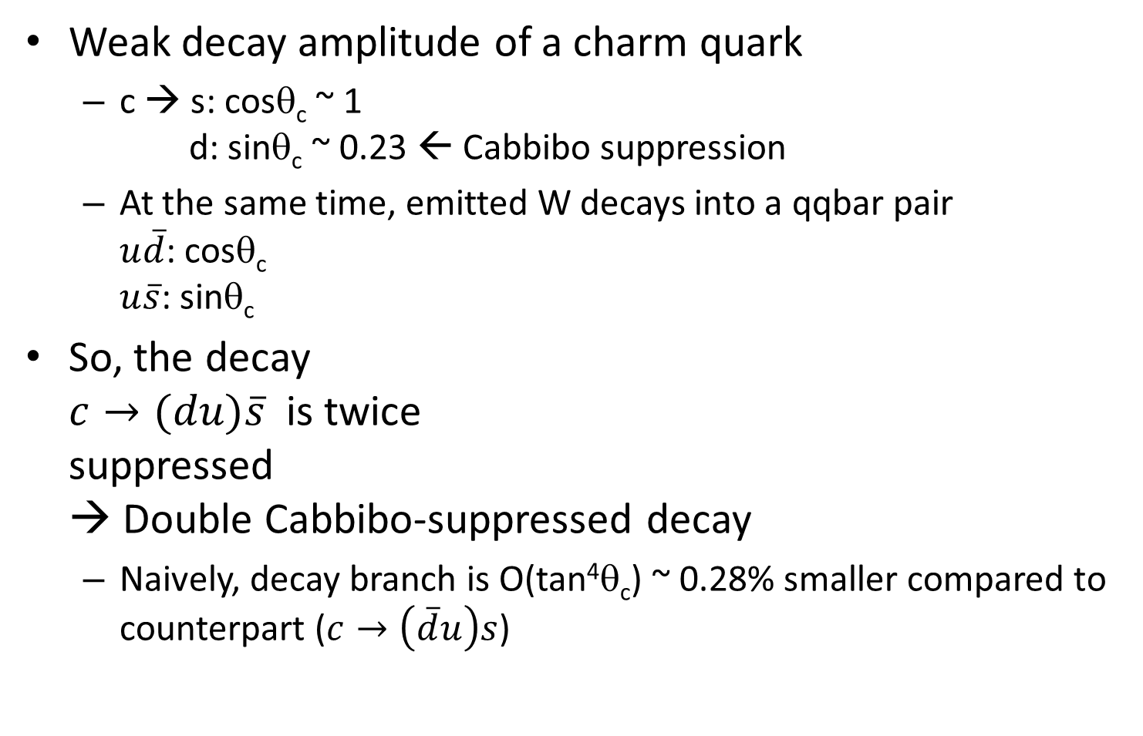
Double Cabbibo-suppressed decay
Weak decay amplitude of a charm quark
  c → s: cosθ_{c} ~ 1
  d: sinθ_{c} ~ 0.23 ← Cabbibo suppression
  At the same time, emitted W decays into a qqbar pair
  $u\overline{d}$: cosθ_{c}
  $u\overline{s}$: sinθ_{c}
So, the decay
$c→(du)\overline{s}$ is twice
suppressed
→ Double Cabbibo-suppressed decay
  Naively, decay branch is O(tan⁴θ_{c}) ~ 0.28% smaller compared to
  counterpart ($c→\left(\overline{d}u\right)s$)

Slide 3
Example DCS decays
Several decays are observed for D mesons
D⁺ → K⁺π⁺π⁻
BR(K⁺π⁺π⁻)/BR(K⁻π⁺π⁺) =(5.77±0.22)×10⁻³ ～ 2tan⁴θ_{c}
D⁰ → K⁺π⁻
BR(K⁺π⁻)/BR(K⁻π⁺) =(3.37±0.21)×10⁻³ ～ 1.2tan⁴θ_{c}
Can be quite different from naïve expectation, reflecting structure and/or decay dynamics
NEVER observed for baryons
BR(Λ_{c}→pK⁺π⁻)/BR(Λ_{c}→pK⁻π⁺) < 0.46% (90%CL) by FOCUS

Slide 4
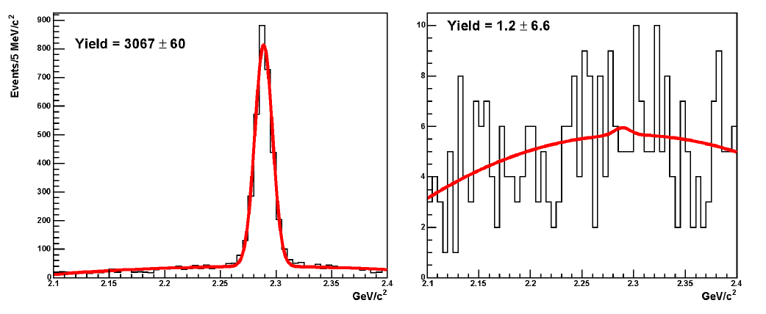


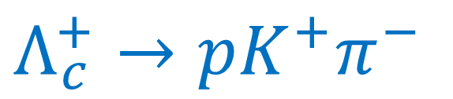

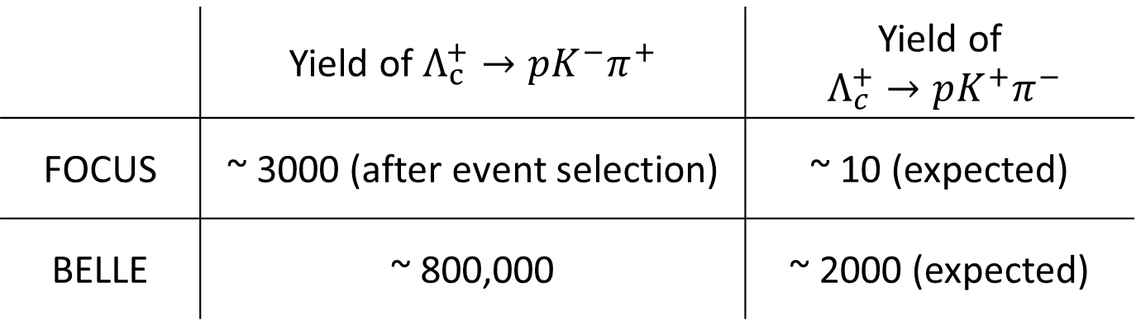


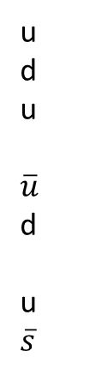

$Λ_{c}^{+}→pK^{+}π^{−}$
u
d
u
$\overline{u}$
d
u
$\overline{s}$
$$p$$
$$Λ_{c}^{+}→pK^{+}π^{−}$$
$$Λ_{c}^{+}→pK^{−}π^{+}$$
u
d
c
$$Λ_{c}^{+}$$
$$π^{−}$$
W+
$$K^{+}$$
FOCUS group, PLB 624 (2005) 166-172
 | Yield of $Λ_{c}^{+}→pK^{−}π^{+}$ | Yield of $Λ_{c}^{+}→pK^{+}π^{−}$
FOCUS | ~ 3000 (after event selection) | ~ 10 (expected)
BELLE | ~ 800,000 | ~ 2000 (expected)

Slide 5
Possible diagrams
Spectator
Exchange
Not available
in DCS decays

Slide 6
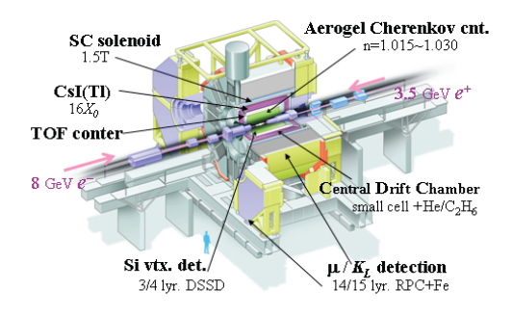
Belle experiment
Almost 4π, good momentum resolution (Δp/p～0.1%),
EM calorimeter, PID & Si Vertex detector

Slide 7

Huge statistics, good quality
$$Λ_{c}^{+}→pK^{−}π^{+}$$
1.5 M events
reconstructed

Slide 8
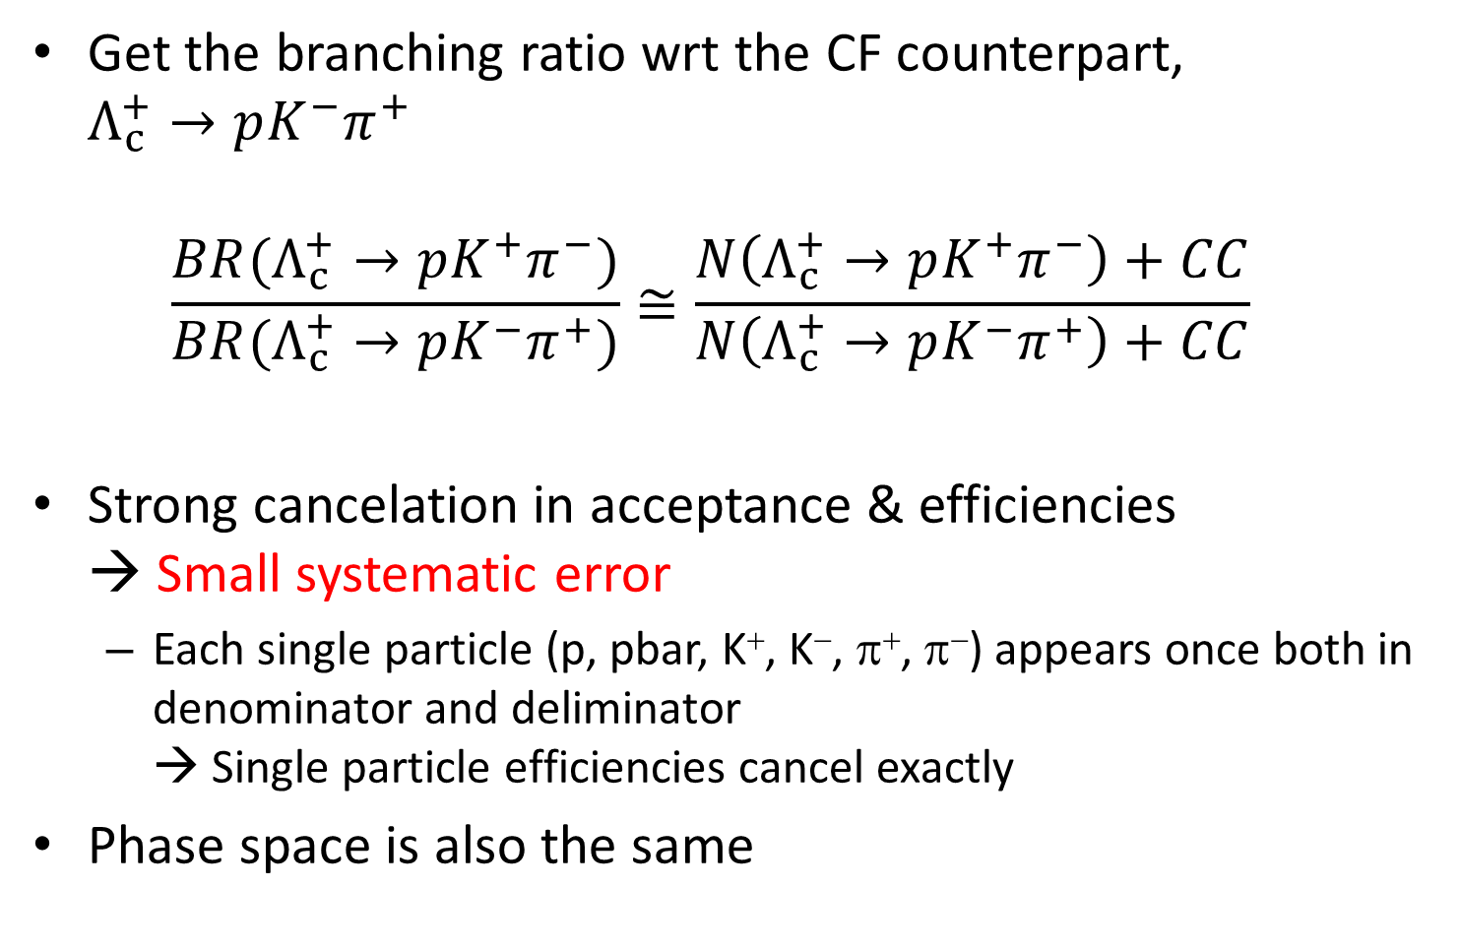
Analysis strategy
Get the branching ratio wrt the CF counterpart,
$Λ_{c}^{+}→pK^{−}π^{+}$
$\frac{BR(Λ_{c}^{+}→pK^{+}π^{−})}{BR(Λ_{c}^{+}→pK^{−}π^{+})}≅\frac{N\left(Λ_{c}^{+}→pK^{+}π^{−}\right)+CC}{N\left(Λ_{c}^{+}→pK^{−}π^{+}\right)+CC}$
Strong cancelation in acceptance & efficiencies
→ Small systematic error
  Each single particle (p, pbar, K⁺, K⁻, π⁺, π⁻) appears once both in denominator and deliminator
  → Single particle efficiencies cancel exactly
Phase space is also the same

Slide 9
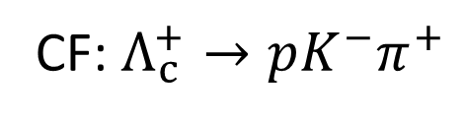
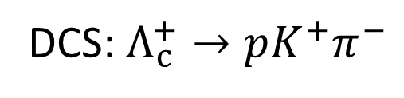
Number of Events
CF: $Λ_{c}^{+}→pK^{−}π^{+}$
DCS: $Λ_{c}^{+}→pK^{+}π^{−}$
(1.452±0.015)×10⁶ events
Significant signal observed!
3587±380 events

Slide 10
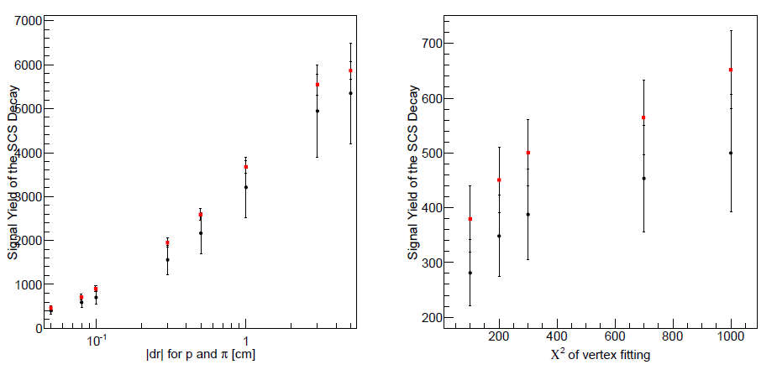

Peaking background
$Λ_{c}^{+}→ΛK^{+}, Λ→pπ^{−}$ is a singly Cabbibo-suppressed decay having the same final state as DCS
  Suppressed by vertex cuts
Contamination estimated by $pπ^{−}$ invariant mass
with relaxing vertex cuts – 208±78 events

Slide 11
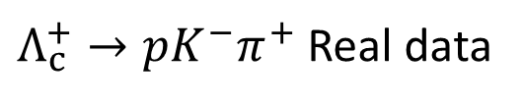
Efficiency – Dalitz plot
Only significant systematic uncertainty
Estimate efficiency on each point of DP
  Integrate for various distribution
$Λ_{c}^{+}→pK^{−}π^{+}$ Real data
Efficiency from MC

Slide 12
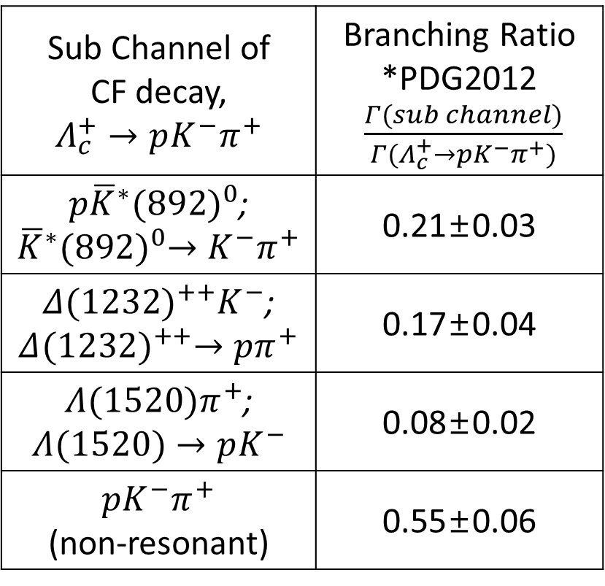

Sub-branches
CF
  PDG branches
  + Phase space
DCS
  Same as CF except
  $Λ\left(1520\right)$
Uncertainty
  CF: nominal vs
  weight from the real data
  DCS: nominal vs
  each sub-branch
  → Maximum difference
Efficiency ratio: 1.01±0.05
Sub Channel of CF decay, $$Λ_{c}^{+}→pK^{−}π^{+}$$ | Branching Ratio *PDG2012 $\frac{Γ(sub channel)}{Γ(Λ_{c}^{+}→pK^{−}π^{+})}$
$p{\overline{K}}^{∗}{(892)}^{0}$; ${\overline{K}}^{∗}{(892)}^{0}→K^{−}π^{+}$ | 0.21±0.03
$Δ{(1232)}^{++}K^{−}$; $$Δ{(1232)}^{++}→pπ^{+}$$ | 0.17±0.04
$Λ(1520)π^{+}$; $$Λ(1520)→pK^{−}$$ | 0.08±0.02
$pK^{−}π^{+}$ (non-resonant) | 0.55±0.06

Slide 13
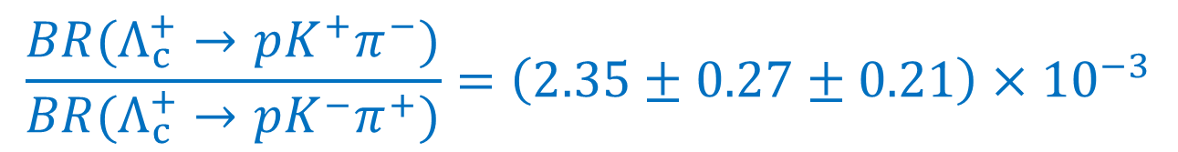
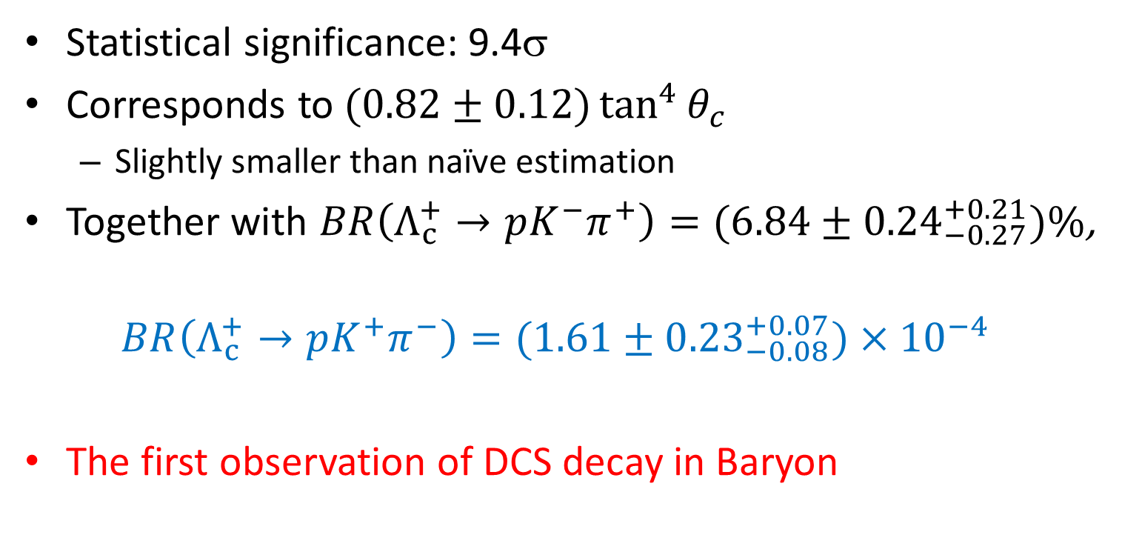
Result
$$\frac{BR(Λ_{c}^{+}→pK^{+}π^{−})}{BR(Λ_{c}^{+}→pK^{−}π^{+})}=\left(2.35±0.27±0.21\right)×{10}^{−3}$$
Statistical significance: 9.4σ
Corresponds to $(0.82±0.12)\tan^{4}{θ_{c}}$
  Slightly smaller than naïve estimation
Together with $BR\left(Λ_{c}^{+}→pK^{−}π^{+}\right)=(6.84±{0.24}_{−0.27}^{+0.21})\%$,
$$BR\left(Λ_{c}^{+}→pK^{+}π^{−}\right)=(1.61±{0.23}_{−0.08}^{+0.07})×{10}^{−4}$$
The first observation of DCS decay in Baryon

Slide 14
+α

Slide 15

Dalitz plot: $Λ_{c}^{+}→pK^{−}π^{+}$

Slide 16
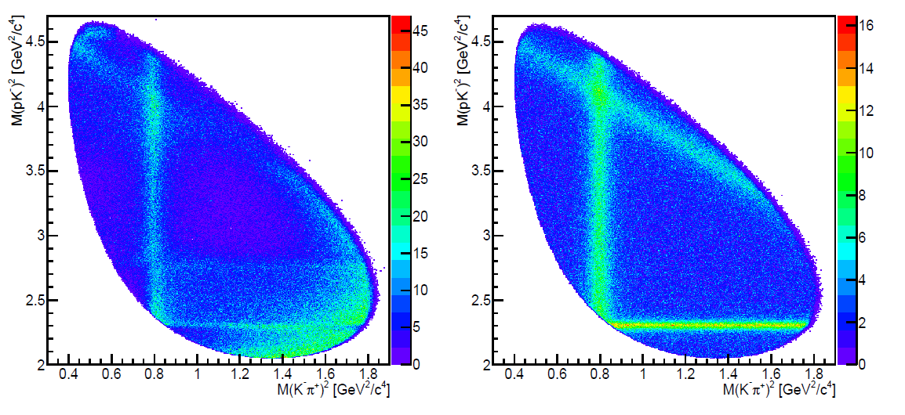
Comparison with MC
Real data
MC
Δ
K*(892)
Λ(1520)
Quite a lot of difference – PDG sub-branches seem wrong
Interesting structure in non-resonant region
Hint for another Λ*/Σ* resonance seen. Λ(1670)?

Slide 17
Prediction from theory side
Miyahara, Hyodo & Oset, PRC 92, 055204 (2015)
Λ(1670)
Λ(1670) is predicted, but …

Slide 18

Hyperon spectroscopy in Λ_{c} decay
Interesting tool to study hyperon resonances
Another example: Ξ*(1690)
  Now we have ~30 times more data
$$Λ_{c}^{+}→ΛK_{s}^{0}K^{+}$$
Belle collaboration
PLB 524, 33 (2002)

Slide 19
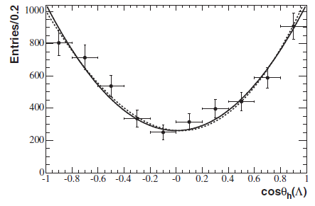
Spin
With the high statistics, now we can determine
spin in model independent way.
  Same method as for Ω (Babar, PRL 97 (2006) 112001)
Cascade process
Λ_{c}⁺ → Ξ⁰(1690) + K⁺ (1/2 → J + 0),
Ξ⁰(1690) → Λ + K⁰ (J → 1/2 + 0)
Angular correlation
  If J=1/2 → uniform
  3/2 → 3cos²θ_{h}+1
Ξ_{c}⁰ → Ω⁻ + K⁺,
Ω⁻ → Λ + K⁻
Λ
θ_{h}
K⁺
Λ_{c}
Ξ
K⁰

Slide 20
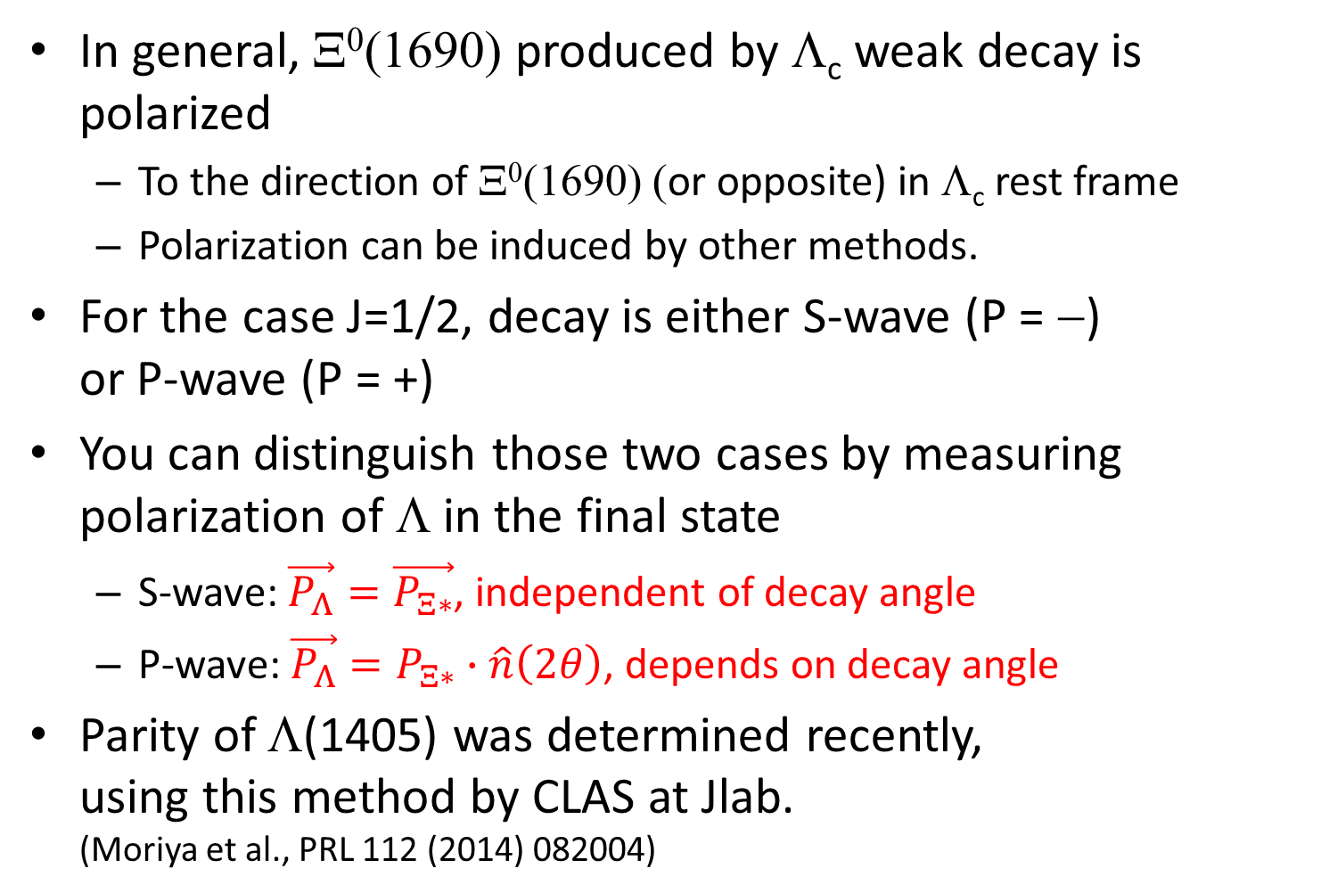
Parity
In general, Ξ⁰(1690) produced by Λ_{c} weak decay is polarized
  To the direction of Ξ⁰(1690) (or opposite) in Λ_{c} rest frame
  Polarization can be induced by other methods.
For the case J=1/2, decay is either S-wave (P = −)
or P-wave (P = +)
You can distinguish those two cases by measuring polarization of Λ in the final state
  S-wave: $\vec{P_{Λ}}=\vec{P_{Ξ∗}}$, independent of decay angle
  P-wave: $\vec{P_{Λ}}=P_{Ξ∗}∙\hat{n}\left(2θ\right)$, depends on decay angle
Parity of Λ(1405) was determined recently,
using this method by CLAS at Jlab.
(Moriya et al., PRL 112 (2014) 082004)

Slide 21
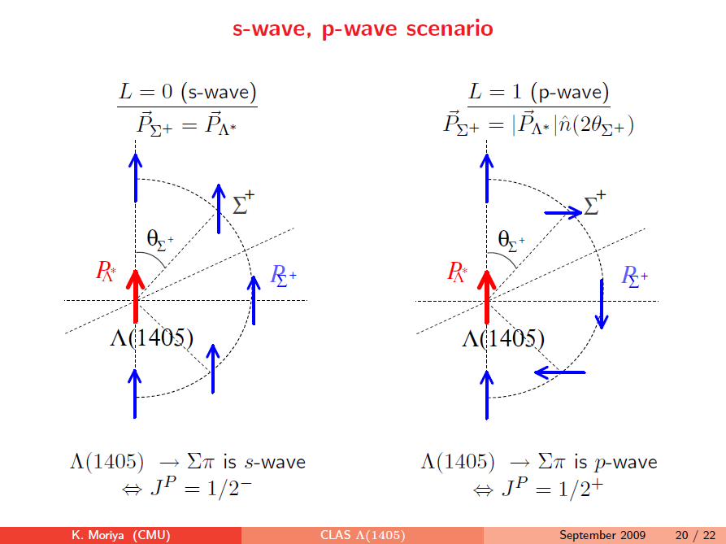
K. Moriya Hyp-X

Slide 22
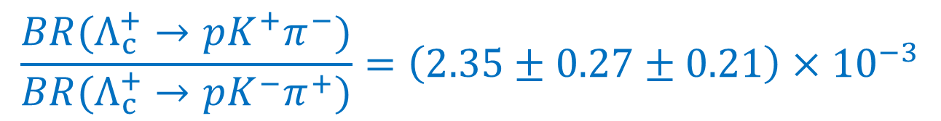
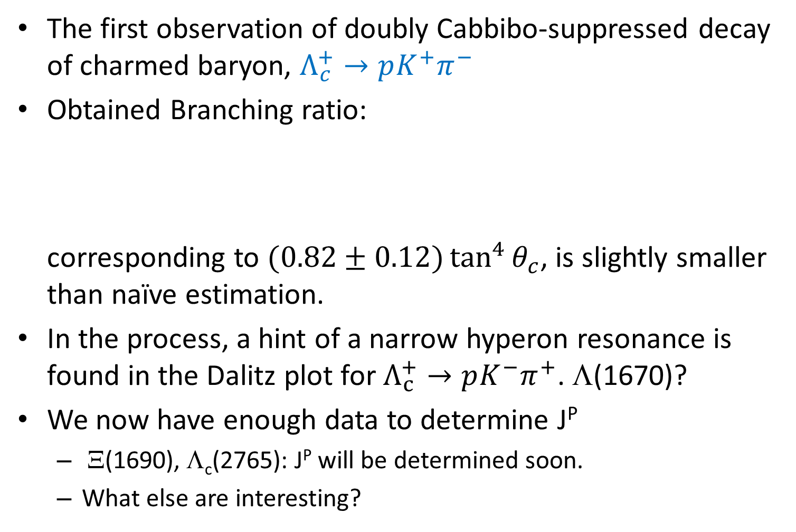
Summary
The first observation of doubly Cabbibo-suppressed decay of charmed baryon, $Λ_{c}^{+}→pK^{+}π^{−}$
Obtained Branching ratio:
corresponding to $(0.82±0.12)\tan^{4}{θ_{c}}$, is slightly smaller than naïve estimation.
In the process, a hint of a narrow hyperon resonance is found in the Dalitz plot for $Λ_{c}^{+}→pK^{−}π^{+}$. Λ(1670)?
We now have enough data to determine J^{P}
  Ξ(1690), Λ_{c}(2765): J^{P} will be determined soon.
  What else are interesting?
$$\frac{BR(Λ_{c}^{+}→pK^{+}π^{−})}{BR(Λ_{c}^{+}→pK^{−}π^{+})}=\left(2.35±0.27±0.21\right)×{10}^{−3}$$

