Slide 1
Spectroscopy of S=-1 hyperon resonances with antikaon-induced meson-production reactions
Hiroyuki Kamano
(KEK)
Seminar@JAEA, December 12th, 2016

Slide 2

Outline
(My) purpose of this talk:
Encouraging new high-statistics measurement of
$\overline{\text{K}}$-induced meson-production reactions at J-PARC
to establish Y*(=Λ*, Σ*) resonance spectrum !!
1. Results from spectroscopic study of Y* resonances
based on Dynamical Coupled-Channels (DCC)
analysis of K⁻ p & K⁻ d reactions
2. Discussion on new data necessary for further
establishing Y* resonance mass spectrum
HK, Nakamura, Lee, Sato, PRC90(2014)065204; 92(2015)025205
HK, Lee, arXiv:1608.03470 (to appear in PRC)
Notes:
ハイペロン共鳴の話に移ります。
かなりのことが分かっていると思っている人もいるかもしれないが、核子共鳴に比べれば断然わかってない。
例えば、核子共鳴とは対照的にlow-lyingな状態にも存在が怪しい状態がいくつかある。
KbarNのしきい以下には、Lambda(1405)以外にも、13xxMeVくらいの質量をもつＳ波共鳴がいる可能性が指摘されている。
これらPDGに載っている状態は、散乱振幅の極として定義されたmodel-independentな共鳴質量ではなくて、Ｂｒｅｉｔ-Wigner共鳴と多項式のバックグラウンドの和でパラメトライズした、ユニタリー性を満たさない部分波振幅を用いた解析で得られたいわゆるBreit-Wignerの質量とよばれるものを集めたものです。
実際、散乱振幅の極でもって定義されたハイペロン共鳴を抜き出す目的で行われた部分波解析は2013年のKent State Universityのグループによるものが初めてで、我々はそれに続いて二例目になります。

Slide 3
Results from spectroscopic study of
Y* resonances based on
DCC analysis of K⁻ p & K⁻ d reactions
(1 of 2)

Slide 4
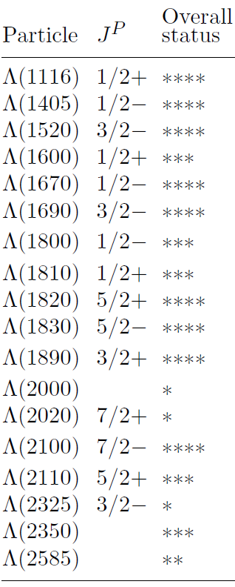

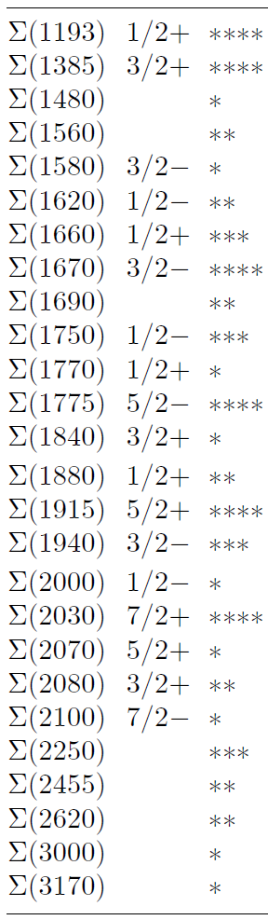
Introduction:
Current situation of Y* spectroscopy
PDG listing
Λ*
Σ*
Y* (= Λ*, Σ*) mass spectrum is
far from being established !!
Existence of ~70% of reported Λ* & Σ* is uncertain.
➔ Even low-lying states are still uncertain.
A large number of Y* resonances are likely to still
remain undiscovered !!
c.f. Resonances below 1.7 GeV have been firmly
established for N* & Δ case.
[One exception: Δ(1600)3/2⁺ (Roper-like state of Δ)]
➔ J-PARC E45 is a promising experiment to establish
Δ(1600)3/2⁺ and high-mass N* & Δ* resonances
➔ Not well
established
➔ Spin-parity
not assigned

Slide 5
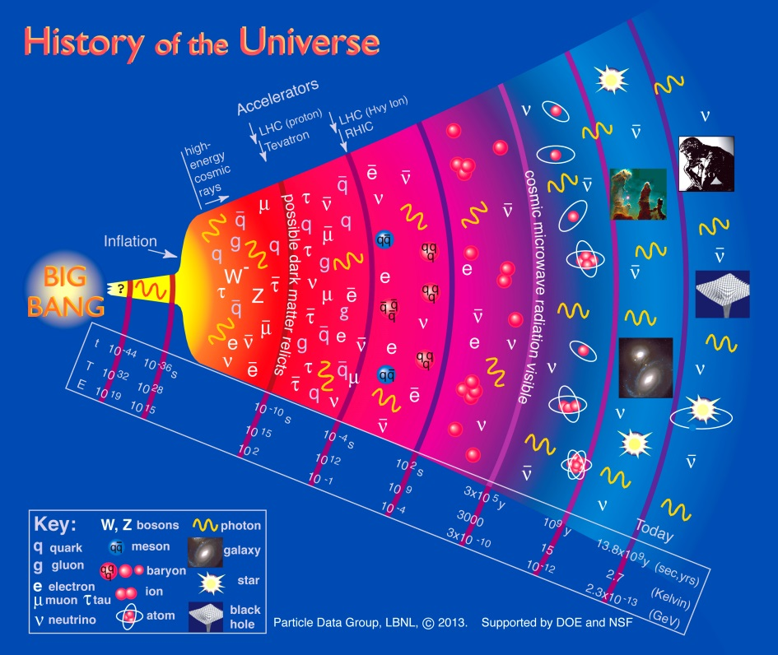
Introduction:
Current situation of Y* spectroscopy
PDG listing
Λ*
Σ*
Establishing Y* spectrum is crucial also for understanding
thermodynamic properties below the QCD crossover.
[Bazavov et al., PRL113(2014)072001]
Y*
Y*
➔ Not well
established
Possibility of producing secondary K_{L} beam are being
discussed at JLab (See e.g., arXiv:1604.02141)
➔ Spin-parity
not assigned

Slide 6
Introduction:
Current situation of Y* spectroscopy
PDG listing
Λ*
Σ*
Almost all Y* results listed in PDG come from old Breit-Wigner analyses of K⁻ p reactions in 60-70s !!
Comprehensive partial-wave analyses of
K⁻ p reactions to extract Y* defined by poles
have only recently been accomplished:
Kent State University (KSU) group
(➔ 2013, “KSU on-shell parametrization” of S-matrix)
Our group
(➔ 2014-2015, dynamical coupled-channels approach)
Zhang et al., PRC88(2013)035204, 035205.
Reanalysis of KSU single-energy solution using an on-shell K-matrix
model (Femandez-Ramirez et al., arXiv:1510.07065)
➔ Not well
established
➔ Spin-parity
not assigned
HK, Nakamura, Lee, Sato, PRC90(2014)065204; 92(2015)025205

Slide 7


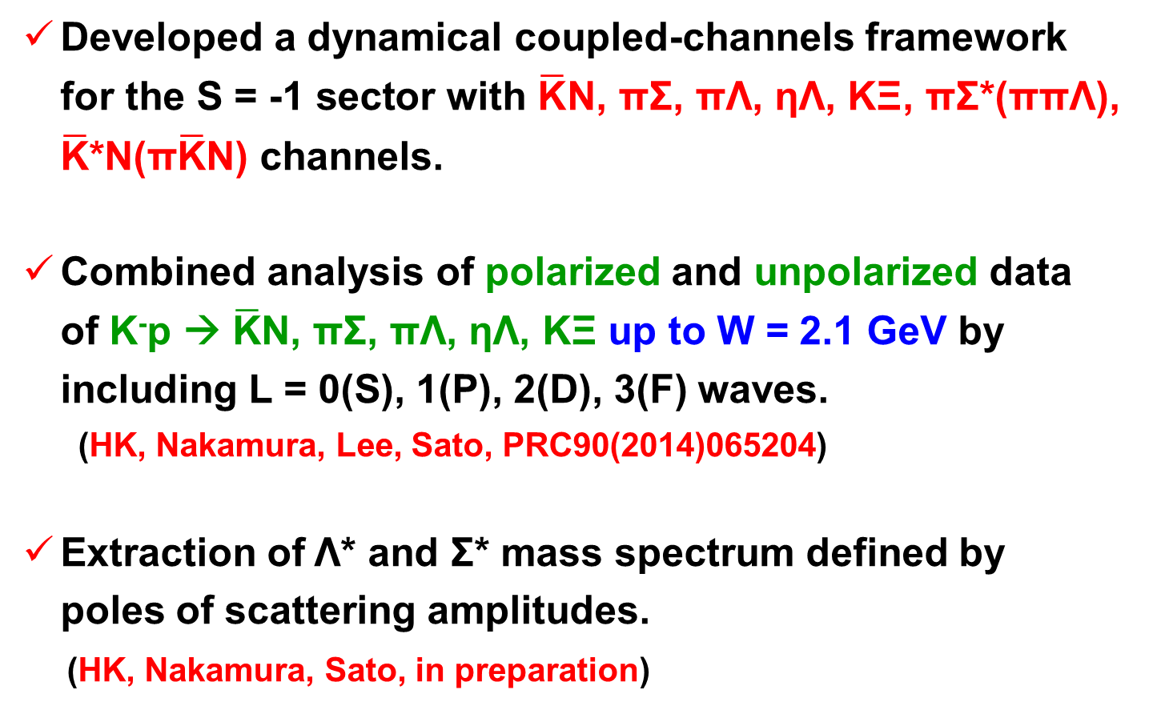

Dynamical Coupled-Channels (DCC) approach to Λ* & Σ* productions
Dynamical Coupled-Channels (DCC) model:
[Matsuyama, Sato, Lee, PR439(2007)193; HK, Nakamura, Lee, Sato, PRC88(2013)035209;90(2014)065204]
CC
effect
off-shell
effect
quasi two-body channels of
three-body ππΛ & π$\overline{\text{K}}$N
Summing up all possible transitions between reaction channels !!
(➔ satisfies multichannel two- and three-body unitarity)
Momentum integral takes into account off-shell rescattering effects
in the intermediate processes.
e.g.）$\overline{\text{K}}$N scattering
$$\overline{\text{K}}$$
$$\overline{\text{K}}$$
π
Σ
K
Ξ
π
Σ*
…
＝
V
＋
＋
＋
N
N

Slide 8



What we have done so far
With the DCC approach developed for the S= -1 sector, we made:
Supercomputers are necessary
for the analysis !!
Comprehensive analysis of ALL available
data (more than 17,000 data points) of
K⁻ p → $\overline{\text{K}}$N, πΣ, πΛ, ηΛ, KΞ up to W = 2.1 GeV.
[HK, Nakamura, Lee, Sato, PRC90(2014)065204]
Determination of threshold parameters (scattering lengths, effective ranges,…); the partial-wave amplitudes of
$\overline{\text{K}}$N → $\overline{\text{K}}$N, πΣ, πΛ, ηΛ, KΞ for S, P, D, and F waves.
[HK, Nakamura, Lee, Sato, PRC90(2014)065204]
Extraction of Y* resonance parameters (mass, width, couplings, …) defined by poles of scattering amplitudes.
[HK, Nakamura, Lee, Sato, PRC92(2015)025205]

Slide 9
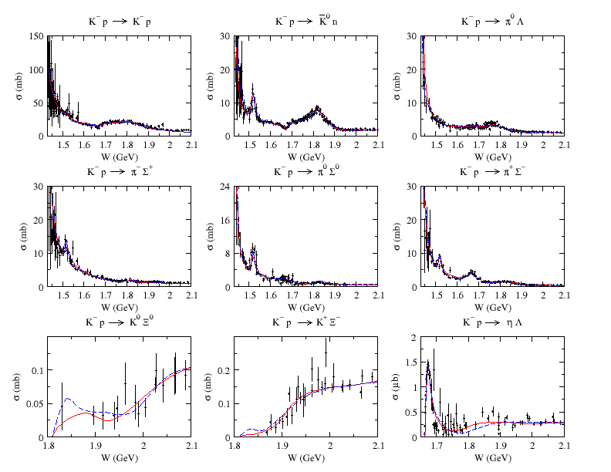
Results of the fits
K⁻ p → MB total cross sections
HK, Nakamura, Lee, Sato, PRC90(2014)065204
Red: Model A
Blue: Model B
“Incompleteness” of
the current database
allows us to have two
parameter sets that
give similar quality
of the fit.

Slide 10
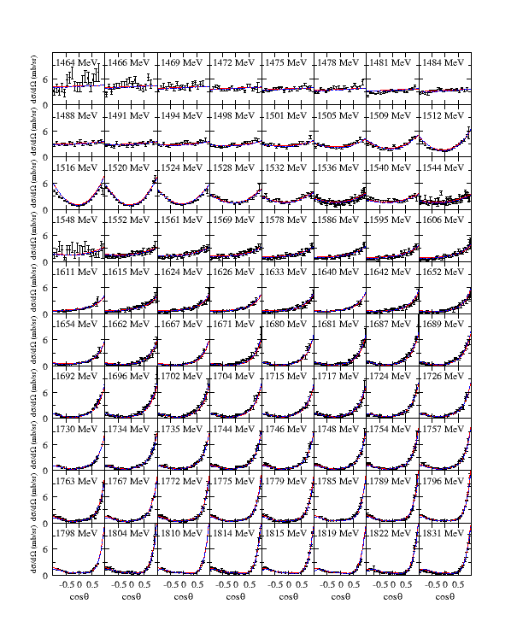
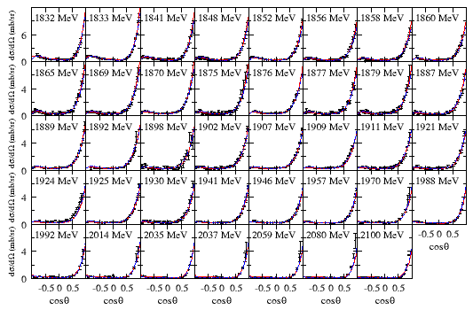
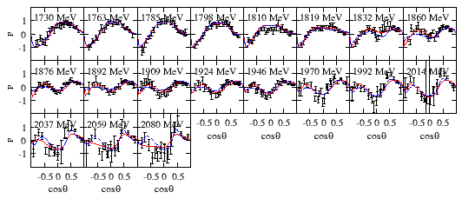
Results of the fits
K⁻ p → K⁻ p scattering
HK, Nakamura, Lee, Sato, PRC90(2014)065204
dσ/dΩ (1464 < W < 1831 MeV)
dσ/dΩ (1832 < W < 2100 MeV)
P (1730 < W < 2080 MeV)
Red: Model A Blue: Model B

Slide 11
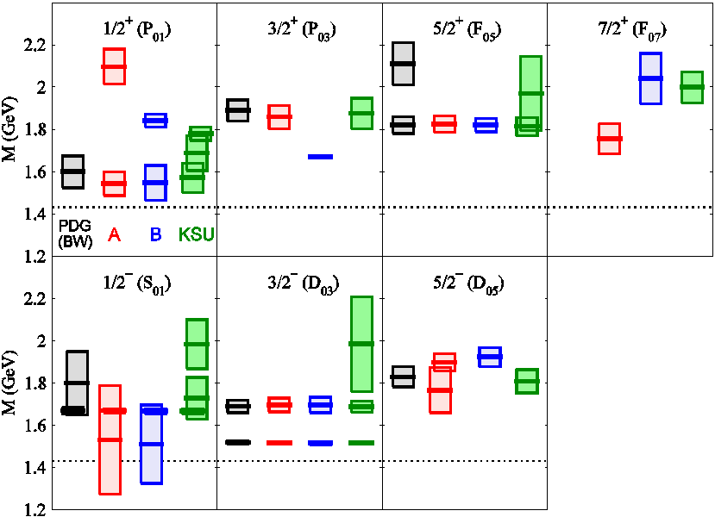
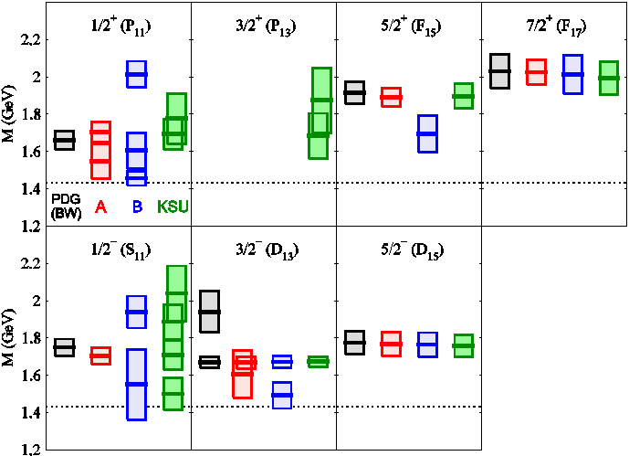
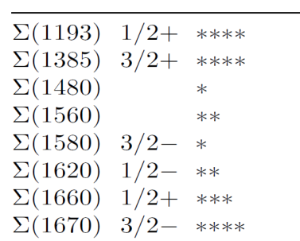

Extracted Λ* and Σ* mass spectrum
Spectrum for Y* resonances found above the $\overline{\text{K}}$N threshold
HK, Nakamura, Lee, Sato, PRC92(2015)025205
(+ updates)
Red: Model A
Blue: Model B
Green: KSU[PRC88(2013)035205]
Black: PDG (only 4- & 3-star Y*;
Breit-Wigner)
New narrow 3/2⁺ resonance
M = 1671 – 5i MeV
near the ηΛ threshold !!
[also, it’s very close to Λ(1670)1/2⁻]
-2Im(M_{R})
(“width”)
Re(M_{R})
M_{R} : Resonance
pole mass
(complex)
J^{P}(L_{I 2J})
“Λ” resonance (I=0)
J^{P}(L_{I 2J})
“Σ” resonance (I=1)
$\overline{\text{K}}$N threshold
Low-lying Σ* resonances (PDG)
Spin partner of
Λ(1520)3/2⁻ ??
?

Slide 12
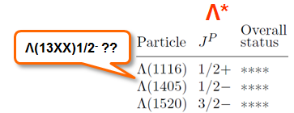
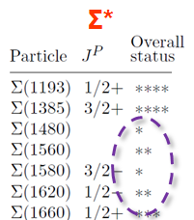
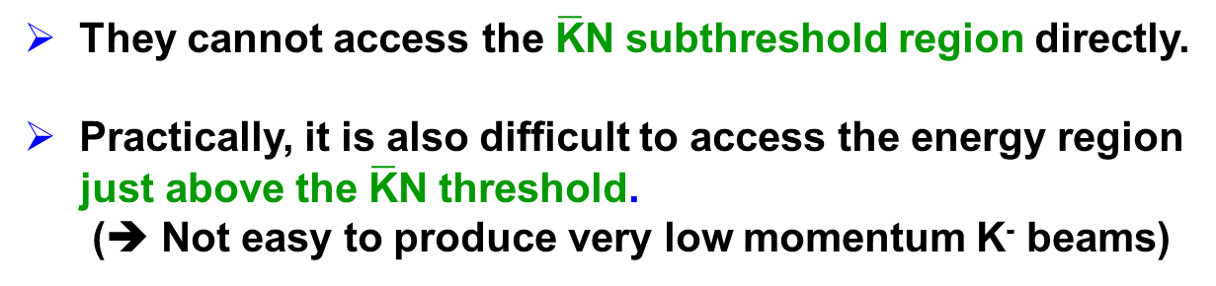

Need of deuteron-target reactions
K⁻ p reactions are the “BEST” for studying
Y* resonances, but…
They cannot access the $\overline{\text{K}}$N subthreshold region directly.
Practically, it is also difficult to access the energy region
just above the $\overline{\text{K}}$N threshold.
(➔ Not easy to produce very low momentum K⁻ beams)
Extends our model to calculate
K⁻ d reaction cross sections.
Enable a comprehensive analysis of
BOTH K⁻ p and K⁻ d reactions !!!
In K⁻ p reactions, Y* can appear as
direct s-channel processes (easy to analyze) !!
K⁻
$\overline{\text{K}}$, π, π, …
New 1/2⁻ Λ* with
Re(M_{R})~1520 MeV
・
・
・
Λ*, Σ*
・
・
・
p
N, Σ, Λ, …
It is not easy to study
low-lying Y* resonances
only using K⁻ p reaction data !!
(J-PARC E31)

Slide 13

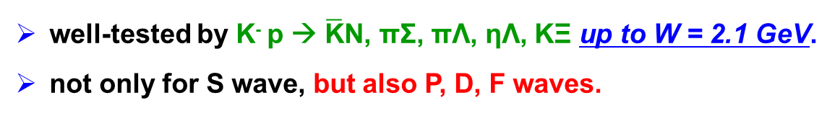



Model for deuteron-target reactions
Multistep processes are treated in a sequential manner.
Off-shell amplitudes for meson-baryon sub-processes ( ) are
taken from our dynamical coupled-channels model.
HK, Nakamura, Lee, Sato, PRC90(2014)065203
“Impulse” term
“$\overline{\text{K}}$-exchange” term
“YN rescattering” term
$$\overline{\text{K}}$$
π
$$\overline{\text{K}}$$
$$\overline{\text{K}}$$
π
Y
N
N
d
+
d
$$\overline{\text{K}}$$
π
+
d
+ ...
N
Y
Y
Use, e.g.,
deuteron w.f. from
ANL-V18 potential
[PRC51(1995)38]
Use YN potential, e.g., in
PRC40(1989)2226;
PRC59(1999)21;
PRC59(1999)3009
Completely dominates the reaction processes at the kinematics with θ_{N} ~ 0.
(➔ J-PARC E31)
Unique feature of our work:
For elementary meson-baryon subprocesses,
we employ amplitudes that are
well-tested by K⁻ p → $\overline{\text{K}}$N, πΣ, πΛ, ηΛ, KΞ up to W = 2.1 GeV.
not only for S wave, but also P, D, F waves.

Slide 14
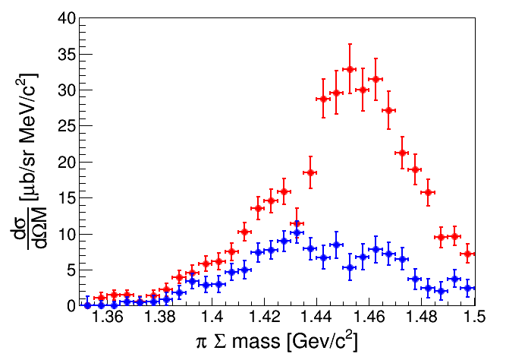


Results for K⁻ d → (πΣ)₀n
p_{K}⁻ = 1 GeV, θ_{n} = 0 deg.
HK, Lee, arXiv:1608.03470
Kawasaki-san’s talk@MENU2016
$${\text{Σ}}^{+}{\text{π}}^{−}$$
$${\text{Σ}}^{−}{\text{π}}^{+}$$
PRELIMINARY
Very preliminary
“$\overline{\text{K}}$-exchange” term
Model A (Full)
Need S, P, D, F,... waves !!
K⁻
Model B (Full)
n
d
$\overline{\text{K}}$^{ex}
π
Σ

Slide 15

Results for K⁻ d → (πΣ)₀n
p_{K}⁻ = 1 GeV, θ_{n} = 0 deg.
HK, Lee, arXiv:1608.03470
Our model (Full)
Our model
(S-wave only)
ChUM
E-dep model
(Ohnishi et al
PRC93)
“$\overline{\text{K}}$-exchange” term
Model A (Full)
Allowed W value
for K⁻ N → $\overline{\text{K}}$^{ex} n
K⁻
Need S, P, D, F,... waves !!
mom. of nucleons inside the deuteron
Model B (Full)
n
Model A (only S-wave for $\overline{\text{K}}$N → $\overline{\text{K}}$^{ex} N)
d
$\overline{\text{K}}$^{ex}
π
Model B (only S-wave for $\overline{\text{K}}$N → $\overline{\text{K}}$^{ex} N)
Σ
Dominated by S wave !!

Slide 16
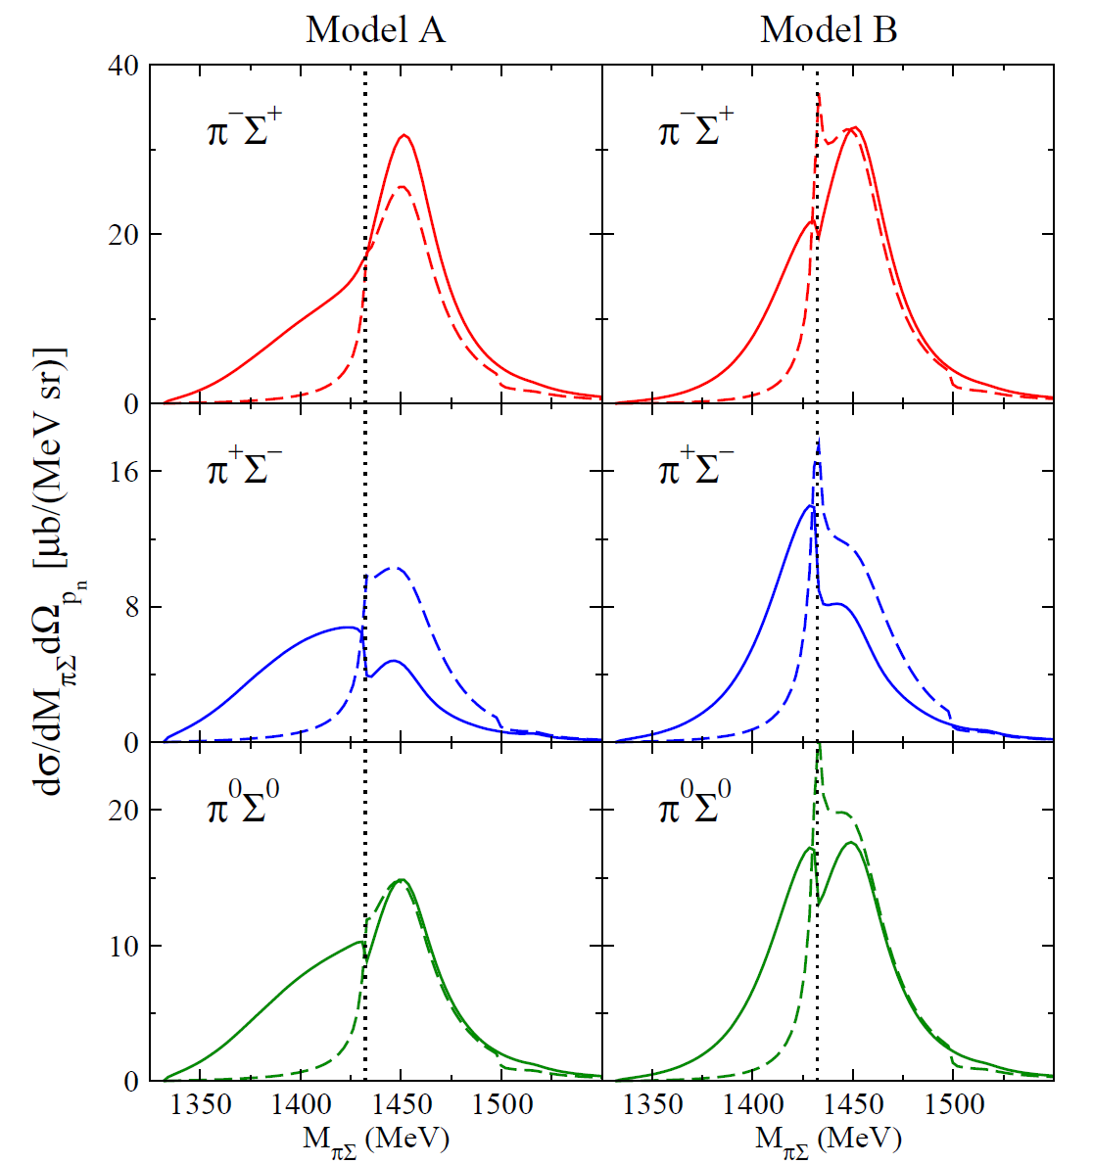

Results for K⁻ d → (πΣ)₀n
p_{K}⁻ = 1 GeV, θ_{n} = 0 deg.
HK, Lee, arXiv:1608.03470
Full
S01 resonance
contribution off
Model A (Full)
Pole positions of
S-wave (J^{P}=1/2⁻)
Λ resonances
below $\overline{\text{K}}$N threshold
[HK et al,
PRC92(2015)025205]
Corresponds
to Λ(1405)1/2⁻
Model B (Full)

Slide 17
Discussion on new data necessary
for further establishing Y* resonance mass spectrum
(2 of 2)

Slide 18







Strategy for establishing Y* resonances
using antikaon-induced reactions
πΛ
πΣ
$\overline{\text{K}}$N
ηΛ
new spin partner
of Λ(1520) ??
poorly established
(one- & two-star)
Σ* resonances
Λ(1405)
new narrow
3/2⁺ Λ* ??
high-mass
Y* resonances
s^{1/2}
$\overline{\text{K}}$d → πYN
$$\overline{\text{K}}$$
“Complete experiments” for K⁻p → $\overline{\text{K}}$N, πY, ηY, KΞ, ωY, η’Y, …
N
d
$$\overline{\text{K}}$$
π
$\overline{\text{K}}$N
πΣ
πΛ
ππΛ
π$\overline{\text{K}}$N
…
Y
$$\overline{\text{K}}$$
Λ*, Σ*
・
・
(e.g, J-PARC E31)
N
・
2 → 3 reactions: K⁻p → ππΛ, π$\overline{\text{K}}$N,…
New measurements at J-PARC !!

Slide 19
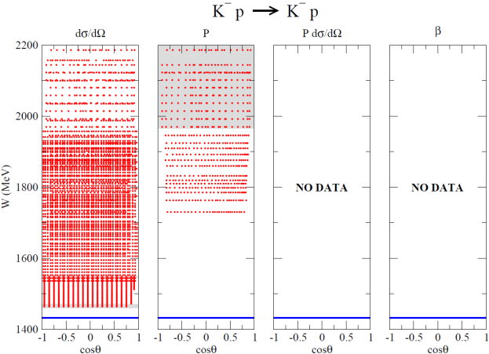
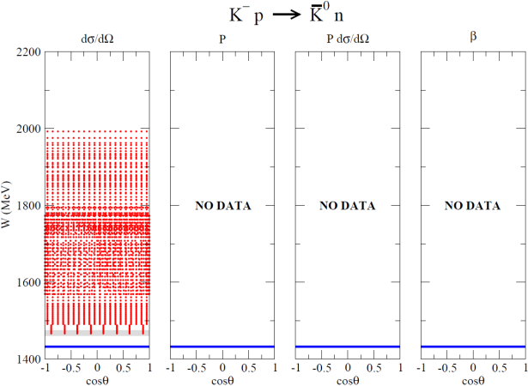
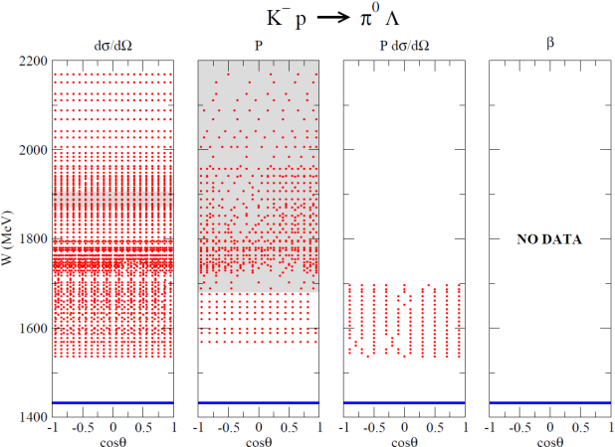
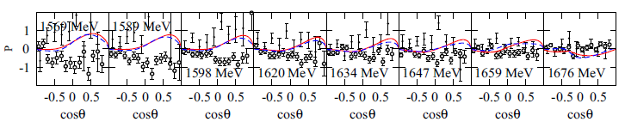
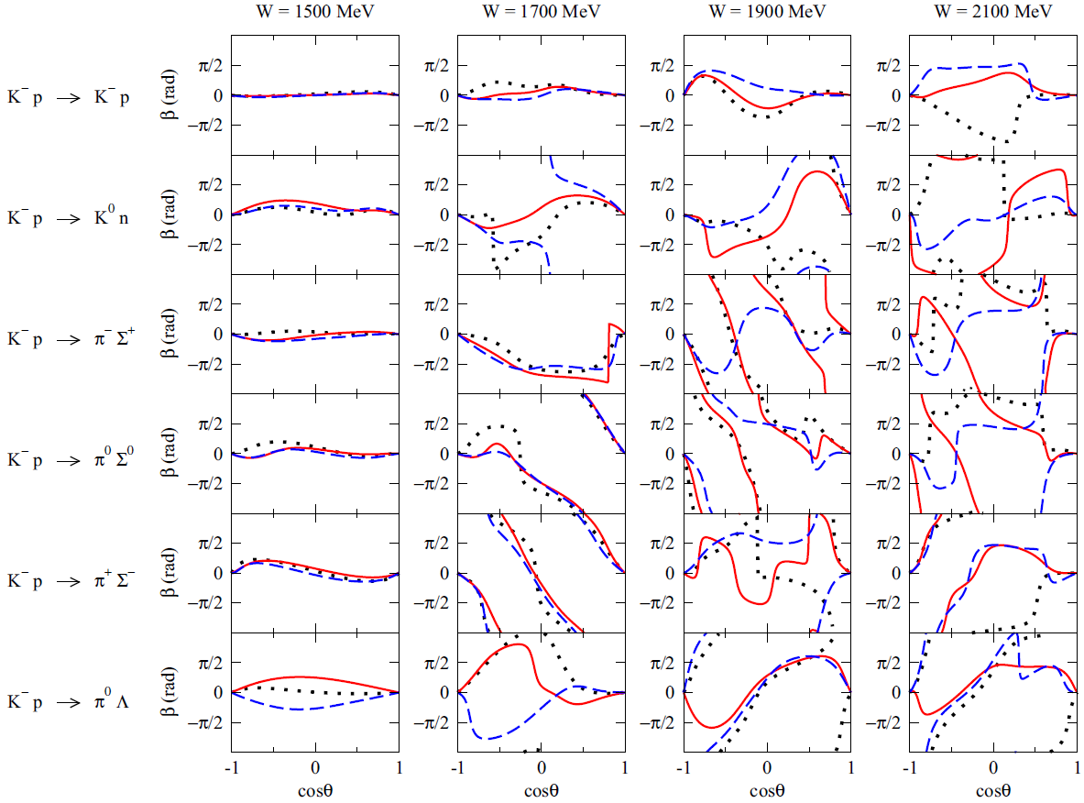
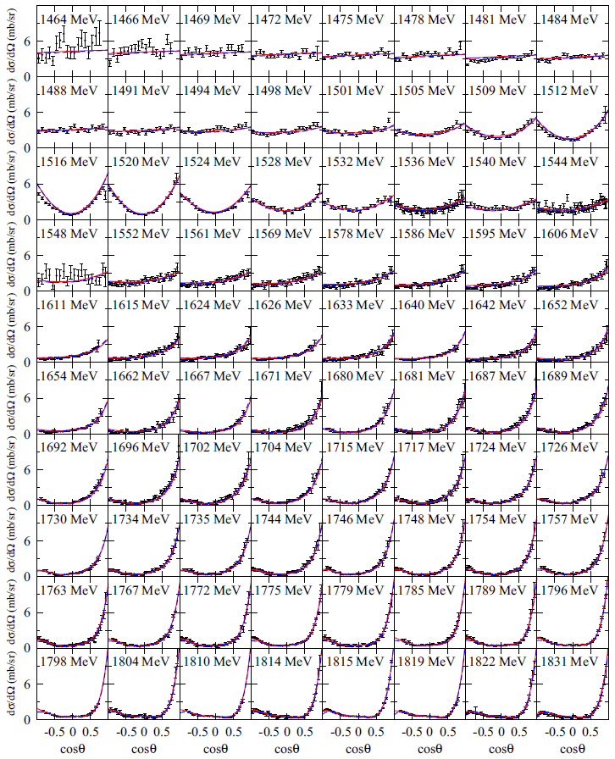
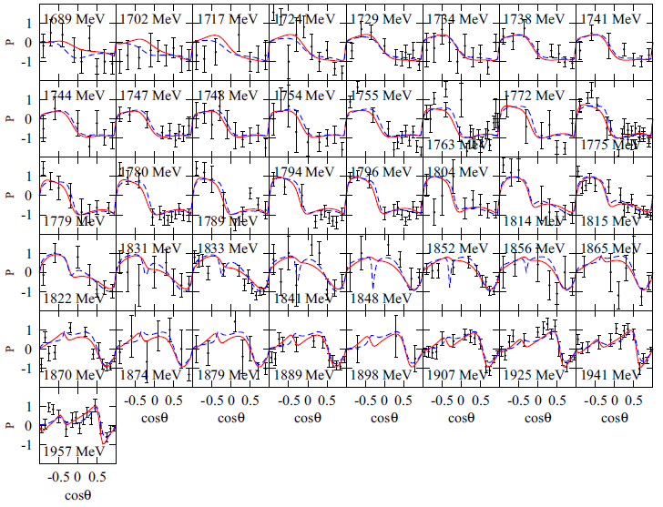
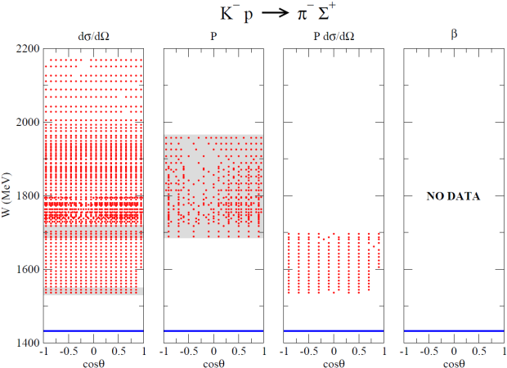
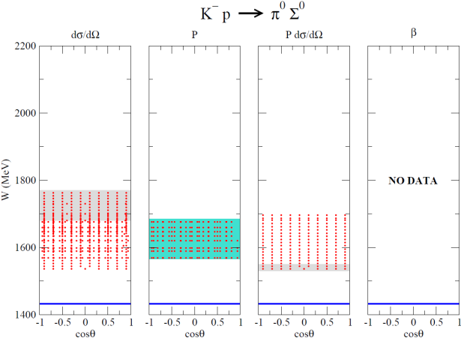
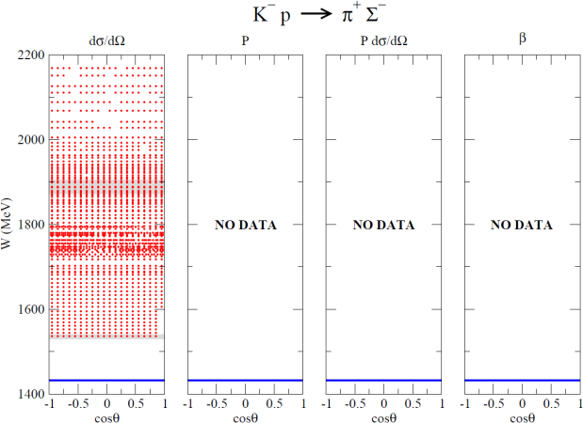
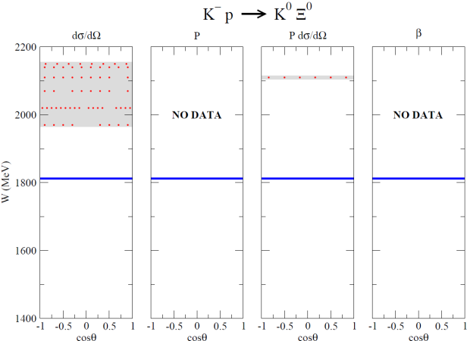
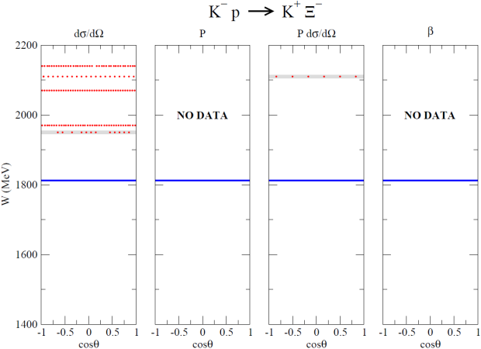
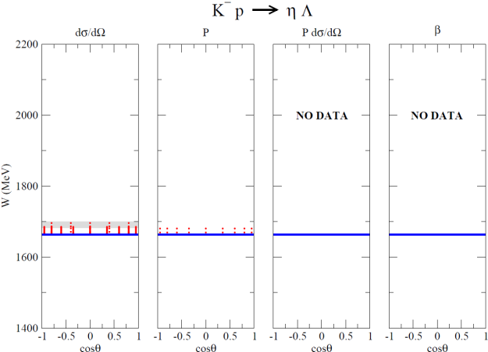

Kinematical (W, cosθ) coverage of
available K⁻ p → $\overline{\text{K}}$N, πΣ, πΛ, ηΛ, KΞ data
K⁻ p → π⁰ Σ⁰ P (1569 < W < 1676 MeV)
Predicted spin-rotation angle β
K⁻ p → K⁻ p dσ/dΩ (1464 < W < 2100 MeV)
K⁻ p → π⁻ Σ⁺ P (1689 < W < 1957 MeV)
Red: Model A
Blue: Model B
Black: KSU
Red: Model A Blue: Model B
Two sets of P are conflicting with each other !!
Prakhov et al., PRC80(2009)025204
Manweiler et al., PRC77(2008)015205
The KSU results are
computed by us using
their amplitudes in
PRC88(2013)035204.
## NOTE:
β is modulo 2π
Red: Model A Blue: Model B
Red: Model A Blue: Model B
data available
low statistics data
dσ/dΩ
P
Pdσ/dΩ
β
conflicting data

Slide 20
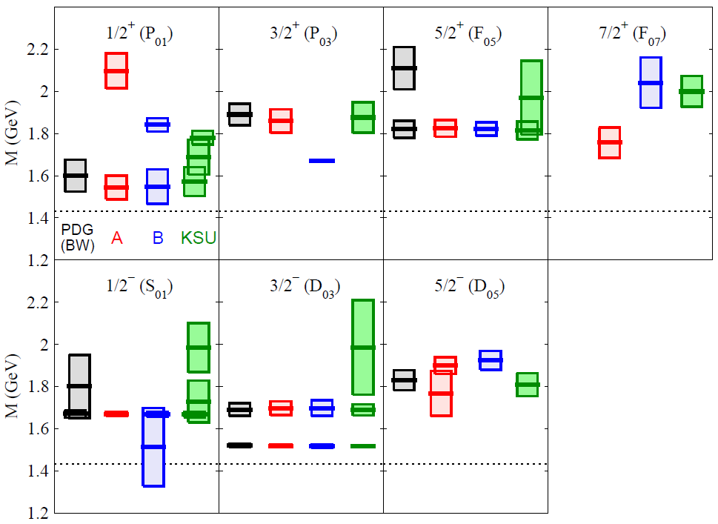
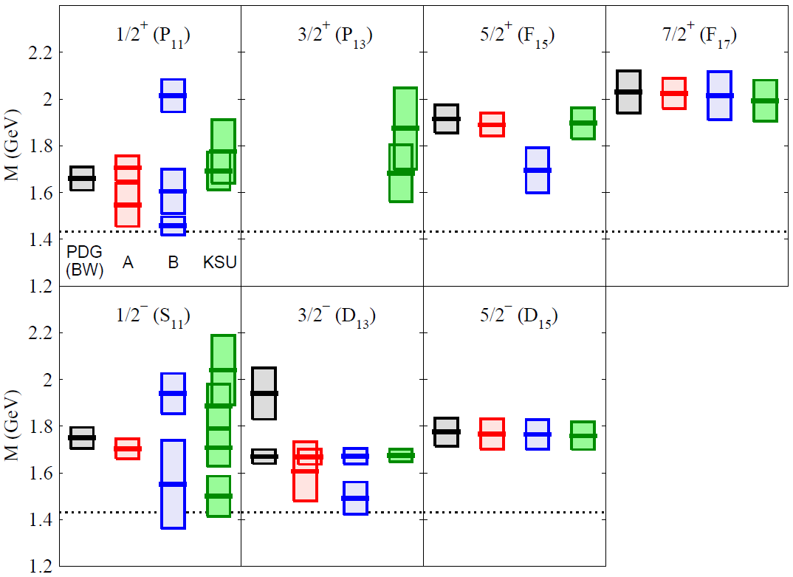

“Analysis dependence” of extracted Λ* and Σ* mass spectrum
HK, Nakamura, Lee, Sato, PRC92(2015)025205
Spectrum for Y* resonances found above the $\overline{\text{K}}$N threshold
-2Im(M_{R})
(“width”)
Re(M_{R})
M_{R} : Resonance
pole mass
(complex)
J^{P}(L_{I 2J})
“Λ” resonance (I=0)
J^{P}(L_{I 2J})
“Σ” resonance (I=1)
$\overline{\text{K}}$N threshold
Red: Model A, Blue: Model B,
Green: KSU, Black: PDG(Breit-Wigner)

Slide 21

“Analysis dependence” of amplitudes and
Y* spectrum in S11, P11, P13 partial waves
Extracted $\overline{\text{K}}$N → πΛ amplitudes
HK, Nakamura, Lee, Sato,
PRC90(2014)065204;92(2015)025205
Real parts
L_{I 2J} : L = S,P,.. ; I = isospin;
J = Total angular mom.
Red : Model A
Blue: Model B
Circles: KSU single-energy solution
[PRC88(2013)035204]
Imaginary parts
Re
Im

Slide 22
New data can eliminate analysis dependence ??
K⁻p→ π⁰Λ observables @ W = 1700 MeV
## β is modulo 2π
At this energy, the difference between Models A and B
mostly comes from S11, P11, P13 waves.
Red: Model A
Blue: Model B
Solid: Full
Dashed: No S11, P11, P13
High statistics data (of P and β in particular) will
reduce significantly the analysis dependence !!!

Slide 23
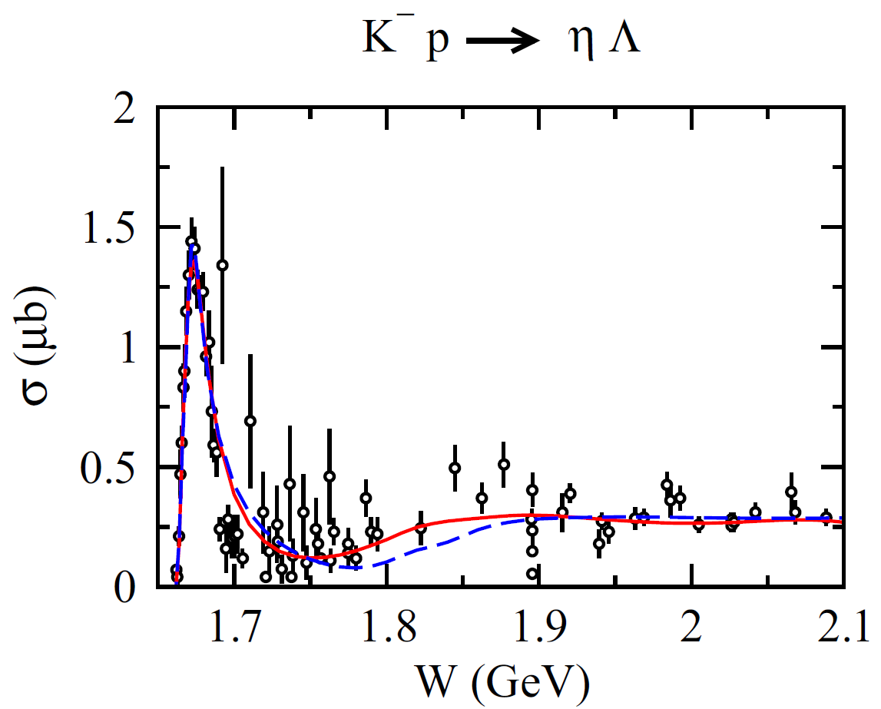
Λ* resonances near the ηΛ threshold
π⁻ p → η n
N(1535)1/2⁻
(Note: peak energy does not
correspond to the pole position)
σ(mb)
Λ(1670)1/2⁻ (4-star in PDG)
pole mass:
Model A: 1669–i9 MeV
Model B: 1667–i12 MeV
KSU : 1667–i13 MeV
In addition, a new narrow
Λ resonance with J^{P} = 3/2⁺
(P03) is found in Model B !!
Model A : Not found
Model B : 1671–i 5 MeV
KSU : Not found

Slide 24
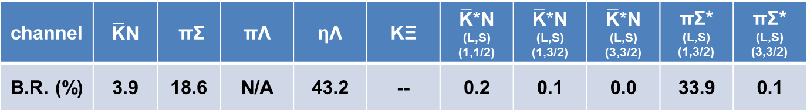
New narrow J^{P}=3/2⁺ Λ resonance
near the ηΛ threshold
Pole mass (M_{R}): 1671 – i 5 MeV (← ηΛ threshold: 1663 MeV)
Spin-parity (J^{P}): 3/2⁺
Branching ratio:
channel | $\overline{\text{K}}$N | πΣ | πΛ | ηΛ | KΞ | $\overline{\text{K}}$*N (L,S) (1,1/2) | $\overline{\text{K}}$*N (L,S) (1,3/2) | $\overline{\text{K}}$*N (L,S) (3,3/2) | πΣ* (L,S) (1,3/2) | πΣ* (L,S) (3,3/2)
B.R. (%) | 3.9 | 18.6 | N/A | 43.2 | -- | 0.2 | 0.1 | 0.0 | 33.9 | 0.1
K⁻ p → K⁻ p
K⁻ p → η Λ
Λ(1670)1/2⁻
New J^{P} = 3/2⁺ Λ*
(only in blue curve)
New J^{P} = 3/2⁺ Λ*
(only in blue curve)
Λ(1670)1/2⁻
& ηΛ cusp
Red: Model A
Blue: Model B

Slide 25
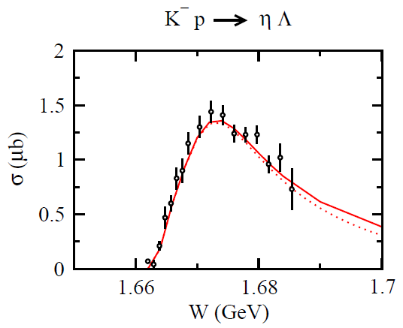
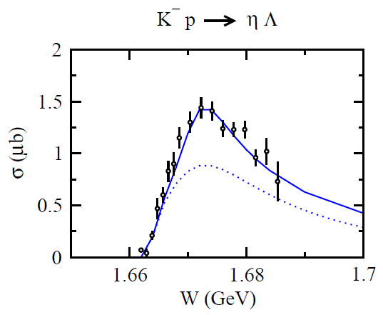
Λ* resonances near the ηΛ threshold
full
full
Model A
Model B
S01
only
S01
only
Comes from P03 resonance
Total cross section does not help to judge
whether the new narrow P03 (J^{P} = 3/2⁺ Λ)
resonance really exists or not.

Slide 26
Λ* resonances near the ηΛ threshold
Model A
(S01 wave ~99%)
Model B
(S01 wave ~60%, P03 wave ~40%)
K⁻ p → ηΛ reaction near threshold
dσ/dΩ
P03 off
Concave-up behavior
not reproduced.
Narrow P03(J^{P} =3/2⁺ Λ)
resonance responsible
for the angular dependence!!
Black data : Crystal Ball (BNL), PRC64(2001)055205
Green data: NPB21(1970)21
Red: Model A
Blue: Model B
To get definitive conclusion for this resonance, one would also need
high-statistics data of polarization observables!!
(As a first step, even just recoil polarization P is much appreciated!!)
➔ in this case, the polarized target is not needed.
Data show clear (non-flat) angular dependence
(➔ indicates high partial-wave contributions already at threshold)
Model B reproduces angular dependence of new BNL data.
(→ Model A shows a linear behavior that is not fitted well the data)

Slide 27
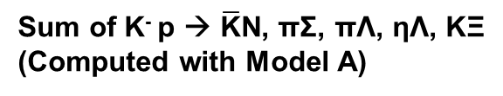
Importance of 2 → 3 reactions:
Dominance of cross sections at high W
TCS for K⁻ p → X
Sum of K⁻ p → $\overline{\text{K}}$N, πΣ, πΛ, ηΛ, KΞ
(Computed with Model A)
Almost come from 2 → 3 reactions !!
TCS for 2 → 3 reactions
(K⁻ p → ππΛ, π$\overline{\text{K}}$N,…):
significant above W ~ 1.7 GeV.
even larger than the 2 → 2 TCS
above W ~ 1.9 GeV !!
Effects of 3-body channels on Y* resonance
parameters are expected to be sizable.
However, at present almost no data is available
for 2 → 3 reactions that can be used for detailed
partial wave analyses !!

Slide 28
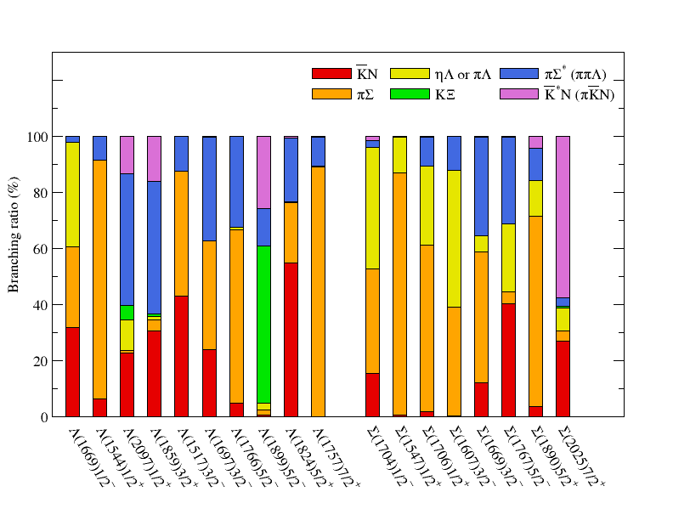
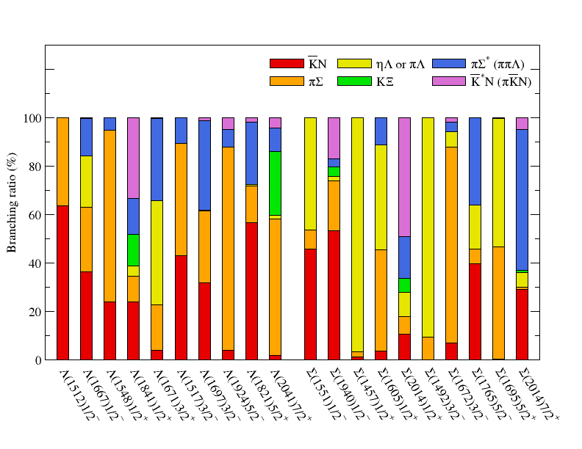
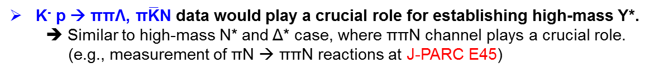
Importance of 2 → 3 reactions:
Branching ratio high-mass Y* resonances
High-mass Y* have large branching ratio to πΣ* (ππΛ) & $\overline{\text{K}}$*N (π$\overline{\text{K}}$N)
K⁻ p → ππΛ, π$\overline{\text{K}}$N data would play a crucial role for establishing high-mass Y*.
➔ Similar to high-mass N* and Δ* case, where ππN channel plays a crucial role.
(e.g., measurement of πN → ππN reactions at J-PARC E45)
Model A
Model B
HK, Nakamura, Lee, Sato, PRC92(2015)025205

Slide 29
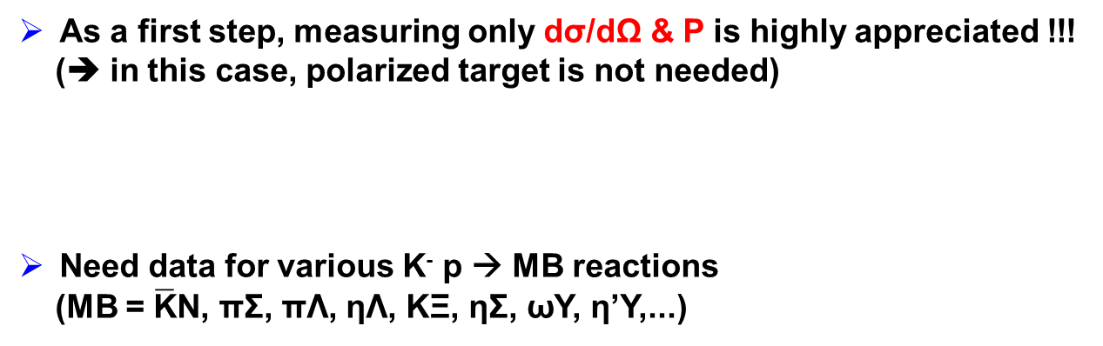
Summary for necessary data
For the 2 → 2 reaction, “complete” measurement is
highly desirable.
For the 2 → 3 reaction, the measurement of the
unpolarized cross sections will be the first step.
As a first step, measuring only dσ/dΩ & P is highly appreciated !!!
(➔ in this case, polarized target is not needed)
Need data for various K⁻ p → MB reactions
(MB = $\overline{\text{K}}$N, πΣ, πΛ, ηΛ, KΞ, ηΣ, ωY, η’Y,...)
Note: Actually, there are almost no data for β even for πN reactions.
Most of N* & Δ* properties were determined with dσ/dΩ & P of πN scattering.

Slide 30


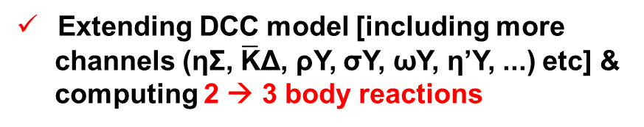

Future plans
Extending DCC model [including more
channels (ηΣ, $\overline{\text{K}}$Δ, ρY, σY, ωY, η’Y, ...) etc] &
computing 2 → 3 body reactions
$$\overline{\text{K}}$$
Λ*, Σ*
ππΛ
π$\overline{\text{K}}$N
…
N
forward K*
(fast)
high-mom. π
Study of low-lying Y* using diffractive
p(π, K*)X processes with high-mom π beam.
virtual
$\overline{\text{K}}$, $\overline{\text{K}}$*
p
Y* (slow)
S=-2 BB amps derived
with potentials from
Chiral EFT
Lattice QCD ...
Study of YY interaction (H dibaryon)
via K⁻ d → K⁰ΛΛ, K⁰ΞN
K－
K⁰
Λ, Ξ
We have (good) amplitudes
for $\overline{\text{K}}$N → KΞ !!
d
Ξ
+ ...
Λ, N
N

Slide 31
Back up

Slide 32
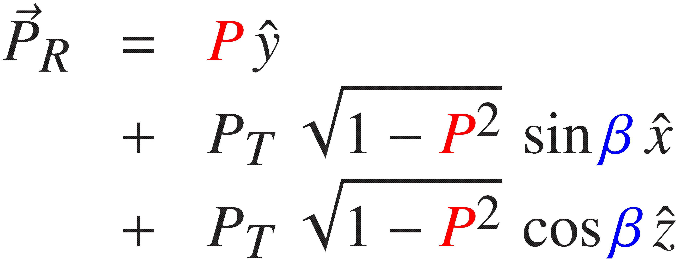

“Complete” data for establishing Y* spectrum
Wolfenstein, Phys. Rev. 96(1954)1654
Kelly, Sandusky, Cutkosky, PRD10(1974)2309
Saxon, Whittaker, Z. Phys. C9(1981)35
Supek et al., PRD47(1993)1762
“Complete” experiment for K⁻ p → 0⁻ + 1/2⁺
Complete set of observables: dσ/dΩ, P, β (or R & A)
y
y
Initial
x
Final
x
spin
average
0⁻
z
z
spin
sum
K⁻
p
1/2⁺
Suppose target polarization points z-axis
(➔ parallel to pion momentum):
Polarization of the recoil 1/2⁺ baryon is then expressed as
Note: Various conventions are taken for β, R, A in literatures.

Slide 33
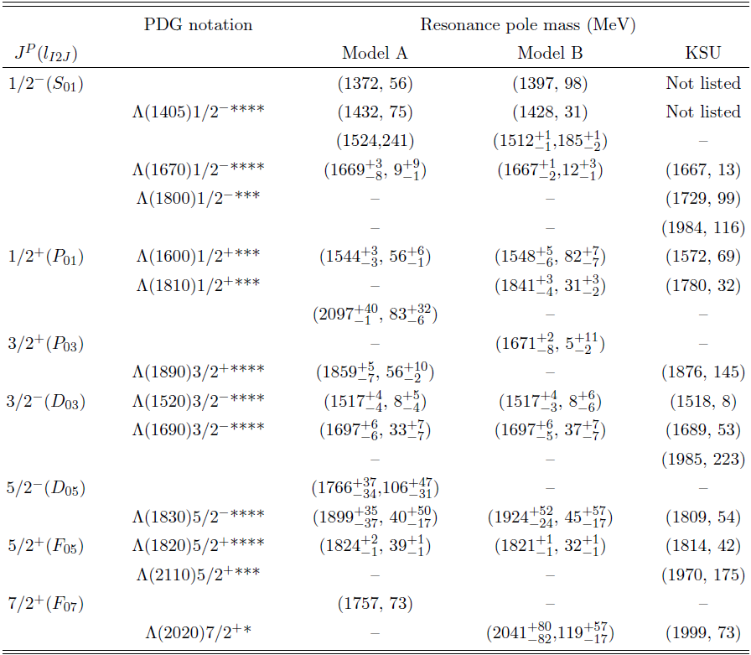
Table of Λ* resonance poles

Slide 34
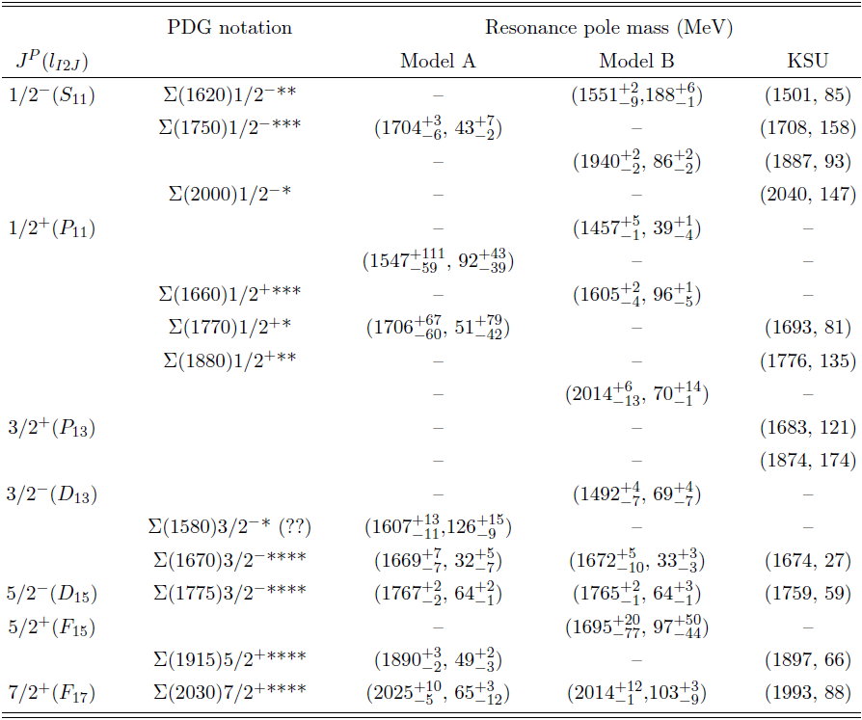
Table of Σ* resonance poles

Slide 35
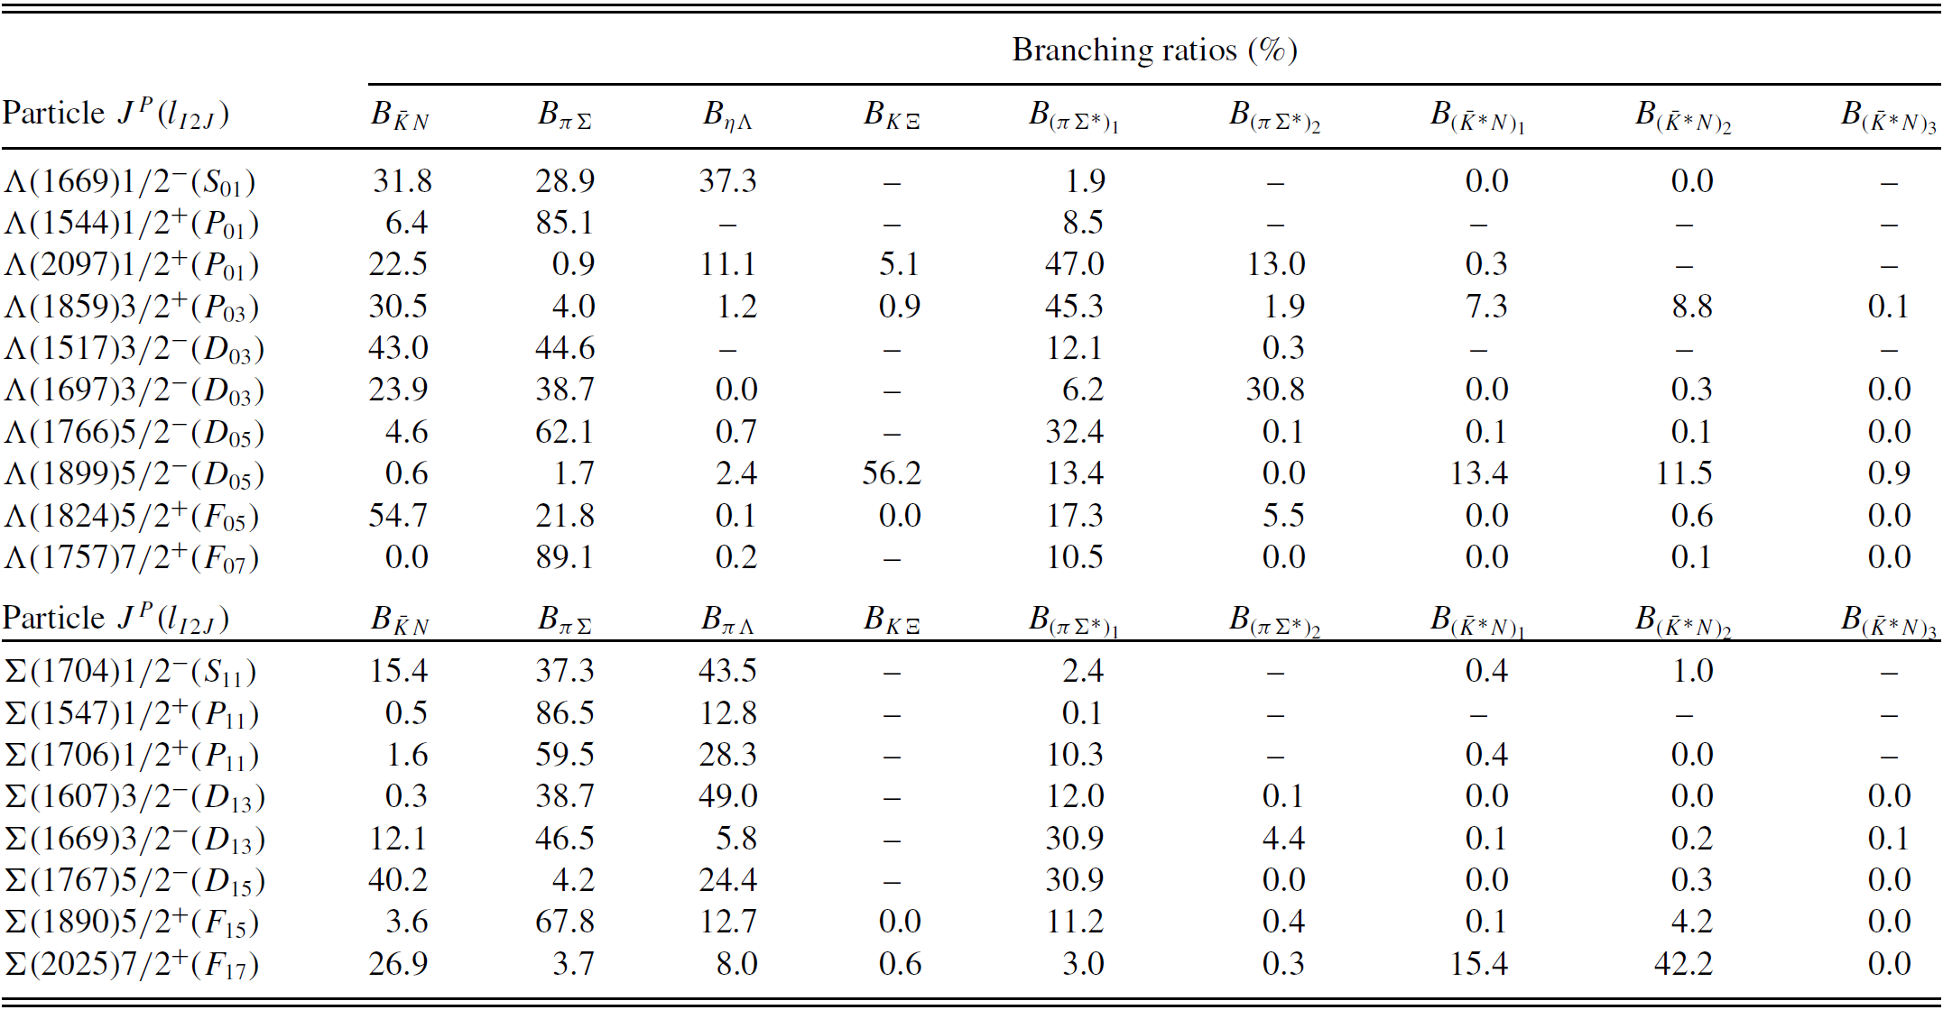
Branching ratios (Model A)

Slide 36
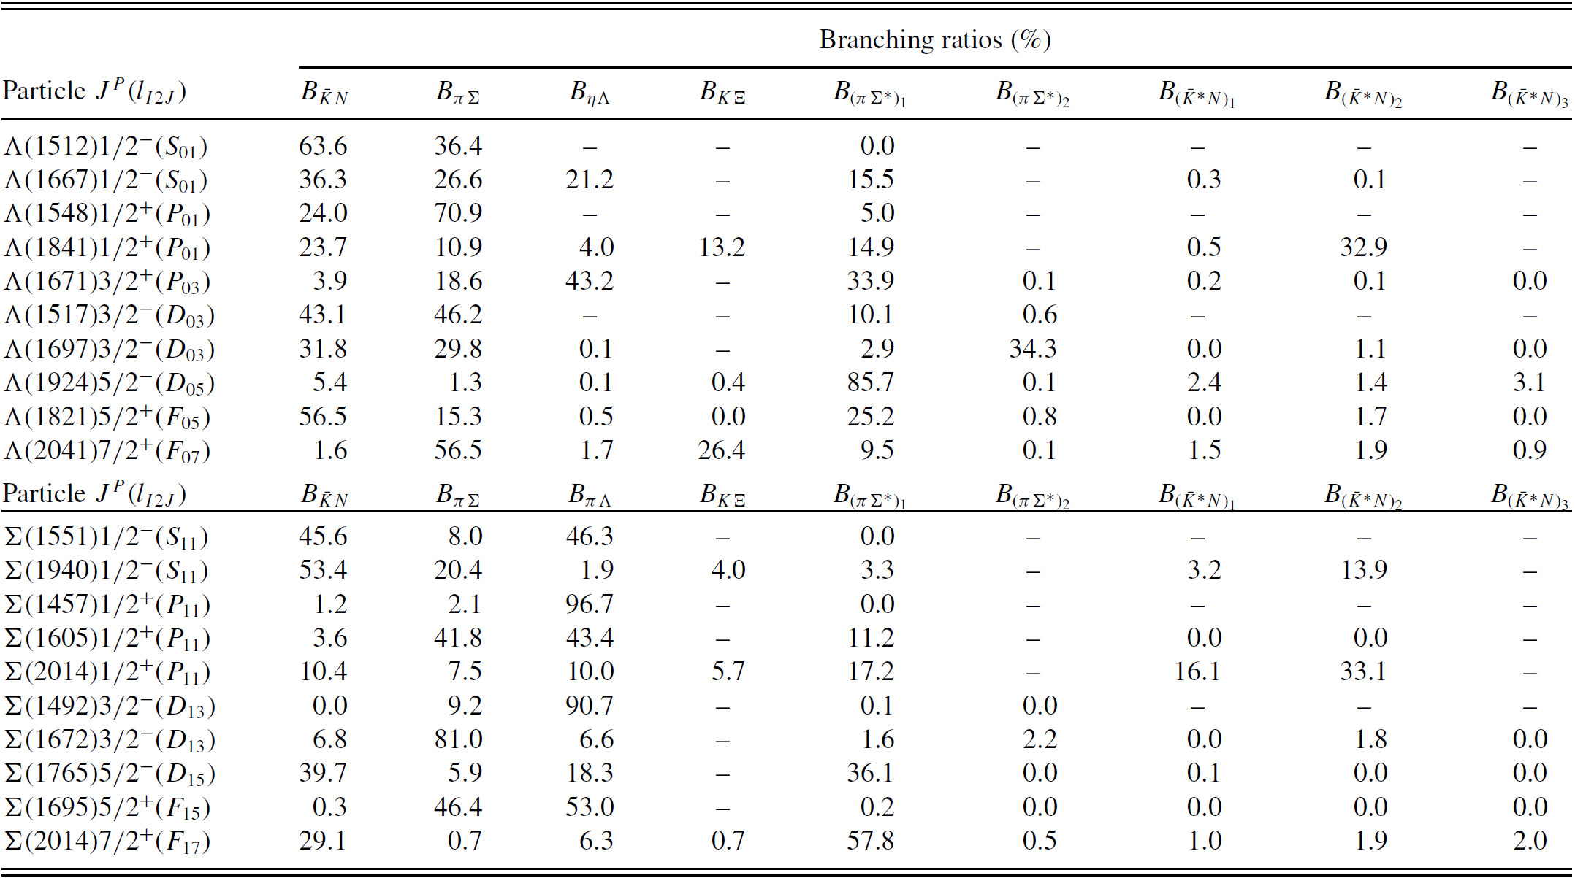
Branching ratios (Model B)

Slide 37
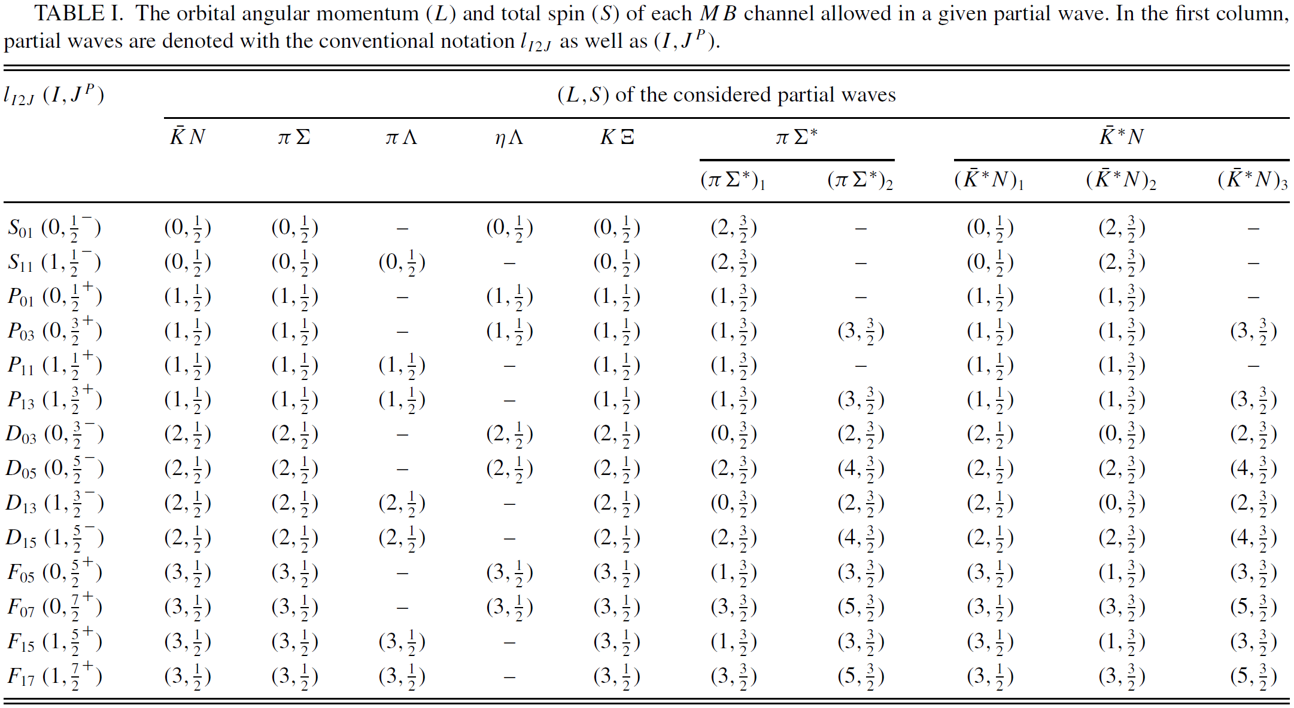
Notation for partial waves

Slide 38

Extracted scattering lengths and effective ranges
HK, Nakamura, Lee, Sato, PRC90(2014)065204
Scattering length and effective range
a_{K-p} = -0.65 + i0.74 fm (Model A)
a_{K-p} = -0.65 + i0.76 fm (Model B)

Slide 39
S-wave dominance ??
K⁻ p → MB total cross sections near threshold
Model B
Solid: Full
Dashed: S wave only
For K- p → πΛ, ηΛ, KΞ,
higher partial waves
visibly contribute
to the cross sections
even in the threshold
region.
→ consistent with the observation in
Jackson et al., PRC91(2015)065208
Naïve expectation for
S-wave dominance
near the threshold
sometimes does not hold !!
HK, Nakamura, Lee, Sato, PRC90(2014)065204

Slide 40
Results of the fits
K⁻ p → K⁻ p scattering
HK, Nakamura, Lee, Sato, PRC90(2014)065204
dσ/dΩ (1464 < W < 1831 MeV)
dσ/dΩ (1832 < W < 2100 MeV)
P
Red: Model A Blue: Model B

Slide 41


Results of the fits
K⁻ p → K⁰ n reaction
HK, Nakamura, Lee, Sato, PRC90(2014)065204
dσ/dΩ (1466 < W < 1796 MeV)
dσ/dΩ (1804 < W < 1992 MeV)
Red: Model A Blue: Model B

Slide 42


Results of the fits
K⁻ p → π⁻ Σ⁺ reaction
HK, Nakamura, Lee, Sato, PRC90(2014)065204
dσ/dΩ
P x dσ/dΩ
P
Red: Model A Blue: Model B

Slide 43


Results of the fits
K⁻ p → π⁰ Σ⁰ reaction
HK, Nakamura, Lee, Sato, PRC90(2014)065204
dσ/dΩ
P x dσ/dΩ
P
Red: Model A Blue: Model B

Slide 44

Results of the fits
K⁻ p → π⁺ Σ⁻ reaction
HK, Nakamura, Lee, Sato, PRC90(2014)065204
dσ/dΩ
Red: Model A Blue: Model B

Slide 45


Results of the fits
K⁻ p → π⁰ Λ reaction
HK, Nakamura, Lee, Sato, PRC90(2014)065204
dσ/dΩ (1536 < W < 1870 MeV)
dσ/dΩ (1875 < W < 2088 MeV)
Red: Model A Blue: Model B

Slide 46


Results of the fits
HK, Nakamura, Lee, Sato, PRC90(2014)065204
K⁻ p → π⁰ Λ reaction (cont’d)
P x dσ/dΩ
P
Red: Model A Blue: Model B

Slide 47




Results of the fits
HK, Nakamura, Lee, Sato, PRC90(2014)065204
K⁻ p → ηΛ reaction
dσ/dΩ
P
K⁻ p → K⁰Ξ⁰ reaction
K⁻ p → K⁺Ξ⁻ reaction
dσ/dΩ
dσ/dΩ
Red: Model A Blue: Model B

Slide 48
Predicted spin-rotation angle β
HK, Nakamura, Lee, Sato, PRC90(2014)065204
## Currently no data for spin-rotation angle β
Analysis dependence is clearly seen !!
Measurement of β will give strong constraints on Y* spectrum !!
Red: Model A
Blue: Model B
Black: KSU
The KSU results are
computed by us using
their amplitudes in
PRC88(2013)035204.
## NOTE:
β is modulo 2π

Slide 49



Comparison of extracted partial-wave amplitudes
Extracted $\overline{\text{K}}$N scattering amplitudes
HK, Nakamura, Lee, Sato, PRC90(2014)065204
L_{I 2J} : L = S, P, ... ; I = isospin; J = Total angular mom.
Red : Model A
Blue: Model B
Circles: KSU single-energy solution
[PRC88(2013)035204]

Slide 50



Comparison of extracted partial-wave amplitudes
Extracted $\overline{\text{K}}$N → πΣ amplitudes
HK, Nakamura, Lee, Sato, PRC90(2014)065204
L_{I 2J} : L = S,P,.. ; I = isospin; J = Total angular mom.
Red : Model A
Blue: Model B
Circles: KSU single-energy solution
[PRC88(2013)035204]

Slide 51


Comparison of extracted partial-wave amplitudes
Extracted $\overline{\text{K}}$N → πΛ amplitudes
Extracted $\overline{\text{K}}$N → ηΛ amplitudes
L_{I 2J} : L = S,P,.. ; I = isospin;
J = Total angular mom.
Red : Model A
Blue: Model B
Circles: KSU single-energy solution
[PRC88(2013)035204]
HK, Nakamura, Lee, Sato,
PRC90(2014)065204

Slide 52


Comparison of extracted partial-wave amplitudes
Extracted $\overline{\text{K}}$N → KΞ amplitudes
HK, Nakamura, Lee, Sato, PRC90(2014)065204
L_{I 2J} : L = S,P,.. ; I = isospin; J = Total angular mom.
Red : Model A
Blue: Model B

