Slide 1
Dynamical Coupled-Channels Approach to Meson Production Reactions and
N* Spectroscopy
Hiroyuki Kamano
(RCNP, Osaka U.)
Seminar@JAEA, April 11, 2012

Slide 2
Outline
1. Background and motivation for N* spectroscopy
2. Results of nucleon resonance extraction from
Collaboration@EBAC
3. Multichannel reaction dynamics in hadron
spectroscopy

Slide 3
Background and motivation for
N* spectroscopy
(1 of 3)

Slide 4
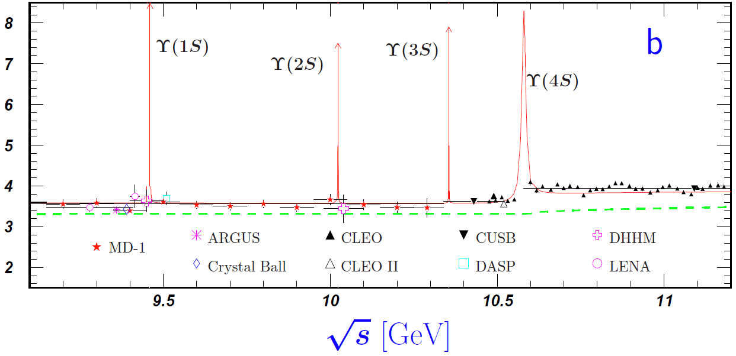
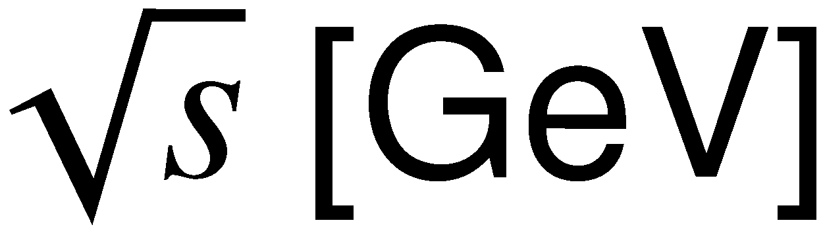
N* spectroscopy :
Physics of broad & overlapping resonances
N* : 1440, 1520, 1535, 1650, 1675, 1680, ...
Δ : 1600, 1620, 1700, 1750, 1900, …
Δ (1232)
Width: a few hundred MeV.
Resonances are highly overlapped
in energy except Δ(1232).
Width: ~10 keV to ~10 MeV
Each resonance peak is clearly separated.

Slide 5
Experimental developments
Since the late 90s, huge amount of high precision data of meson
photo-production reactions on the nucleon target has been reported
from electron/photon beam facilities.
JLab, MAMI, ELSA, GRAAL, LEPS/SPring-8, …
Opens a great opportunity to make quantitative study of
the N* states !!
E. Pasyuk’s talk at Hall-B/EBAC meeting

Slide 6
N* states and PDG *s
Arndt, Briscoe, Strakovsky, Workman PRC 74 045205 (2006)
?
π
π
Most of the N*s were extracted from
L_{2I 2J}
?
?
L
L
N*
?
Need comprehensive analysis of
N
N
?
Isospin = I, Spin = J
Parity = (−)^{L+1}
channels !!

Slide 7
Hadron spectrum and reaction dynamics
Various static hadron models have been proposed to calculate
hadron spectrum and form factors.
In reality, excited hadrons are “unstable” and can exist
only as resonance states in hadron reactions.
Quark models, Bag models, Dyson-Schwinger approaches, Holographic QCD,…
Excited hadrons are treated as stable particles. → The resulting masses are real.
“molecule-like” states
“Mass” becomes complex !!
→ “pole mass”
u
u
d
core (bare state) + meson cloud
What is the role of reaction dynamics in interpreting
the hadron spectrum, structures, and dynamical origins ??
Constituent quark model
N*
meson cloud
bare state

Slide 8
Results of nucleon resonance extraction from Collaboration@EBAC
(2 of 3)

Slide 9

Collaboration at Excited Baryon Analysis Center (EBAC) of Jefferson Lab
Founded in January 2006
http://ebac-theory.jlab.org/
Reaction Data
Objectives and goals:
Through the comprehensive analysis
of world data of πN, γN, N(e,e’) reactions,
Determine N* spectrum (pole masses)
Extract N* form factors
(e.g., N-N* e.m. transition form factors)
Provide reaction mechanism information
necessary for interpreting N* spectrum,
structures and dynamical origins
Analysis Based on Reaction Theory
Spectrum, structure,…
of N* states
“Dynamical coupled-channels model of meson production reactions”
A. Matsuyama, T. Sato, T.-S.H. Lee Phys. Rep. 439 (2007) 193
Hadron Models
Lattice QCD
QCD

Slide 10






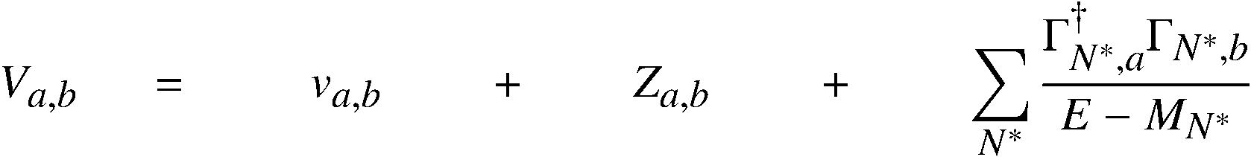
Dynamical coupled-channels (DCC) model for meson production reactions
For details see Matsuyama, Sato, Lee, Phys. Rep. 439,193 (2007)
Partial wave (LSJ) amplitudes of a → b reaction:
Reaction channels:
Transition Potentials:
t-channel
contact
s-channel
u-channel
π, ρ, σ, ω,..
Physical N*s will be a “mixture” of the two pictures:
N
N, Δ
π
coupled-channels effect
Δ
π
Exchange potentials
ρ, σ
baryon
meson cloud
π
N
N
Δ
Δ
Meson-Baryon Green functions
π
Can be related to hadron states of the static hadron models (quark models, DSE, etc.)
excluding meson-baryon continuum.
meson
core
Z-diagrams
Stable channels
Quasi 2-body channels
N*_{bare}
Bare N* states
N
π
Δ
Δ
ρ, σ
ρ, σ
π
π
π
π
N
N
Exchange potentials
Z-diagrams
bare N* states

Slide 11
Dynamical coupled-channels (DCC) analysis
Fully combined analysis of γN , πN → πN , ηN , KΛ, KΣ reactions !!
2006 - 2009
6 channels
(γN,πN,ηN,πΔ,ρN,σN)
< 2 GeV
< 1.6 GeV
< 2 GeV
―
―
―
2010 - 2012
8 channels
(γN,πN,ηN,πΔ,ρN,σN,KΛ,KΣ)
< 2.1 GeV
< 2 GeV
< 2 GeV
< 2 GeV
< 2.1 GeV
< 2.2 GeV
# of coupled
channels
    πp → πN
    γp → πN
    πp → ηN
    γp → ηp
    πp → KΛ, ΚΣ
    γp → K⁺Λ, KΣ
Kamano, Nakamura, Lee, Sato
(2012)

Slide 12
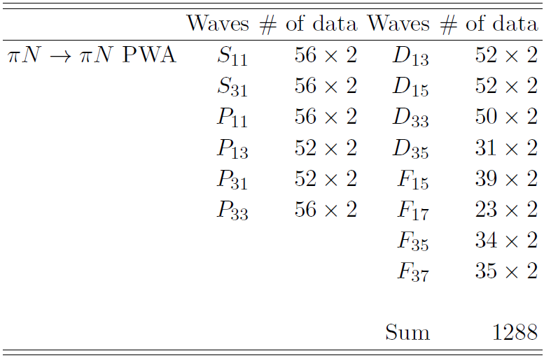
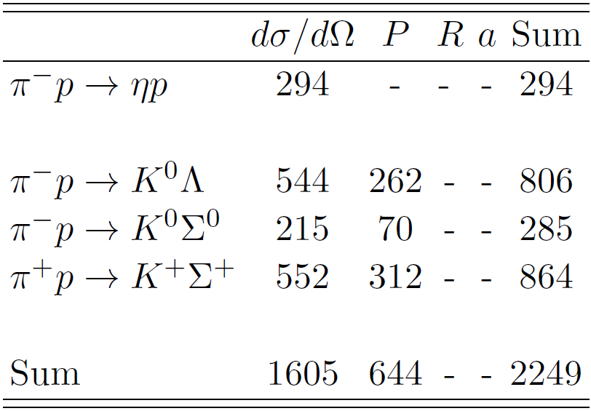
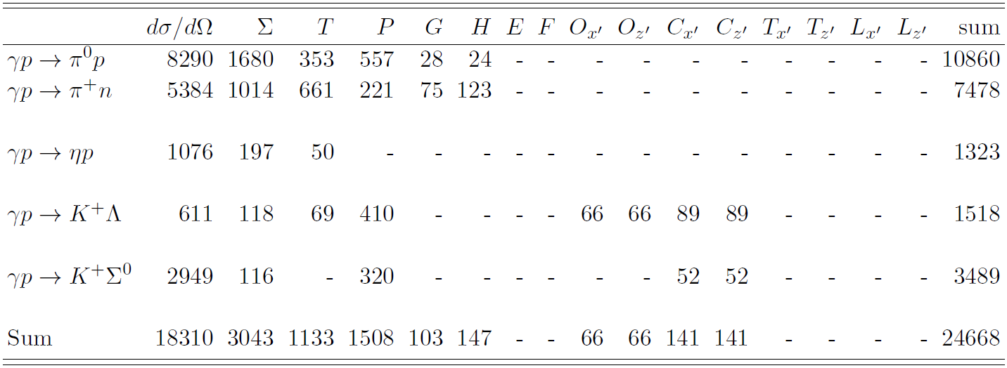
Analysis Database
Pion-induced
reactions
(purely strong
reactions)
SAID
Energy-Independent Solution
~ 28,000 data points to fit
Photo-
production
reactions

Slide 13
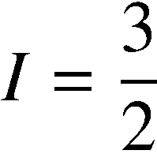
Partial wave amplitudes of pi N scattering
Real part
8ch DCC-analysis
(Kamano, Nakamura, Lee, Sato
2012)
6ch DCC-analysis
(fitted to πN → πN data only)
[PRC76 065201 (2007)]
Imaginary part

Slide 14



Single pion photoproduction
Angular distribution
Photon asymmetry
1334 MeV
1137 MeV
1232 MeV
1137 MeV
1232 MeV
1334 MeV
1462 MeV
1527 MeV
1617 MeV
1462 MeV
1527 MeV
1617 MeV
1729 MeV
1834 MeV
1958 MeV
1729 MeV
1834 MeV
1958 MeV
8ch DCC-analysis
Kamano, Nakamura, Lee, Sato 2012
6ch DCC-analysis [PRC77 045205 (2008)]
(fitted to γN → πN data up to 1.6 GeV)

Slide 15




Eta production reactions
Kamano, Nakamura, Lee, Sato, 2012
Photon asymmetry
1535 MeV
1549 MeV
1674 MeV
1657 MeV
1811 MeV
1787 MeV
1930 MeV
Analyzed data up to W = 2 GeV.
π⁻ p → η n data are selected
following Durand et al. PRC78 025204.
1896 MeV

Slide 16



pi N → KY reactions
Kamano, Nakamura, Lee, Sato, 2012
Angular distribution
Recoil polarization
1732 MeV
1757 MeV
1792 MeV
1732 MeV
1792 MeV
1757 MeV
1845 MeV
1879 MeV
1879 MeV
1845 MeV
1879 MeV
1879 MeV
1985 MeV
1966 MeV
1966 MeV
1985 MeV
1966 MeV
1966 MeV
2031 MeV
2059 MeV
2059 MeV
2031 MeV
2059 MeV
2059 MeV

Slide 17


gamma p → K+ Lambda, K+ Sigma0
Kamano, Nakamura, Lee, Sato, 2012
1781 MeV
2041 MeV
1785 MeV
1985 MeV
Polarization observables are calculated using the formulae in
Sandorfi, Hoblit, Kamano, Lee, J. Phys. G 38, 053001 (2011)

Slide 18

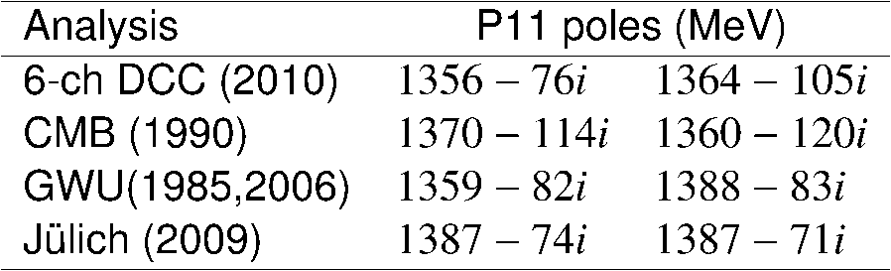
Spectrum of N* resonances
(8-channel DCC analysis)
Real parts of N* pole values
Two degenerate poles of the Roper:
1376-79i MeV & 1418-121i MeV
Ours
 | PDG | Ours
N* with 3*, 4* | 18 | 16
N* with 1*, 2* | 5
PDG 4*
PDG 3*
L_{2I 2J}
Kamano, Nakamura, Lee, Sato, 2012

Slide 19

Width of N* resonances
(8-channel DCC analysis)
Kamano, Nakamura, Lee, Sato, 2012
Note: Some freedom exists on the definition of partial width
from the residue of the amplitudes.

Slide 20

Need of comprehensive analysis for reliable N* extraction (1st D35 N*)
Kamano, Nakamura, Lee, Sato, 2012
Full results
D35 N* contributions off

Slide 21
Precise determination of YN and YY interactions via pion- and kaon-induced deuteron reactions
Collaboration with
T.-S. H. Lee (Argonne), S. Nakamura (JLab), Y. Oh (Kyungpook U.), T. Sato (Osaka U./KEK)
Elemental hyperon-production
amplitudes are provided from
our dynamical coupled-channels
approach.
π
K
Y
d
N
Precision and reliability of extracted YN interactions
strongly depend on reliability of the elemental πN → KY model !!

Slide 22
Precise determination of YN and YY interactions via pion- and kaon-induced deuteron reactions
Collaboration with
T.-S. H. Lee (Argonne), S. Nakamura (JLab), Y. Oh (Kyungpook U.), T. Sato (Osaka U./KEK)
K
K, π, K
K
K
Λ*, Σ*
Λ*, Σ*
M
N
N, Σ, Ξ
N
Ξ∗
B
_
_
K
π, K
K
Y
Y
π
d
d
N
Y
K

Slide 23
Multichannel reaction dynamics in hadron spectroscopy
(3 of 3)

Slide 24
Definition of N* parameters
In terms of scattering theory,
definitions of resonance masses and coupling constants are:
N* masses (spectrum) ➔ Pole positions of the amplitudes
N* → MB, γN decay vertices ➔ Residues^{1/2} of the pole
N* → b
decay vertex
N* pole position
( Im(E₀) < 0 )

Slide 25
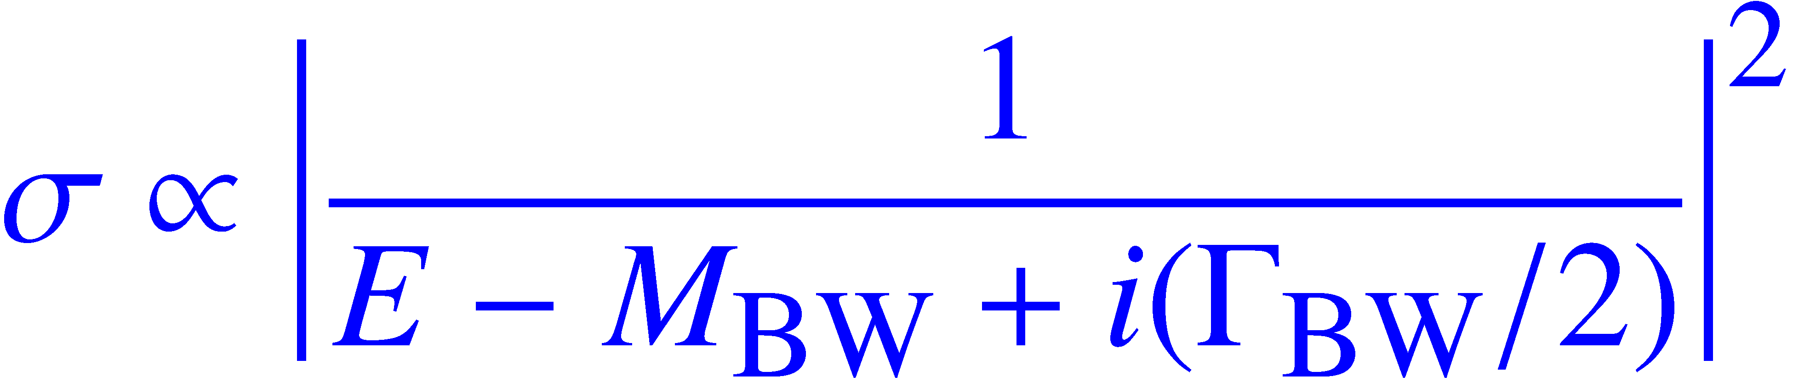

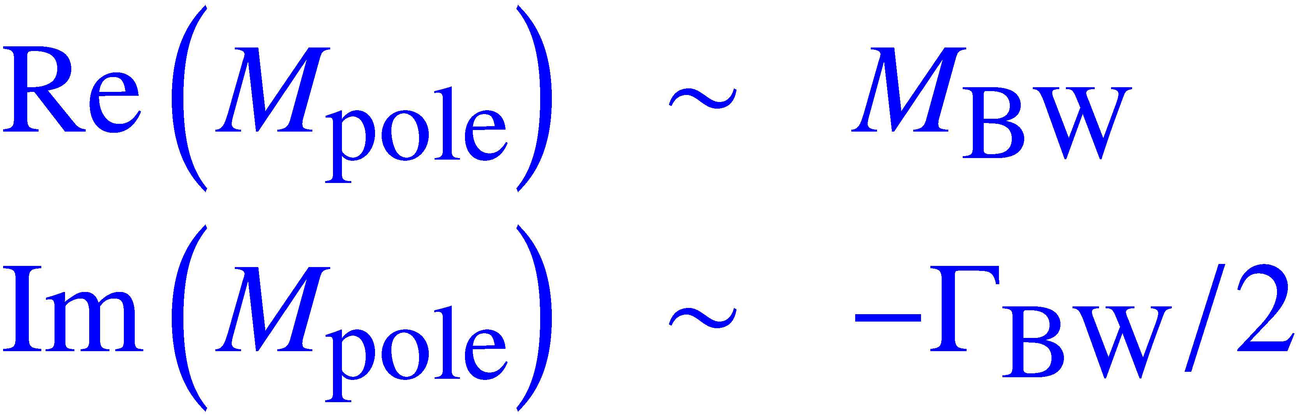


“Resonance pole in
complex-E plane” and
“Peak of cross sections
in real E-axis”
(Breit-Wigner formula)
Im (E)
Cross section σ ~ |T|²
Condition:
Pole is isolated.
Small background.
Re (E)
No discontinuity in amplitudes between the pole and the real energy axis.

Slide 26
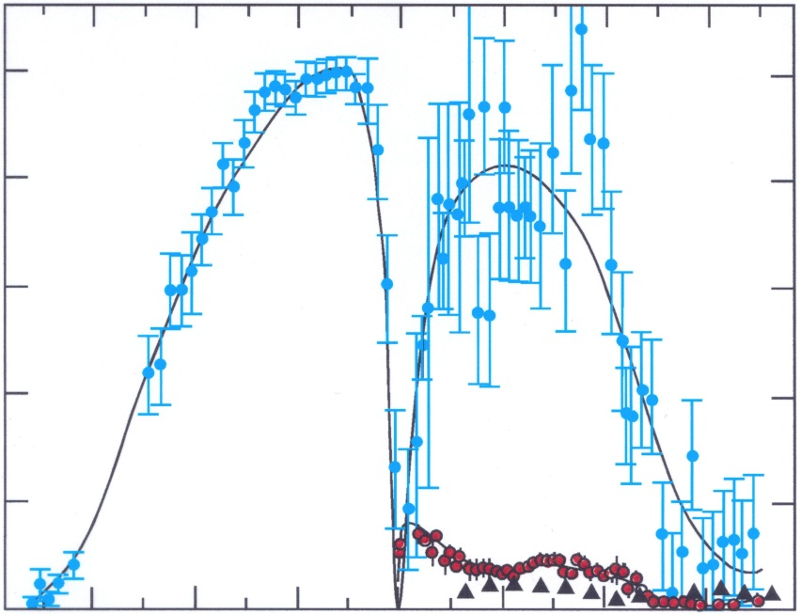
f₀(980) in pi-pi scattering
π
π
f₀ (980)
π
From M. Pennington’s talk
f₀ (980)
π
σ (ππ→ππ)
Im(E)
(GeV)
Re(E)
(GeV)
0.4
0.8
1.2
？
1.6
～ 980 – 70i (MeV)

Slide 27
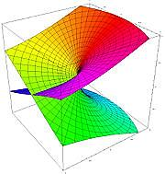
Multi-layer structure of the scattering amplitudes
e.g.) single-channel meson-baryon scattering
physical sheet
2-channel case (4 sheets):
(channel 1, channel 2) =
(p, p), (u, p) ,(p, u), (u, u)
p = physical sheet
u = unphysical sheet
Scattering amplitude is a double-valued function of complex E !!
Essentially, same analytic structure as square-root function: f(E) = (E – E_{th})^{1/2}
unphysical sheet
N-channels → Need 2^{N} energy sheets
physical sheet
unphysical sheet
Re(E) + iε ＝“physical world”
Im (E)
0
Im (E)
0
E_{th}
(branch point)
E_{th}
(branch point)
×
×
×
×
Re (E)
Re (E)

Slide 28

f₀(980) in pi-pi scattering, Cont’d
f₀(980) is barely contributed
From M. Pennington’s talk
ｆ
ππ → ππ
Not only the resonance poles, but also the analytic structure of
the scattering amplitudes in the complex E-plane plays a crucial role
for the shape of cross sections on the real energy axis (= real world) !!
ππ physical & KK physical sheet
Im (E)
ππ
KK
Re (E)
Just slope of the peak
produced by the
f₀(980) pole is seen.
f₀(980)
K K
ππ unphysical & KK physical sheet
ππ unphysical & KK unphysical sheet

Slide 29
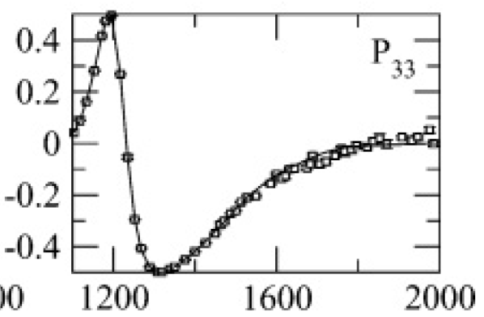
Delta(1232) : The 1st P33 resonance
Suzuki, Julia-Diaz, Kamano, Lee, Matsuyama, Sato, PRL104 042302 (2010)
Complex E-plane
Re (T)
Im (T)
Real energy axis
“physical world”
P33
πN physical & πΔ physical sheet
Im (E)
π N
Re (E)
πN unphysical & πΔ physical sheet
π Δ
In this case, BW mass & width can be
a good approximation of the pole position.
1211-50i
pole 1211 , 50
Small background
Isolated pole
Simple analytic structure
of the complex E-plane
BW 1232 , 118/2=59
πN unphysical & πΔ unphysical sheet
Riemann-sheet for other channels: (ηN,ρN,σN) = (-, p, -)

Slide 30

Two-pole structure of the Roper P11(1440)
Suzuki, Julia-Diaz, Kamano, Lee, Matsuyama, Sato, PRL104 042302 (2010)
Complex E-plane
Re (T)
Im (T)
Real energy axis
“physical world”
P11
πN physical & πΔ physical sheet
Im (E)
π N
Re (E)
Pole A cannot generate a resonance shape on
“physical” real E axis.
πN unphysical & πΔ physical sheet
π Δ
In this case, BW mass & width has NO
clear relation with the resonance poles:
A
Two 1356 , 78
poles 1364 , 105
1356-78i
1364-105i
B
πΔ branch point prevents
pole B from generating
a resonance shape on “physical” real E axis.
?
BW 1440 , 300/2 = 150
πN unphysical & πΔ unphysical sheet
Riemann-sheet for other channels: (ηN,ρN,σN) = (p,p,p)

Slide 31


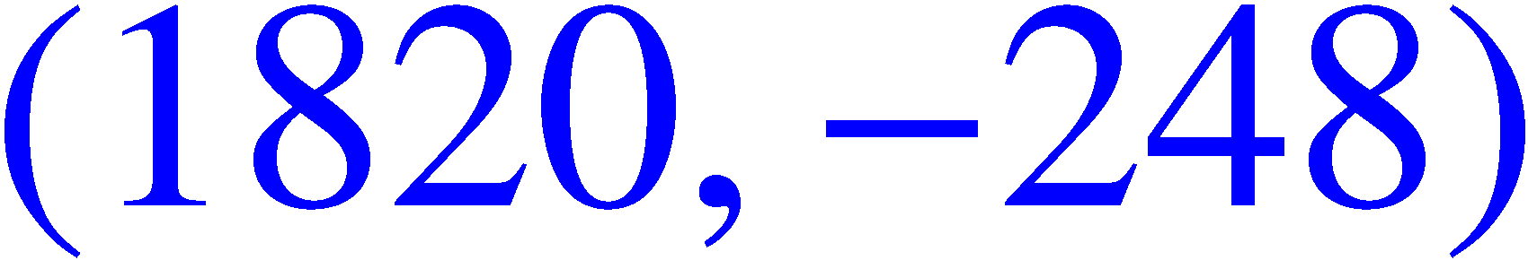
Dynamical origin of P11 resonances
Suzuki, Julia-Diaz, Kamano, Lee, Matsuyama, Sato, PRL104 042302 (2010)
All three P11 poles below 2 GeV are generated from a same, single bare state!
P11 N* resonances
in the EBAC-DCC model
100
Multi-channel reactions can
generate many resonance poles
from a single bare state
0
Im E (MeV)
-100
Eden, Taylor, Phys. Rev. 133 B1575 (1964)
-200
Evidences in hadron and nuclear physics are summarized
e.g., in Morgan and Pennington, PRL59 2818 (1987)
-300
1400
1600
1800
Re E (MeV)

Slide 32
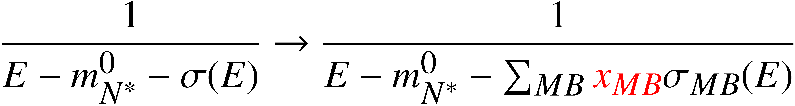


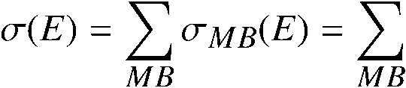




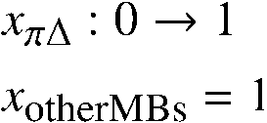
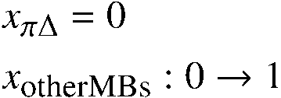
Dynamical origin of P11 resonances
Suzuki, Julia-Diaz, Kamano, Lee, Matsuyama, Sato, PRL104 042302 (2010)
Pole trajectory
of N* propagator
self-energy:
Bare state
ηN threshold
πΔ threshold
(ηN, ρN, πΔ) = (p, u, u)
Im E (MeV)
A:1357–76i
(ηN, ρN, πΔ) = (p, u, －)
ρN threshold
(ηN, ρN, πΔ) = (p, u, p)
(ηN, ρN, πΔ) = (u, u, u)
B:1364–105i
C:1820–248i
(πN,σN) = (u,p)
for three P11 poles
Re E (MeV)

Slide 33
Summary and future works
Summary
Extraction of N* states from DCC analysis 2006-2012
Fully combined analysis of πp, γp → πN, ηN, KΛ, KΣ is almost
completed.
N* spectrum in W < 2 GeV has been determined.
The Roper resonance is associated with two resonance poles.
The two Roper poles and N*(1710) pole are generated from a single
bare state.
Multichannel reaction dynamics plays
a crucial role for interpreting the N* spectrum !!

Slide 34
Summary and future works
Future works
Add ωN channel and complete the 9 coupled-channels analysis
of the πp, γp → πN, ηN, KY, ωN data.
Applications to p(ν, μπ), p(ν, μη) reactions beyond the Δ region
(W > 1.3 GeV) and study axial form factors of N*.
A part of the new collaboration “Toward unified description of lepton-nucleus
reactions from MeV to GeV region” at J-PARC branch of KEK theory center.
Applications to strangeness production reactions
(Y* spectroscopy, YN & YY interactions, hypernucleus …)
Applications to meson spectroscopy via heavy-meson decays
γ
Kamano, Nakamura, Lee, Sato, PRD84 114019 (2011)
J/Ψ
γ
X
X
Exotic hybrids?
f0, ρ, ..
p
p
Heavy meson decays
GlueX experiment at HallD@JLab

Slide 35
back up

Slide 36


DCC analysis @ EBAC (2006-2009)
πN, ηN, πΔ, ρN, σN coupled-channels
calculations were performed.
Hadronic part
π N → π N : Analyzed to construct a hadronic part of the model up to W = 2 GeV
Julia-Diaz, Lee, Matsuyama, Sato, PRC76 065201 (2007)
π N → η N : Analyzed to construct a hadronic part of the model up to W = 2 GeV
    Durand, Julia-Diaz, Lee, Saghai, Sato, PRC78 025204 (2008)
π N → π π N : First fully dynamical coupled-channels calculation up to W = 2 GeV
    Kamano, Julia-Diaz, Lee, Matsuyama, Sato, PRC79 025206 (2009)
γ^{(∗)} N → π N : Analyzed to construct a E.M. part of the model up to W = 1.6 GeV and Q² = 1.5 GeV²
(photoproduction) Julia-Diaz, Lee, Matsuyama, Sato, Smith, PRC77 045205 (2008)
(electroproduction) Julia-Diaz, Kamano, Lee, Matsuyama, Sato, Suzuki, PRC80 025207 (2009)
γ N → π π N : First fully dynamical coupled-channels calculation up to W = 1.5 GeV
Kamano, Julia-Diaz, Lee, Matsuyama, Sato, PRC80 065203 (2009)
Extraction of N* pole positions & new interpretation on the dynamical origin of P11 resonances
Suzuki, Julia-Diaz, Kamano, Lee, Matsuyama, Sato, PRL104 065203 (2010)
Stability and model dependence of P11 resonance poles extracted from pi N → pi N data
Kamano, Nakamura, Lee, Sato, PRC81 065207 (2010)
Extraction of γN → N* electromagnetic transition form factors
Suzuki, Sato, Lee, PRC79 025205 (2009); PRC82 045206 (2010)
Electromagnetic part
Extraction of N* parameters

Slide 37
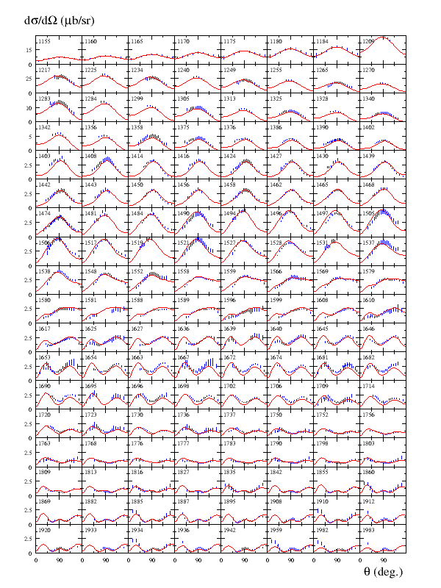
Kamano, Nakamura, Lee, Sato,
2012

Slide 38
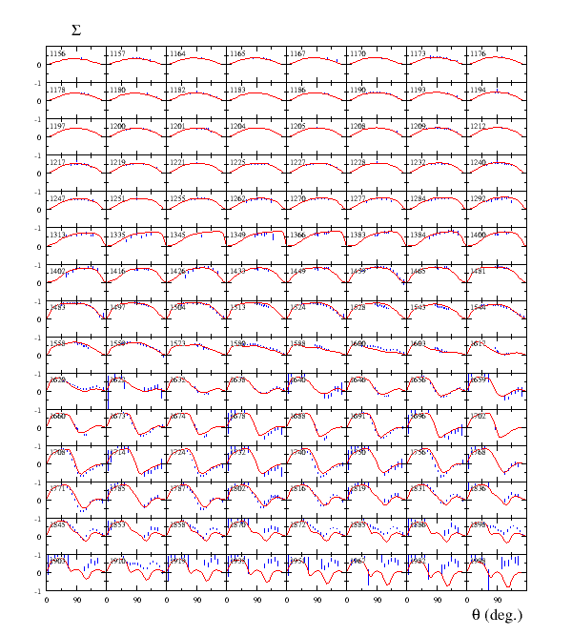
Kamano, Nakamura, Lee, Sato, 2012

Slide 39
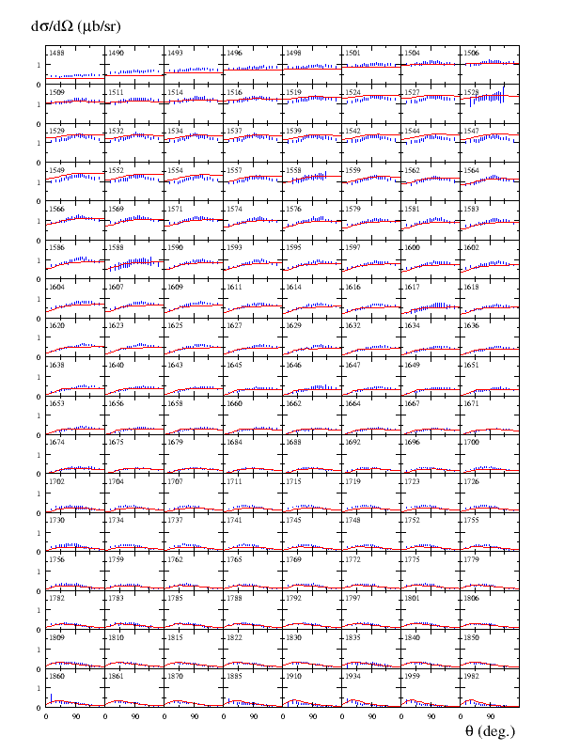

Kamano, Nakamura, Lee, Sato, 2012

Slide 40
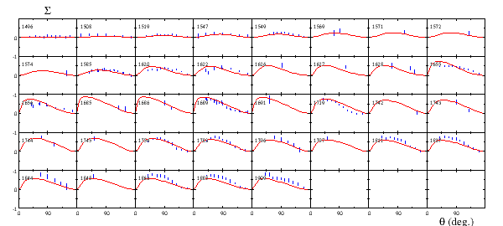
Kamano, Nakamura, Lee, Sato, 2012

Slide 41



Double pion photoproduction
Kamano, Julia-Diaz, Lee, Matsuyama, Sato, PRC80 065203 (2009)
Parameters used in the calculation are from πN → πN & γN → πN analyses.
Good description near threshold
Reasonable shape of invariant
mass distributions
Above 1.5 GeV, the total cross
sections of pπ⁰π⁰ and pπ⁺π⁻
overestimate the data.

Slide 42


Single pion electroproduction (Q² > 0)
Julia-Diaz, Kamano, Lee, Matsuyama, Sato, Suzuki, PRC80 025207 (2009)
Fit to the structure function data (~ 20000) from CLAS
p (e,e’ π⁰) p
W < 1.6 GeV
Q² < 1.5 (GeV/c)²
is determined
at each Q².
γ
q
(q² = -Q²)
N
N*
N-N* e.m. transition
form factor

Slide 43
Single pion electroproduction (Q² > 0)
Julia-Diaz, Kamano, Lee, Matsuyama, Sato, Suzuki, PRC80 025207 (2009)
Five-fold differential cross sections at Q² = 0.4 (GeV/c)²
p (e,e’ π⁰) p
p (e,e’ π⁺) n

Slide 44
N-N* transition form factors at resonance poles
Nucleon - 1st D13 e.m. transition form factors
Coupling to meson-baryon continuum states
makes N* form factors complex !!
Real part
Imaginary part
Fundamental nature of resonant particles
(decaying states)
Julia-Diaz, Kamano, Lee, Matsuyama, Sato, Suzuki PRC80 025207 (2009)
Suzuki, Sato, Lee, PRC82 045206 (2010)

Slide 45
Meson cloud effect in gamma N → N* form factors
G_{M}(Q²) for γ N → Δ (1232) transition
N, N*
Full
Bare
Note:
Most of the available static
hadron models give G_{M}(Q²)
close to “Bare” form factor.

Slide 46
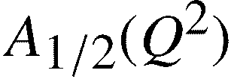
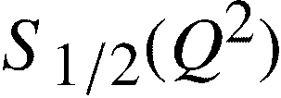

A clue how to connect with static hadron models
γ p → Roper e.m. transition
“Static” form factor from
DSE-model calculation.
(C. Roberts et al)
“Bare” form factor
determined from
our DCC analysis.

Slide 47

pi N → pi pi N reaction
Kamano, Julia-Diaz, Lee, Matsuyama, Sato, PRC79 025206 (2009)
Parameters used in the calculation are from πN → πN analysis.
(# of πN → ππN data) / (# of πN → πN data) ~ 1200 / 24000
Above W = 1.5 GeV,
All πN → ππN data were measured more than 3 decades ago.
No differential cross section data are available for
quantitative fits.
σ (mb)
W (GeV)
Full result
Need help of hadron beam facilities such as J-PARC !!
C. C. effect off
Data handled with
the help of R. Arndt
Full result
Phase space

Slide 48




Cross sections of inelastic channels

