Slide 1
Charmed Nuclei
Shigehiro Yasui
Tokyo Institute of Technology
Thanks to my collaborators:
A. Hosaka (RCNP), K. Sudoh (Nishogakusha U.), T. Hyodo (YITP), Y. Yamaguchi (Genova U.), S. Ohkoda
REIMEI Workshop@JAEA, 17 Jan. 2016

Slide 2
References
HQS doublet/singlet in exotic hadrons and nuclei
S.Y., K.Sudoh, Y.Yamaguchi, S.Ohkoda, A.Hosaka, T.Hyodo, Phys. Lett. B727, 185 (2013)
Y.Yamaguchi, S.Ohkoda, T.Hyodo, A.Hosaka, S.Y., Phys. Rev. D91, 034034 (2015)
D⁽*⁾N, D⁽*⁾NN hadronic molecules
S.Y., K.Sudoh, Phys. Rev. D80, 034008 (2009)
Y.Yamaguchi, S.Ohkoda, S.Y., A.Hosaka, Phys. Rev. D84, 014032 (2011)
Y.Yamaguchi, S.Ohkoda, S.Y., A.Hosaka, Phys. Rev. D85, 054003 (2013)
Y.Yamaguchi, S.Y., A.Hosaka, Nucl. Phys. A927, 110 (2014)
D⁽*⁾ in nuclear matter and Kondo effects
S.Y., K.Sudoh, Phys. Rev. C87, 015202 (2013)
S.Y., K.Sudoh, Phys. Rev. C88, 015201 (2013)
NLO in 1/m_{Q} expansion for D⁽*⁾ in nuclear matter
S.Y., K.Sudoh, Phys. Rev. C89, 015201 (2014)
D⁽*⁾N hadronic molecules
Y.Yamaguchi, S.Ohkoda, S.Y., A.Hosaka, Phys. Rev. D87, 074019 (2013)

Slide 3






1. Multi-flavor nucleus
Nucleus meets Flavor
HiggsTan.com
charge
1st
2nd
3rd
up
charm
top
Q=+2/3
2 MeV
1300 MeV
173000 MeV
down
strange
bottom
Q=-1/3
5 MeV
100 MeV
4200 MeV

Slide 4
1. Multi-flavor nucleus
Nucleus meets Flavor
1. Hadron-nucleon interaction
N
2. Hadron in medium
N
N
H
N
N
3. Nuclear structure
N
N
Impurity Physics

Slide 5
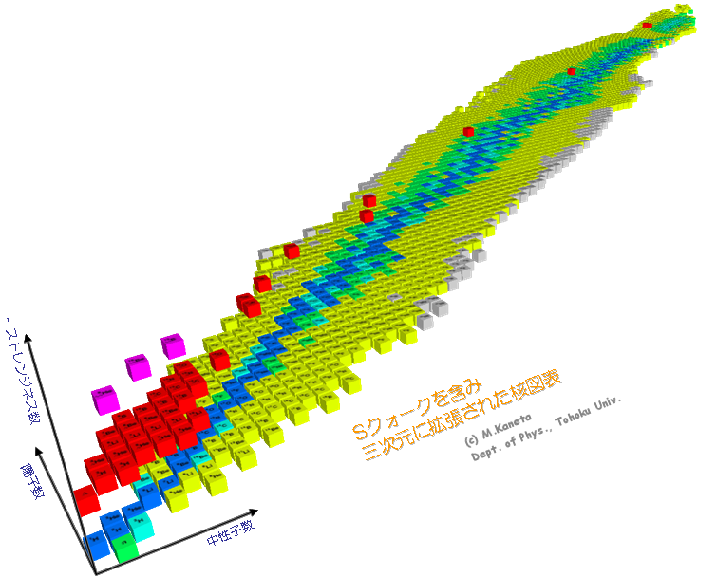
1. Multi-flavor nucleus
Nucleus + Strangeness
1. Hadron-nucleon interaction
2. Hadron in medium
3. Nuclear structure
Impurity Physics

Slide 6
1. Multi-flavor nucleus
Nucleus + Charm
Mass hierarchy (m_{c}>>Λ_{QCD})
~1.2 GeV ~0.2 GeV
1. Hadron-nucleon interaction
???
2. Hadron in medium
3. Nuclear structure
Impurity Physics

Slide 7
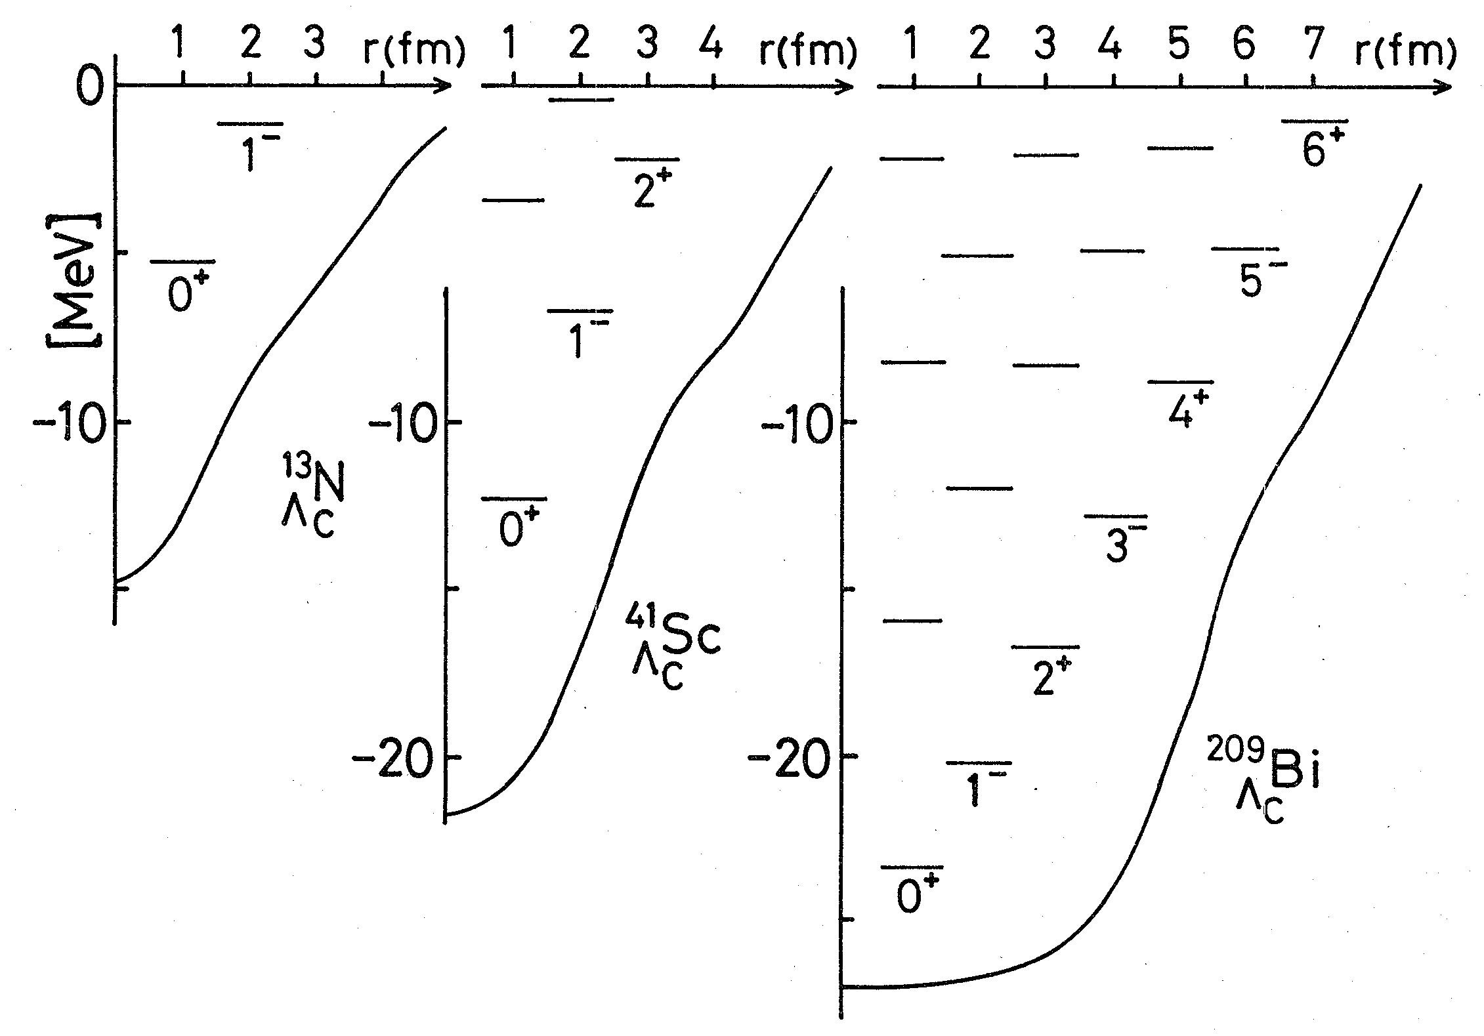
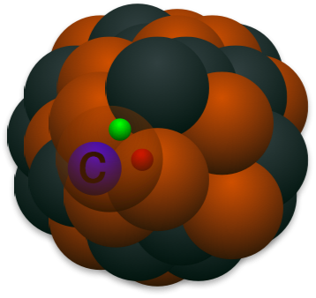
1. Multi-flavor nucleus
Strangeness
Charm
Λ(uds) → Λ_{c}(udc)
Charm baryon Λ_{c}(udc)
H.Bando, “Flavor Nuclei”, PTP Suppl. 81, 197 (1985)

Slide 8
1. Multi-flavor nucleus
Strangeness
Charm
Λ(uds) → Λ_{c}(udc)
φ(ss) → J/ψ(cc)
K(qs) → D(qc)
Stable “mesic” nuclei ? (no quark-antiquark annihilation)
K(qs) → D(qc)
Repulsive
(Chiral symmetry)
Attractive?
(Heavy-quark spin symmetry)

Slide 9
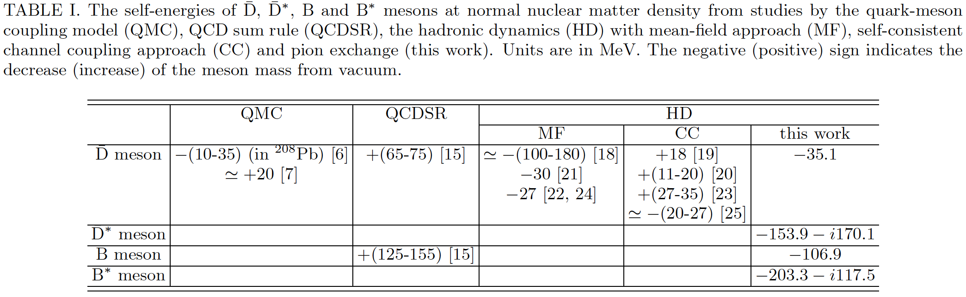
1. Multi-flavor nucleus
D (B) meson in nuclear systems
Quark-meson coupling model, QCD sum rules, hadronic interactions (mean-field approach, channel coupling, pion interaction), ...
Binding energy in nuclear matter [MeV]
Hadron dynamics
Quark-meson coupling model
QCD rum rule
Mean field
WT-type coupling
π exchange
~ a few ten MeV
(Repulsive? Attractive?)
[26]
-50 MeV [27]
+30 MeV [28]
-66 MeV [29]
[6] K. Tsushima, D. -H. Lu, A. W. Thomas, K. Saito and R. H. Landau, Phys. Rev. C 59, 2824 (1999).
[7] A. Sibirtsev, K. Tsushima and A. W. Thomas, Eur. Phys. J. A 6, 351 (1999).
[15] T. Hilger, R. Thomas and B. Kampfer, Phys. Rev. C 79, 025202 (2009).
[16] T. Hilger, R. Schulze and B. Kampfer, J. Phys. G G 37, 094054 (2010).
[17] Z. -G. Wang and T. Huang, Phys. Rev. C 84, 048201 (2011).
[18] A. Mishra, E. L. Bratkovskaya, J. Schaffner-Bielich, S. Schramm and H. Stoecker, Phys. Rev. C 69, 015202 (2004).
[19] M. F. M. Lutz and C. L. Korpa, Phys. Lett. B 633, 43 (2006).
[20] L. Tolos, A. Ramos and T. Mizutani, Phys. Rev. C 77, 015207 (2008).
[21] A. Mishra and A. Mazumdar, Phys. Rev. C 79, 024908 (2009).
[22] A. Kumar and A. Mishra, Phys. Rev. C 81, 065204 (2010).
[23] C. E. Jimenez-Tejero, A. Ramos, L. Tolos and I. Vidana, Phys. Rev. C 84, 015208 (2011).
[24] A. Kumar and A. Mishra, Eur. Phys. J. A 47, 164 (2011).
[25] C. Garcia-Recio, J. Nieves, L. L. Salcedo and L. Tolos, Phys. Rev. C 85, 025203 (2012).
[26] S. Yasui, K. Sudoh, Phys. Rev. C87, 015202 (2013).
[27] A. Hayashigaki, Phys. Lett. B487, 96 (2000)
[28] K. Suzuki, P. Gubler, M. Oka, Pos Hadron2013, 179 (2014).
[29] K. Azzi, N. Er, H. Sundu, Eur. Phys. J. C74, 3021 (2014).

Slide 10
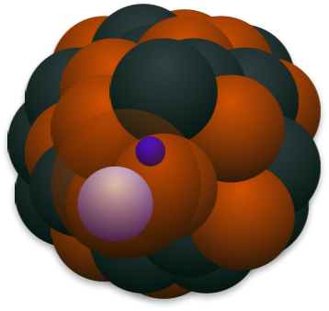
1. Multi-flavor nucleus
D (B) meson in nuclear systems
Quark-meson coupling model, QCD sum rules, hadronic interactions (mean-field approach, channel coupling, pion interaction), ...
D, D*
q
c
- Binding energy
- Dispersion relation
- Spectral function
- Reaction
- Restoration of χSB
- Nuclear structure
- etc.
Heavy quark spin
m_{c} >> Λ_{QCD}
Nucleus
Charm nucleus mass spectroscopy

Slide 11
Contents
1. Multi-flavor nucleus
2. Heavy quark symmetry
3. Application 1: Leading order in 1/m_{Q} expansion
4. Application 2: Next-to-Leading order in 1/m_{Q} expansion
5. Conclusion

Slide 12

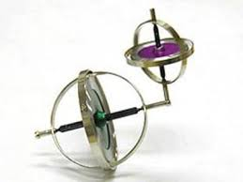
2. Heavy quark symmetry
Heavy quark symmetry (HQS)
Normal hadrons, exotic hadrons, hadronic molecules, exotic nuclei, ...
Heavy quark spin × Light quark and gluon total spin
Brown muck
(Spin-complex)
j
j
S_{Q}=1/2
S_{Q}=1/2
Heavy hadron
spin-spin interaction
Total spin = j ± 1/2: degenerate
suppressed:
S_{Q}・j ~Λ_{QCD}/m_{Q} << 1

Slide 13



2. Heavy quark symmetry
Heavy quark symmetry (HQS)
Normal hadrons, exotic hadrons, hadronic molecules, exotic nuclei, ...
Hadron mass
J₊ = j + 1/2
J₊ = 1/2
1/m_{Q}
J₋ = j - 1/2
HQS doublet
(j≠0)
HQS singlet
(j=0)
OR

Slide 14
ρ
2. Heavy quark symmetry
K*
Spin 1
D*
770 MeV
B*
890 MeV
2010 MeV
5325 MeV
630 MeV
390 MeV
140 MeV
45 MeV
5280 MeV
B
1870 MeV
D
→ HQS doublet
P⁽*⁾=(P,P*)
500 MeV
K
Spin 0
140 MeV
π

Slide 15
2. Heavy quark symmetry
→ HQS doublet
Σ_{Q}⁽*⁾=(Σ_{Q},Σ_{Q}*)
Δ
Σ*
Spin 3/2
Σ_{c}*
Σ_{b}*
1230 MeV
1385 MeV
2520 MeV
5830 MeV
290 MeV
195 MeV
65 MeV
20 MeV
5810 MeV
2455 MeV
Σ_{b}
1190 MeV
Σ_{c}
Σ
Spin 1/2
940 MeV
2286 MeV
5619 MeV
N
1115 MeV
Λ
Λ_{c}
Λ_{b}
→ HQS singlet
(Λ_{Q})
Spin 1/2

Slide 16
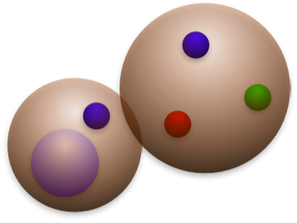
Question
Charm (bottom) exotic hadrons and nuclei
c
c
Nucleon
D, D* meson
Hadronic molecule (A=1)
Nucleus (A: large)
Answer
HQS doublet or singlet?
HQS doublet!!

Slide 17
3. Application 1: Leading order in 1/m_{Q} expansion
Heavy hadron effective theory
LO in 1/m_{Q} expansion

Slide 18
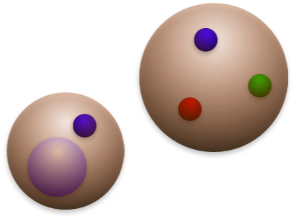
3. Application 1: Leading order in 1/m_{Q} expansion
Qq
=P⁽*⁾
q
q
π
① No quark-antiquark annihilation
(very simple system!)
q
q
π
Q
② Relation for interaction vertices:
g_{PP*π} = g_{P*P*π} (heavy quark symmetry)
D⁽*⁾ meson
Nucleon
~
Hadronic molecule
P(0⁻)
P*(1⁻)
HQS doublet or singlet?

Slide 19
3. Application 1: Leading order in 1/m_{Q} expansion
Qq
=P⁽*⁾
•
•
•
q
q
P
S-wave
N
π
π
q
P*
S-wave
N
Time
q
π
π
Q
P*
D-wave
N
D⁽*⁾ meson
Nucleon
π
P
S-wave
N
Hadronic molecule
J^{P}=1/2⁻ case
Tensor force and ...
(mixing of S-wave and D-wave, like in deuteron)
P(0⁻)-P*(1⁻) mixing are important !

Slide 20


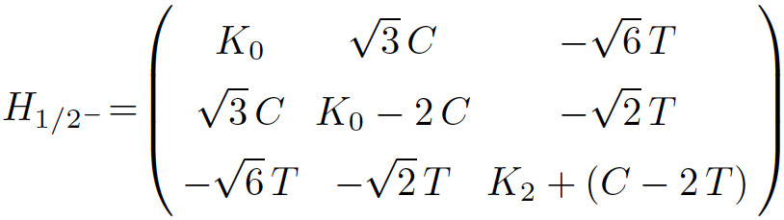
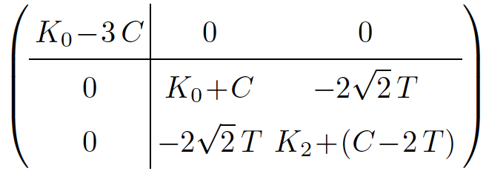
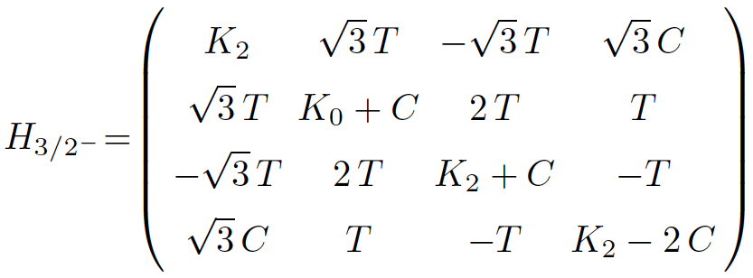
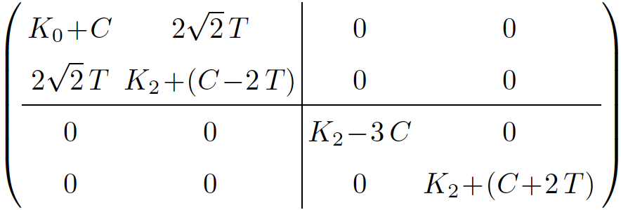
3. Application 1: Leading order in 1/m_{Q} expansion
J^{P}=1/2⁻, 3/2⁻
{P⁽*⁾N(^{2S+1}L_{J})}
N
J^{P}=1/2⁻ : {PN(²S_{1/2}), P*N(²S_{1/2}), P*N(⁴D_{1/2})}
P⁽*⁾
π exchange
HQS singlet
Unitary transformation
(Heavy quark + Brown muck)
HQS doublet
(tensor potential)
J^{P}=3/2⁻ : {PN(²D_{3/2}), P*N(⁴S_{3/2}), P*N(⁴D_{3/2}), P*N(²D_{3/2})}
Unitary transformation
(Heavy quark + Brown muck)
K_{L}: kinetic term
(angular momentum L)
C: central potential
T: tensor potential
1/2⁻ and 3/2⁻ are degenerate in mass.
HQS doublet

Slide 21
3. Application 1: Leading order in 1/m_{Q} expansion
Mass
P⁽*⁾N
D*N
N
142 MeV
P⁽*⁾
π exchange
isospin 0
B*N
46 MeV
DN
BN
PN, P*N
0 MeV
0 MeV
0 MeV
Charm
Bottom
m_{Q}→∞

Slide 22
3. Application 1: Leading order in 1/m_{Q} expansion
Mass
P⁽*⁾N
Predictions
N
142 MeV
P⁽*⁾
π exchange
isospin 0
46 MeV
P⁽*⁾N
0 MeV
0 MeV
0 MeV
3/2⁻
1/2⁻
Charm
Bottom
m_{Q}→∞

Slide 23
3. Application 1: Leading order in 1/m_{Q} expansion
Mass
P⁽*⁾N
Predictions
D⁽*⁾N
N
142 MeV
3/2⁻
P⁽*⁾
π exchange
B⁽*⁾N
isospin 0
Feshbach resonance (Γ=18 MeV)
46 MeV
J^{P}=3/2⁻ : {PN(²D_{3/2}), P*N(⁴S_{3/2}), P*N(⁴D_{3/2}), P*N(²D_{3/2})}
P⁽*⁾N
3/2⁻
0 MeV
0 MeV
0 MeV
1/2⁻
1/2⁻
HQS doublet
3/2⁻
1/2⁻
Charm
Bottom
m_{Q}→∞

Slide 24
3. Application 1: Leading order in 1/m_{Q} expansion
Mass
P⁽*⁾NN
Predictions
D⁽*⁾NN
N
Argonne v₈’ pot.
(tensor force)
142 MeV
AV8’
π
1⁻
B⁽*⁾NN
N
P⁽*⁾
π
46 MeV
isospin 1/2
P⁽*⁾NN
1⁻
0 MeV
0 MeV
0 MeV
0⁻
0⁻
1⁻
0⁻
HQS doublet
Charm
Bottom
m_{Q}→∞

Slide 25
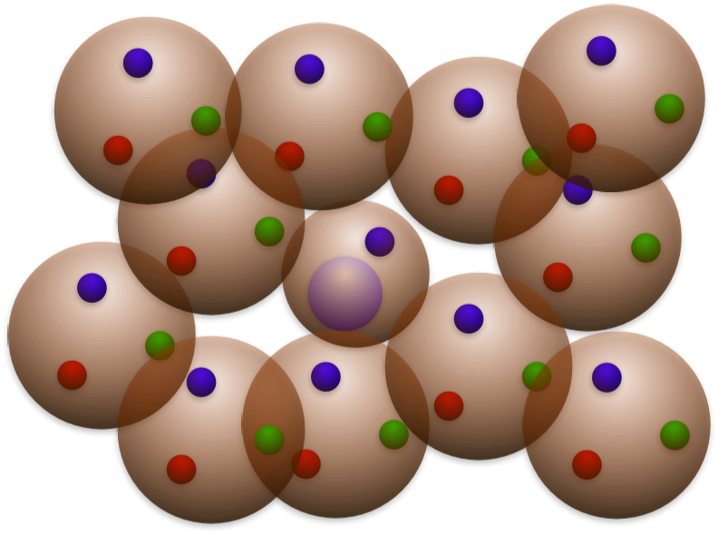
3. Application 1: Leading order in 1/m_{Q} expansion
P⁽*⁾ in nuclear matter
In-medium mass of P, P* mesons
in nuclear matter.
P
g
P*
g
π
π
g=g_{PP*π}=g_{P*P*π}
P*
P, P*
NN⁻¹
NN⁻¹
③
①
②
+
g
π
g
π
P
P*
P self-energy
P* self-energy
P⁽*⁾ meson
HQS doublet
Mass(P)=Mass(P*)
Cf. HQS singlet in “pion condensate” (Suenaga, He, Ma, Harada, PRC89, 068201 (2014))

Slide 26
4. Appl.2: Next-to-Leading order in 1/m_{Q} expansion
1/m_{Q} expansion
LO
+
NLO

Slide 27
4. Appl.2: Next-to-Leading order in 1/m_{Q} expansion
Change of “velocity-frame”
small
velocity-rearrangement
Effective field
Example: Heavy Quark Effective Theory (HQET)
L₀+L₁: invariant

Slide 28
4. Appl.2: Next-to-Leading order in 1/m_{Q} expansion
Heavy hadron mass “parametrization”
1/m_{Q} expansion
ρ: nuclear matter density
at NLO
M.Neubert, Phys. Lett.
B322, 419 (1994)
Color electric gluon
Color magnetic gluon
“Non-perturbative” gluon

Slide 29
4. Appl.2: Next-to-Leading order in 1/m_{Q} expansion
Can we calculate hadron w.f.
in nuclear medium from QCD?
Very difficult, but…

Slide 30
4. Appl.2: Next-to-Leading order in 1/m_{Q} expansion
Heavy hadron effective theory
LO + NLO
1/m_{Q} expansion in quark ⇄ 1/M expansion in hadron
M = m_{Q} + Λ + 1/m_{Q} + O(1/m_{Q}²)
1/M = 1/m_{Q} + O(1/m_{Q}²)
Question: what is NLO?

Slide 31


4. Appl.2: Next-to-Leading order in 1/m_{Q} expansion
How to construct effective Lagrangian?
1. Heavy quark symmetry is conserved at O(1).
Light quark+gluon
Heavy quark
=
2. Invariance under Lorentz boost at O(1)+O(1/M).
Luke, Manohar, PLB286, 348 (1992), Kitazawa, Kurimoto, PLB323, 65 (1994)
v-frame
w-frame
v
w = v - q/M
(q/M<<1)
H_{v}(x)
H_{w}(x)
Question: what is NLO?
Lorentz boost (velocity-rearrangement)

Slide 32
4. Appl.2: Next-to-Leading order in 1/m_{Q} expansion
How to construct effective Lagrangian?
1. Heavy quark symmetry is conserved at O(1).
Light quark+gluon
Heavy quark
=
2. Invariance under Lorentz boost at O(1)+O(1/M).
Luke, Manohar, PLB286, 348 (1992), Kitazawa, Kurimoto, PLB323, 65 (1994)
3. Heavy quark symmetry breaking terms at O(1/M).
≠

Slide 33
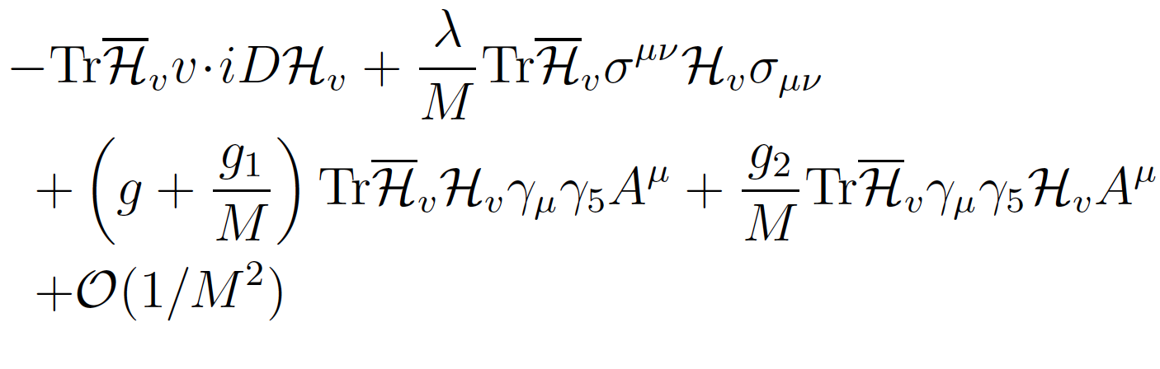

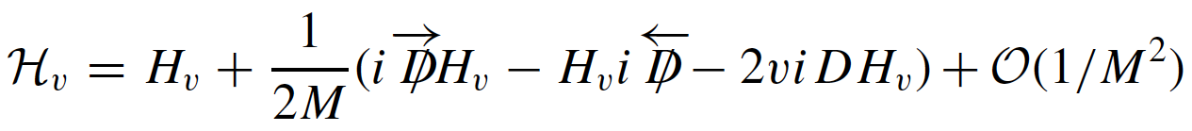
4. Appl.2: Next-to-Leading order in 1/m_{Q} expansion
Kitazawa, Kurimoto, PLB323, 65 (1994)
Heavy meson effective theory with 1/M corrections
P(0⁻), P*(1⁻)
π
g (LO), g/M, g₁/M, g₂/M (NLO)
P(0⁻), P*(1⁻)
“Covariant” field for velocity-rearrangement

Slide 34
4. Appl.2: Next-to-Leading order in 1/m_{Q} expansion
with breaking of HQS
P⁽*⁾ in nuclear matter
g_{P*P*π} = g + (g₁+g₂)/M
≠ g_{P*Pπ} = g + (g₁-g₂)/M
P⁽*⁾
π
M_{P*} = M-2λ/M
≠ M_{P} = M+6λ/M
P⁽*⁾
particle-hole
NN⁻¹
π
P⁽*⁾

Slide 35
4. Appl.2: Next-to-Leading order in 1/m_{Q} expansion
λ₁(ρ)
“Color electric gluon enhanced”
λ₂(ρ,m_{c})
“Color magnetic gluon suppressed”
λ₂(ρ,m_{b})
vacuum
normal nuclear matter

Slide 36

4. Appl.2: Next-to-Leading order in 1/m_{Q} expansion
D, D*
q
c
HiggsTan.com
Nucleus
Charm hadron
Probing gluon fields
1/m_{Q} expansion

Slide 37
5. Conclusion
1. We discuss heavy quark symmetry (HQS) at LO
in 1/m_{Q} expansion.
2. HQS gives doublet/singlet in mass spectrum
in exotic heavy hadrons and nuclei.
3. Mass modifications and splitting of D and D*
mesons are concerned with gluon in medium.
4. Toward experiments at J-PARC, GSI-FAIR,
LHC, RHIC, etc.!!

Slide 38
5. Conclusion
Many open problems...
- Relation to other fundamental aspects of QCD？
(Dynamical breaking of chiral symmetry, Quark Confinement, ...)
- Hadron-nucleon interaction？ Many-body physics？
(Pion exchange, Mean field approximation, Symmetry restoration, ...)
- What about atomic nucleus with charm？
- Lattice QCD: what QCD says about charm nucleus？
- Production cross sections of charm nucleus？
- etc.

Slide 40
Question
Charm (bottom) exotic hadrons and nuclei
H
H
HN^{2n+1}
HN^{2n}
Qq
doublet
doublet
singlet
doublet
D, D*
？
Σ_{c}, Σ_{c}*
doublet
singlet
doublet
doublet
singlet
Qqq
Λ_{c}

Slide 41
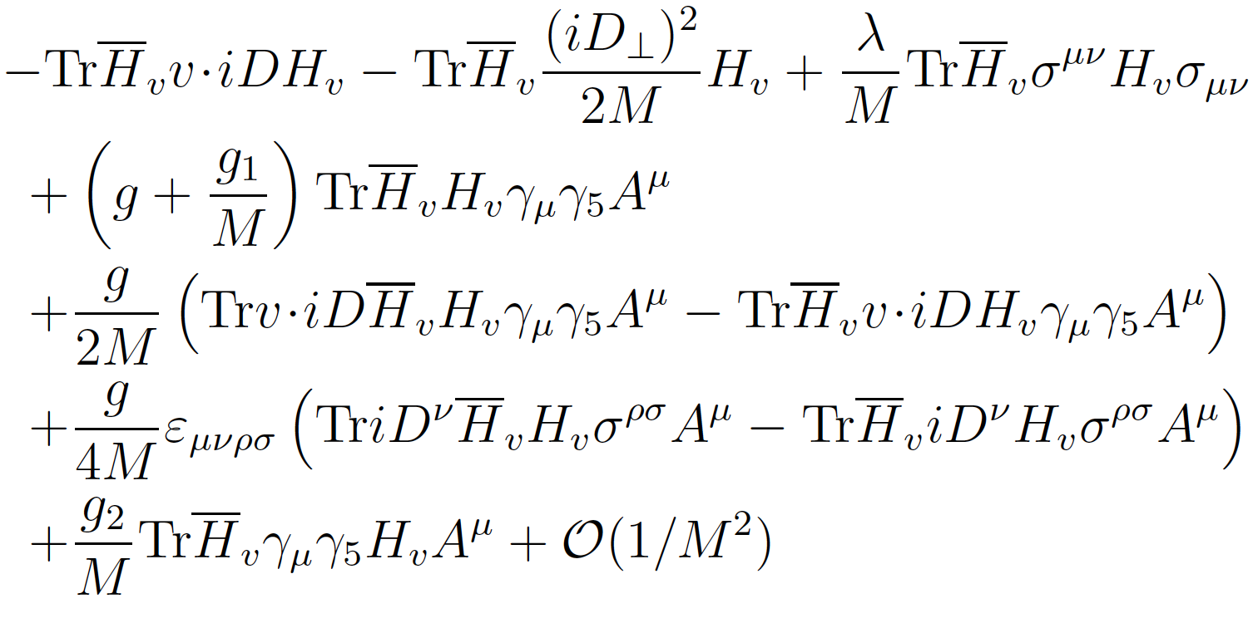
4. Appl.2: Next-to-Leading order in 1/m_{Q} expansion
Heavy meson effective theory with 1/M corrections
spin-flip (1/M)
Kitazawa, Kurimoto, PLB323, 65 (1994)
“Covariant” field for velocity-rearrangement
LO: g
NLO: g/M, g₁/M, g₂/M, λ/M
Some terms are constrained by invariance under velocity rearrangement.

Slide 42
2. Heavy quark symmetry
Introduction to “velocity-frame”
Propagator:

Slide 43


2. Heavy quark symmetry
1/m_{Q} expansion
(positive energy state Q_{v} with velocity v)
Manohar, Wise, Luke, Grinstein, ...
LO
Heavy quark spin in m_{Q}→∞ is
conserved.
Heavy quark symmetry (HQS)

Slide 44
3. Application 1: Leading order in 1/m_{Q} expansion
Numerical results for cutoff momentum 800 MeV
P(0⁻), P*(1⁻) self-energy in nuclear medium
P(0⁻)
P*(1⁻)
1. Imaginary parts
2. Large mass drop

Slide 45
3. Application 1: Leading order in 1/m_{Q} expansion
Qq
P⁽*⁾
P*
P
=
or
1⁻
same mass
0⁻
Q=c
Q=b
D*
B*
D
B
H.Georgi, Phys. Lett. B240, 447 (1990)
A.F.Falk, H.Georgi, B.Grinstein, Nucl. Phys. B343, 1 (1990)

Slide 46
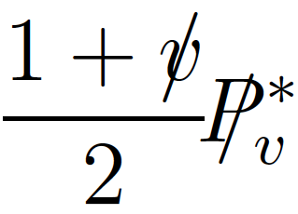
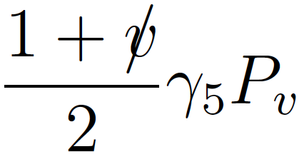
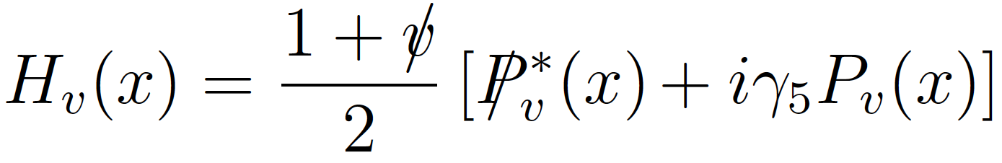
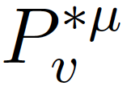
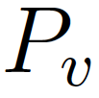
3. Application 1: Leading order in 1/m_{Q} expansion
Qq
1⁻
0⁻
H.Georgi, Phys. Lett. B240, 447 (1990)
A.F.Falk, H.Georgi, B.Grinstein, Nucl. Phys. B343, 1 (1990)

Slide 47
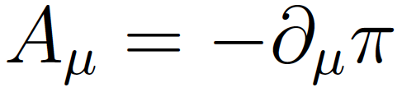

3. Application 1: Leading order in 1/m_{Q} expansion
Interaction of P(0⁻), P*(1⁻) meson with pion field
in local chial symmetry + HQS
kinetic term
interaction with pion
P*(1⁻)
P(0⁻)
P*(1⁻)
HQS
π
π
π
P(0⁻)
P*(1⁻)
P*(1⁻)
H.Georgi, Phys. Lett. B240, 447 (1990)
A.F.Falk, H.Georgi, B.Grinstein, Nucl. Phys. B343, 1 (1990)

