Slide 1
Spectral functions of mesons at finite temperature/density
P. Gubler and K. Ohtani, Phys. Rev. D 90, 094002 (2014). P. Gubler and W. Weise, Phys. Lett. B 751, 396 (2015).
K. Suzuki, P. Gubler and M. Oka, arXiv:1511.04513 [hep-ph].
Talk at the 31st Reimei workshop on hadron physics in extreme conditions at J-PARC,
Tokai, Japan
17. January, 2016
Collaborators:
Keisuke Ohtani (Tokyo Tech)
Wolfram Weise (TUM)
Kei Suzuki (RIKEN)
Makoto Oka (Tokyo Tech)

Slide 2
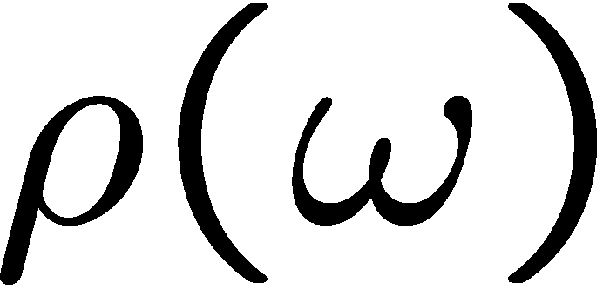

Introduction
Spectral functions at finite density
How is this complicated behavior related to partial restauration of chiral symmetry?
modification at finite density
coupling to nucleon resonances?
broadening?
mass/threshold shifts?

Slide 3




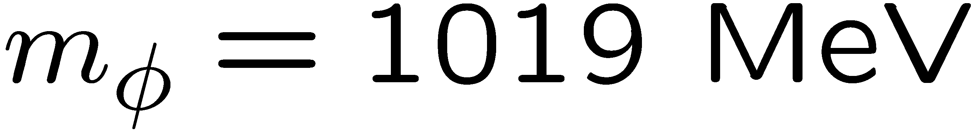
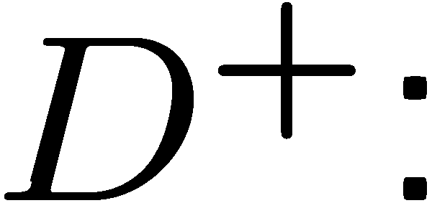


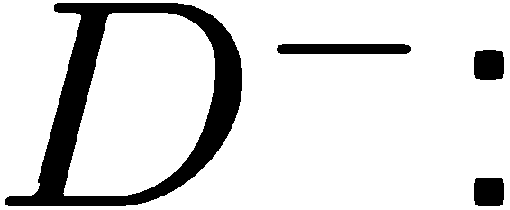

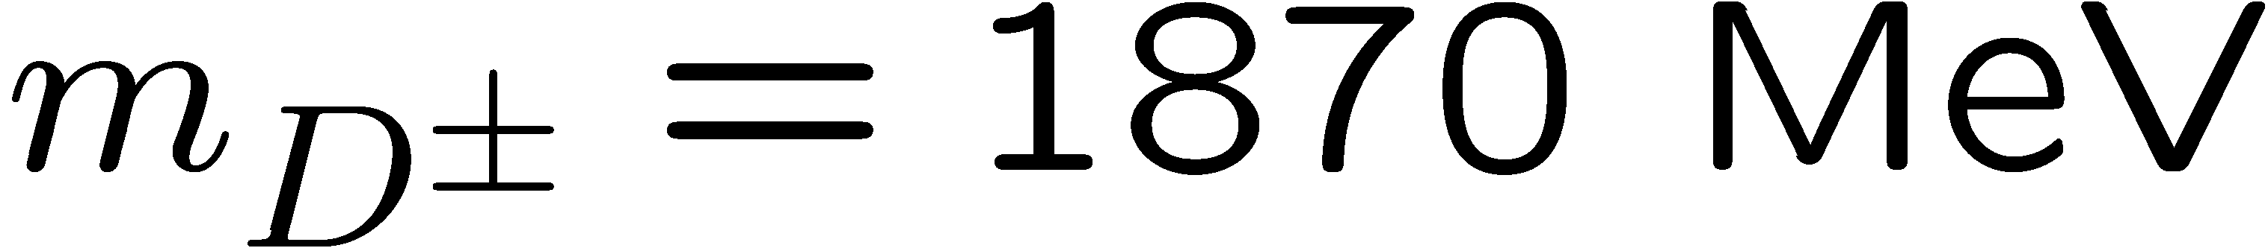
Introduction
φ meson
D mesons

Slide 4
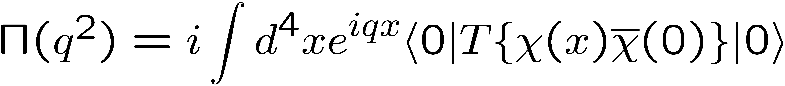
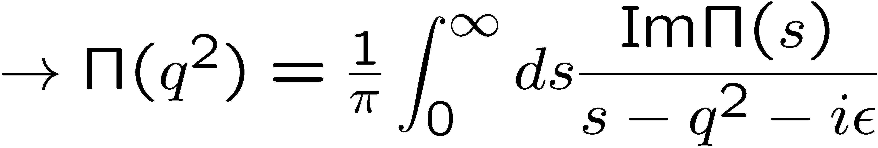
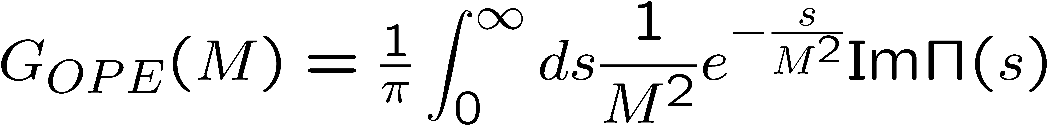
QCD sum rules
M.A. Shifman, A.I. Vainshtein and V.I. Zakharov, Nucl. Phys. B147, 385 (1979); B147, 448 (1979).
Exploit the analytic properties of the two point function:
q²
is calculated
“perturbatively”,
using OPE
spectral function
of the operator χ
After the Borel transformation:

Slide 5
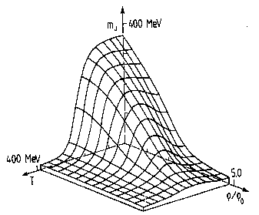
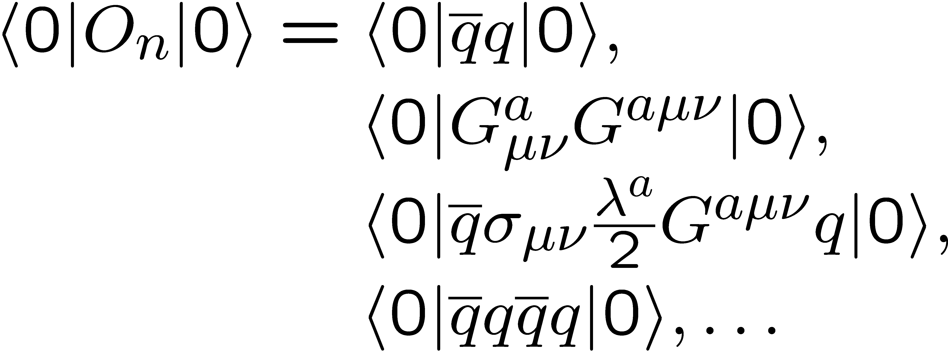
More on the OPE in matter
non-perturbative condensates
perturbative Wilson coefficients
Change in hot or dense matter!

Slide 6
φ meson in nuclear matter: experimental results
The E325 Experiment (KEK)
Slowly moving φ mesons are produced in 12 GeV p+A reactions and are measured through di-leptons.
e
e
p
e
p
φ
φ
e
outside decay
inside decay
No effect (only vacuum)
Di-lepton spectrum reflects the modified φ-meson

Slide 7

Fitting Results
βγ<1.25 (Slow)
1.25<βγ<1.75
1.75<βγ (Fast)
Small Nucleus
Large Nucleus

Slide 8
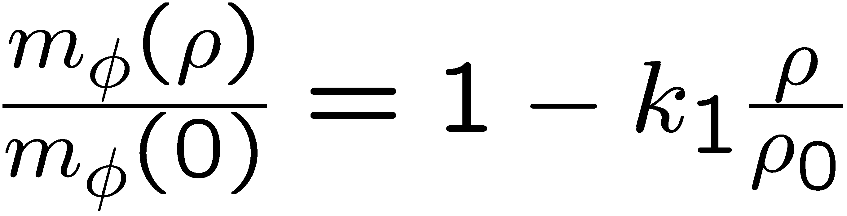
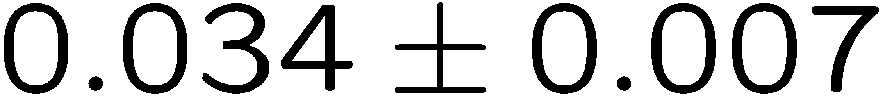
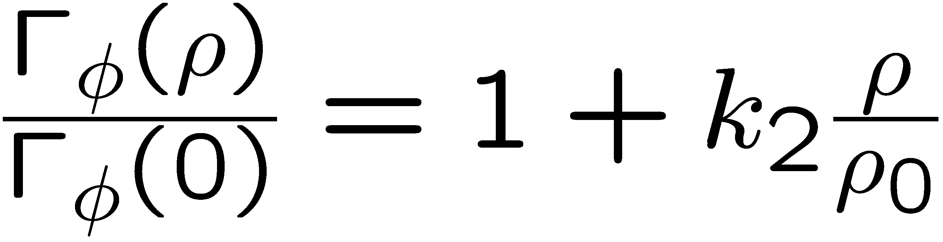
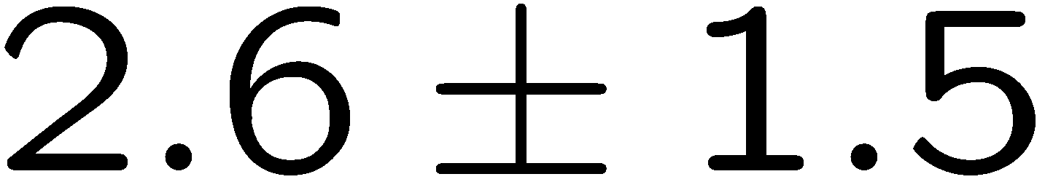
Experimental Conclusions
R. Muto et al, Phys. Rev. Lett. 98, 042501 (2007).
Pole mass:
35 MeV negative mass shift at normal nuclear matter density
Pole width:
Increased width to 15 MeV at normal nuclear matter density

Slide 9
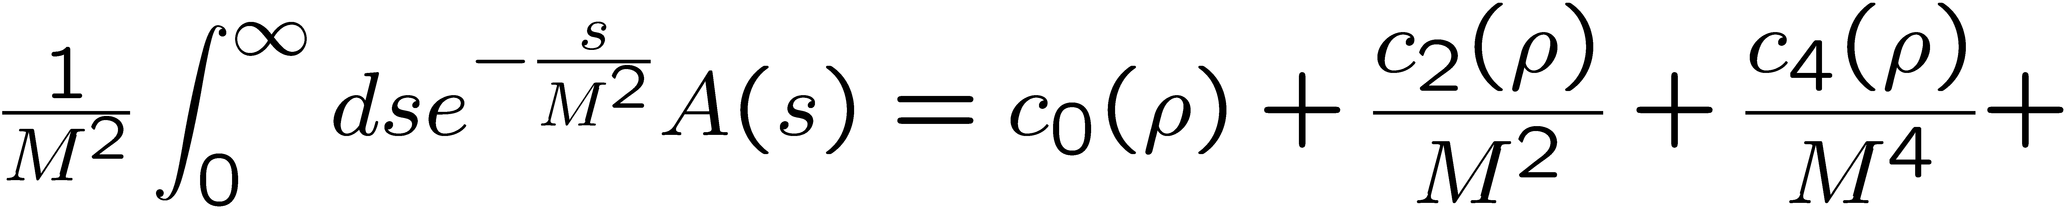
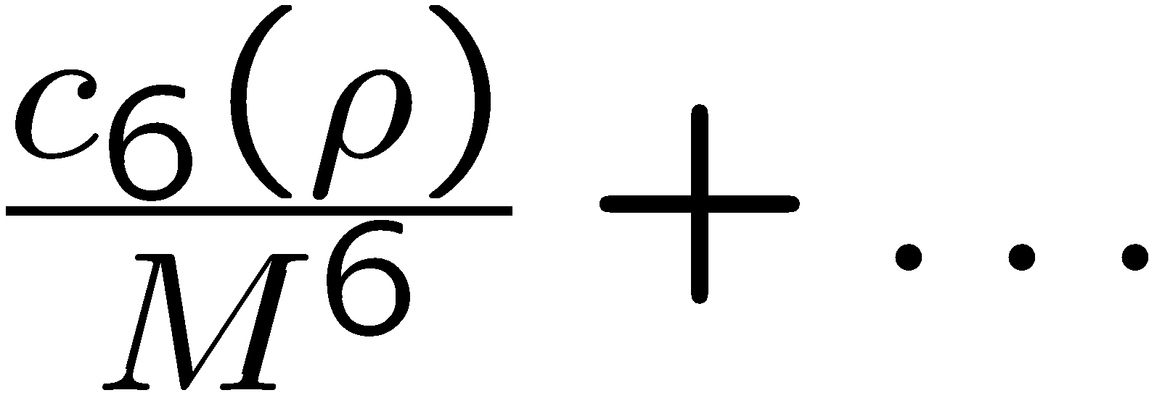
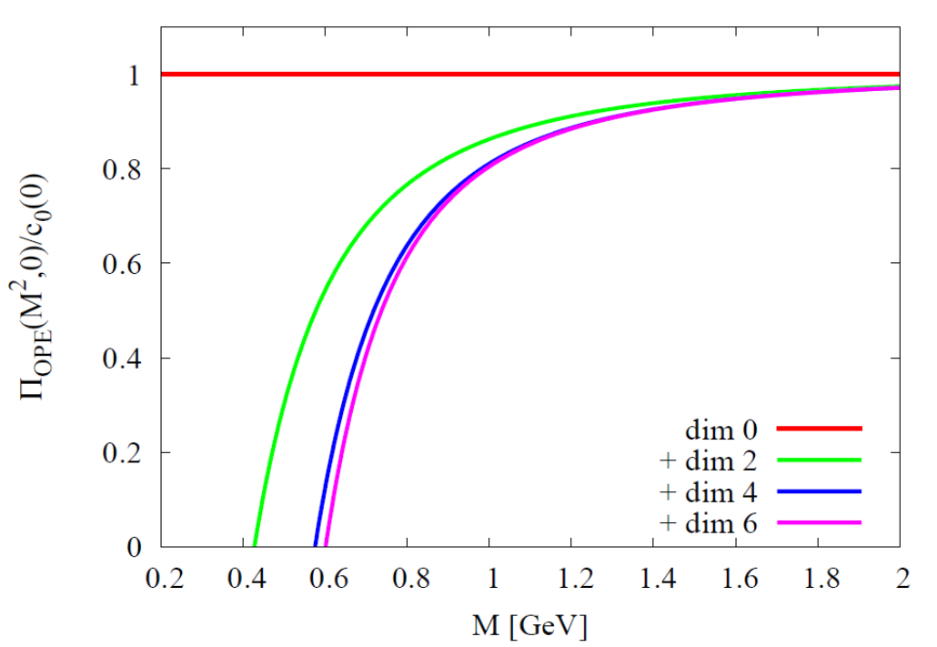
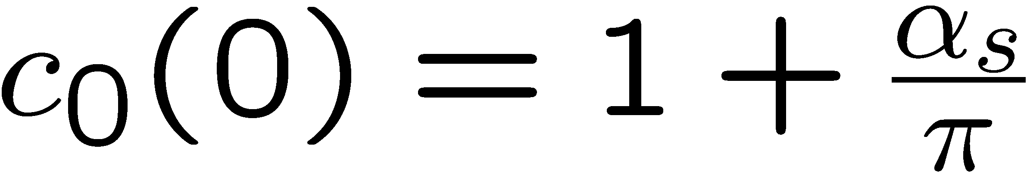
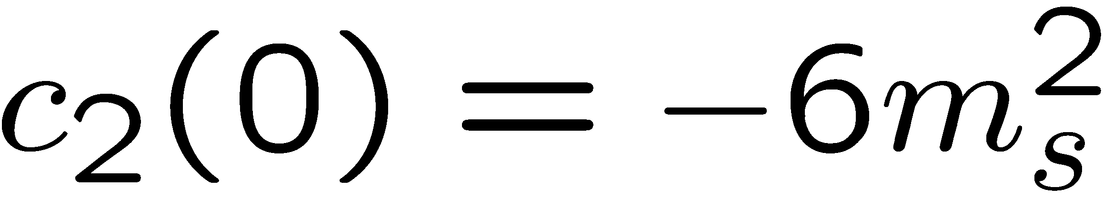
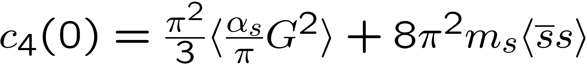
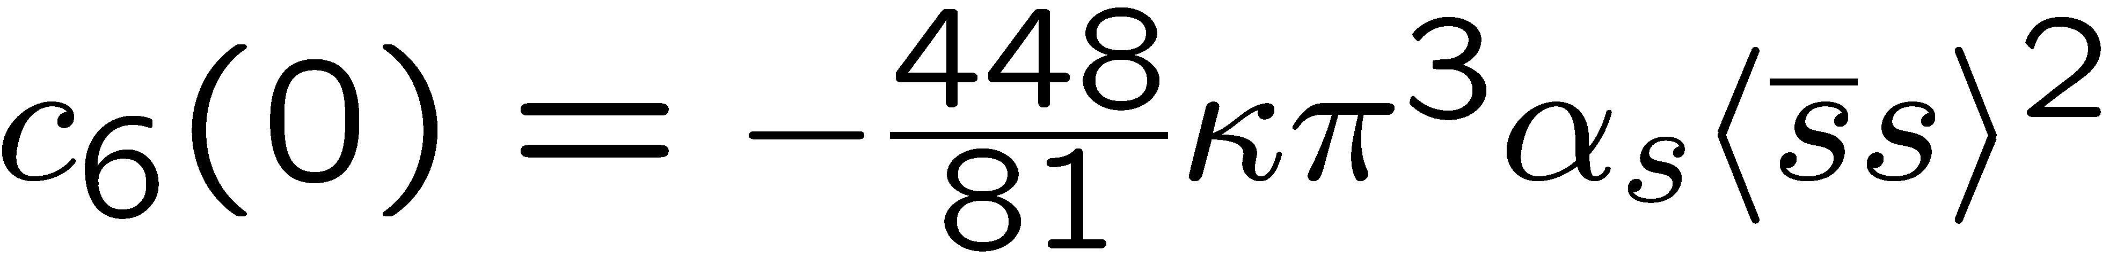
Structure of QCD sum rules for the phi meson
In Vacuum
Dim. 0:
Dim. 2:
Dim. 4:
Dim. 6:

Slide 10
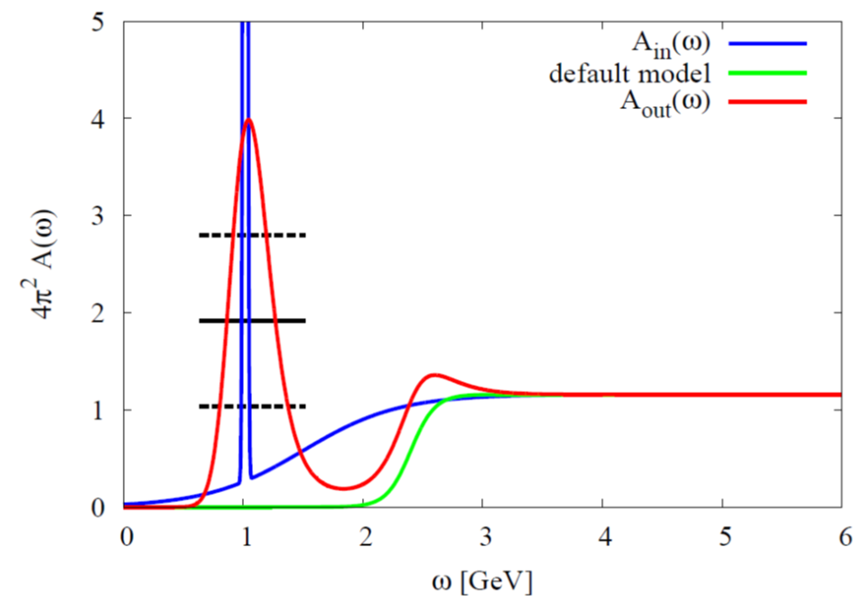
Results of test-analysis (using MEM)
Peak position can be extracted, but not the width!
P. Gubler and K. Ohtani, Phys. Rev. D 90, 094002 (2014).

Slide 11
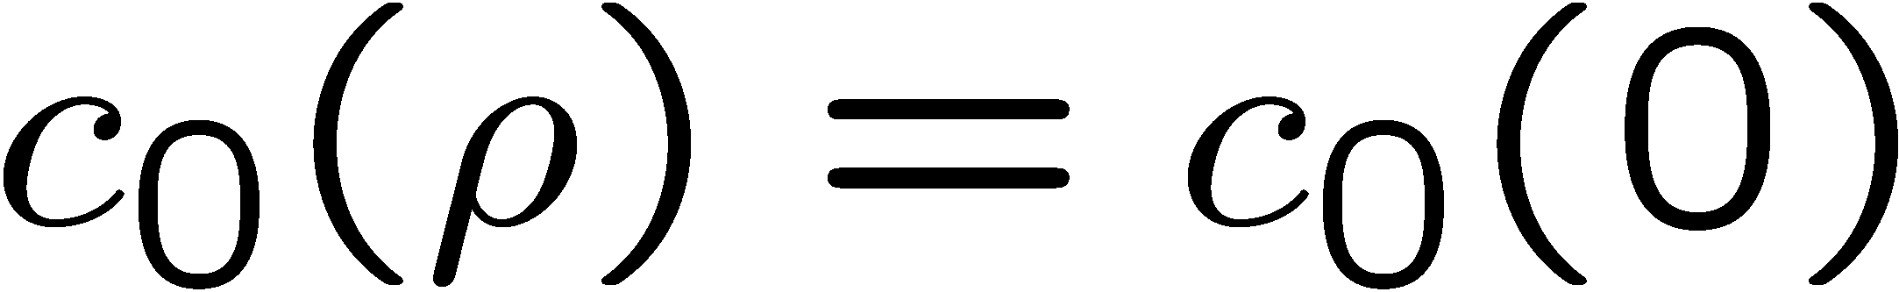
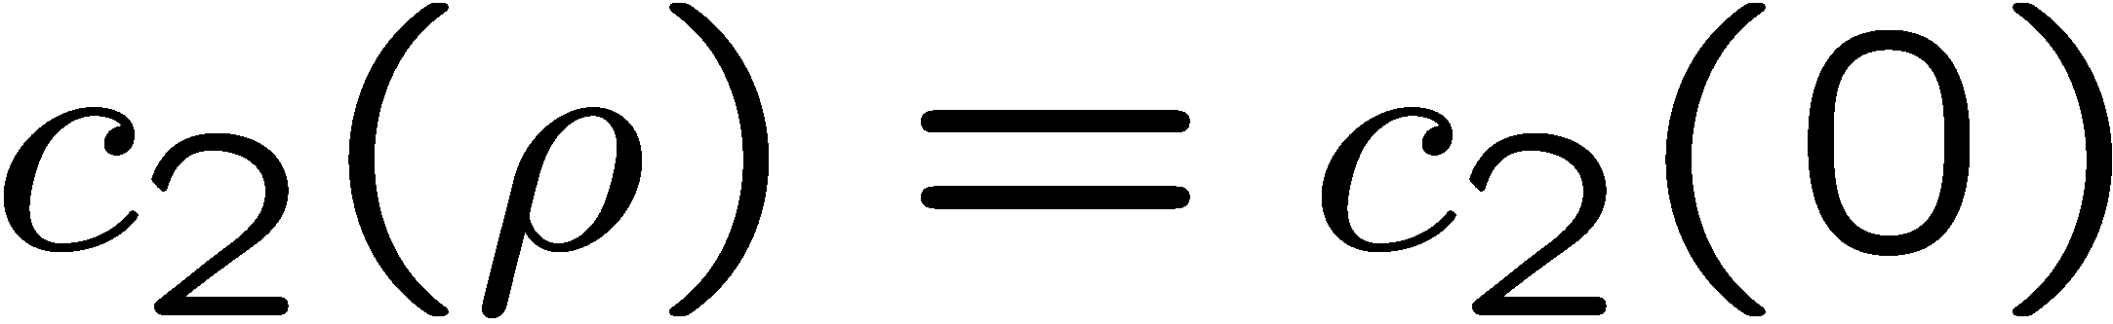
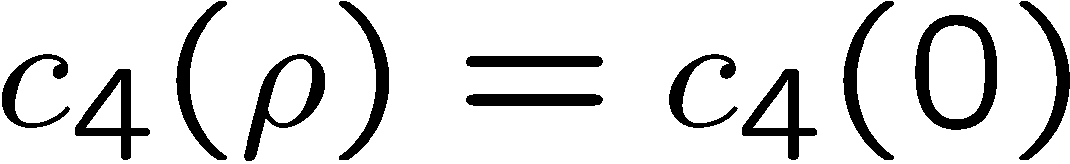
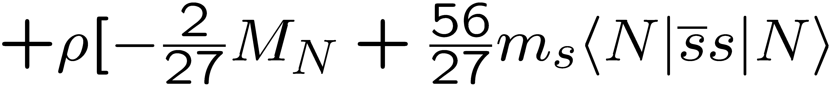
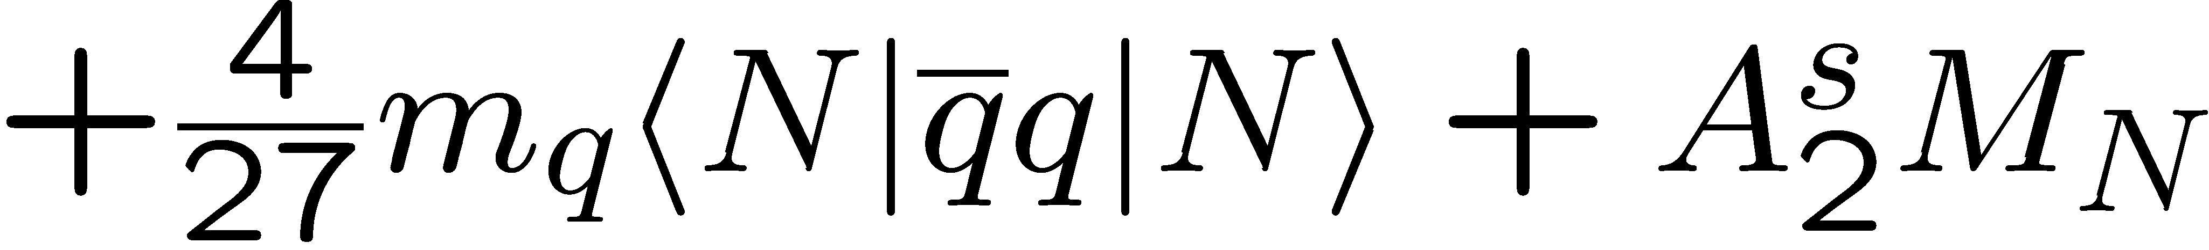
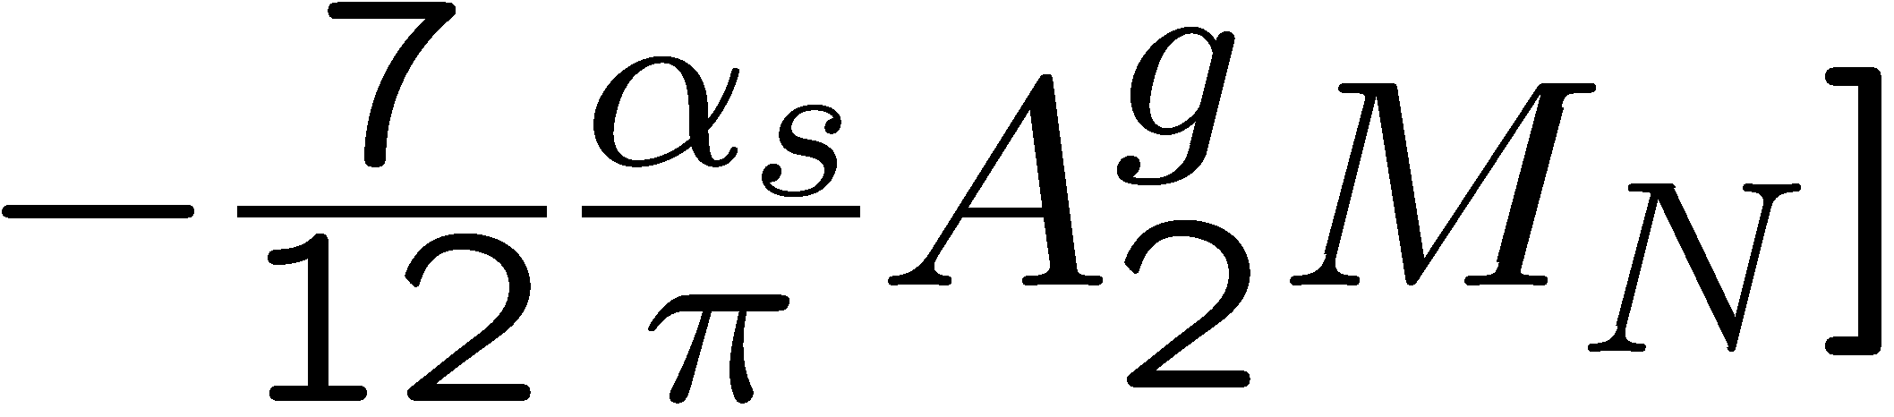
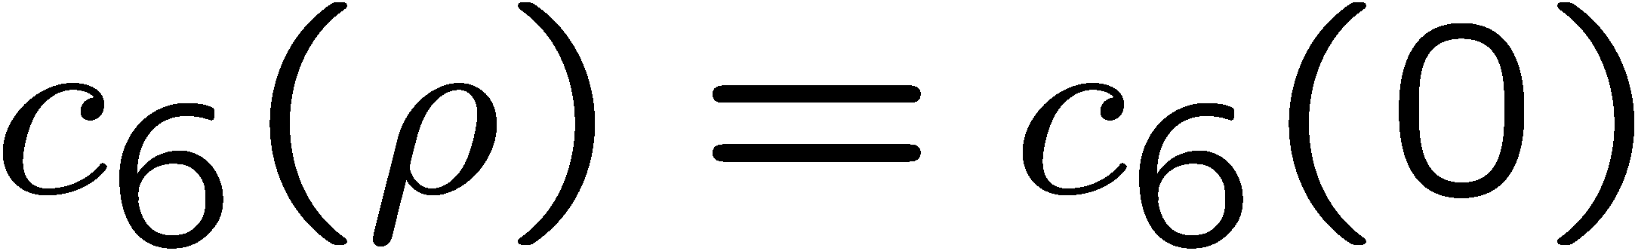
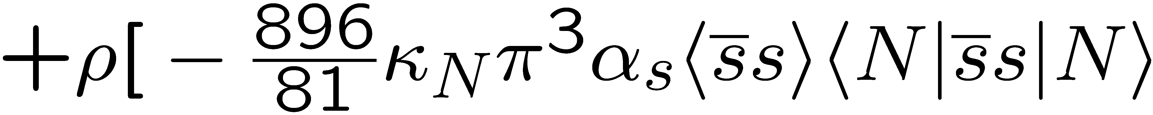
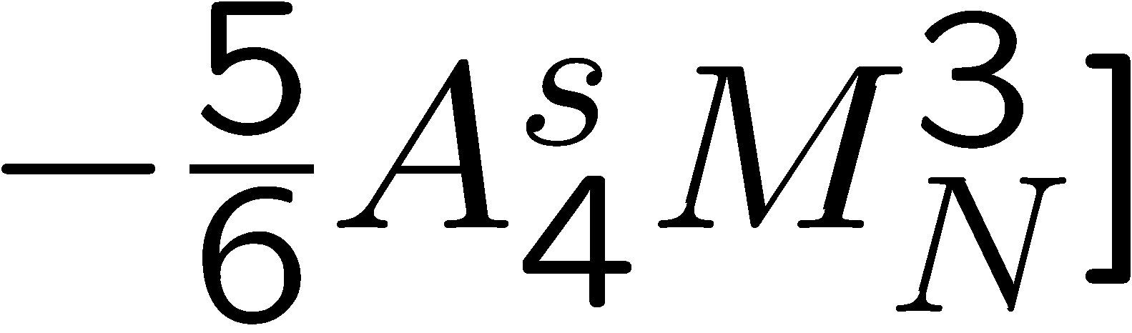
Structure of QCD sum rules for the phi meson
In Nuclear Matter
Dim. 0:
Dim. 2:
Dim. 4:
Dim. 6:

Slide 12
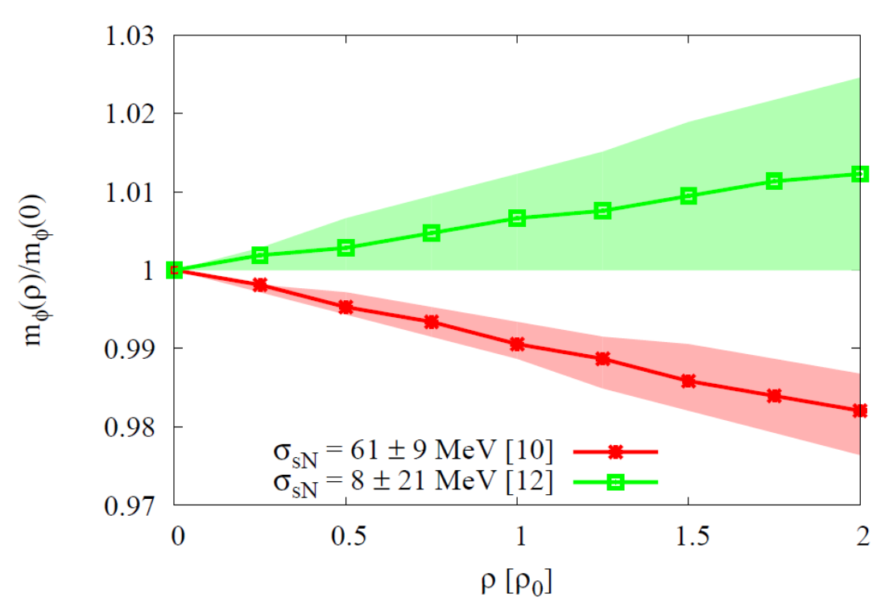
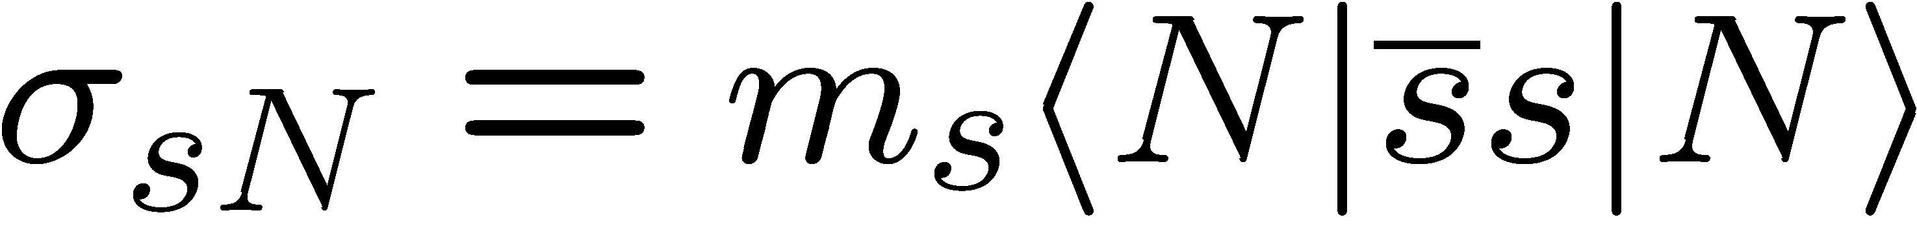
Results for the φ meson mass
Most important parameter, that
determines the behavior of the φ meson mass at finite density:
Strangeness content of the nucleon
P. Gubler and K. Ohtani, Phys. Rev. D 90, 094002 (2014).

Slide 13
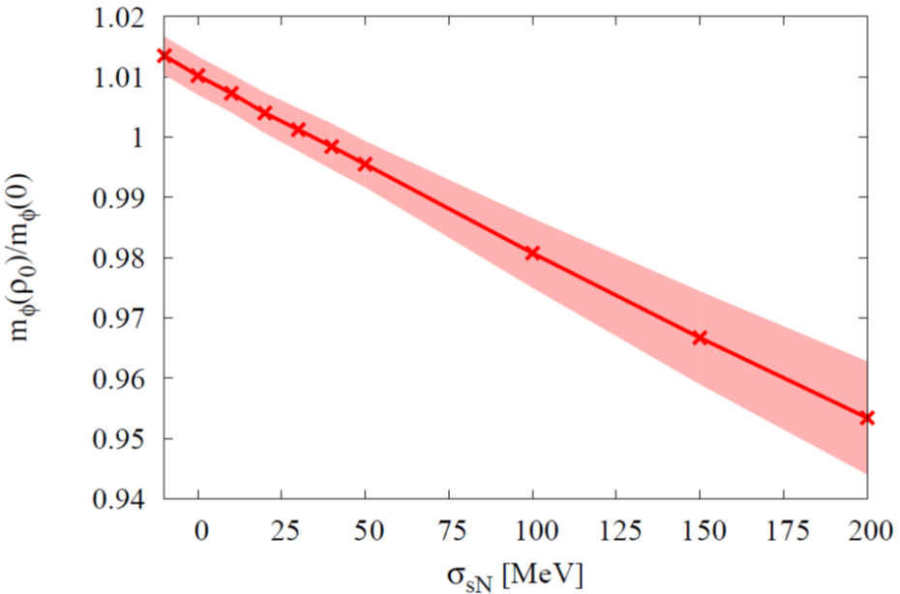
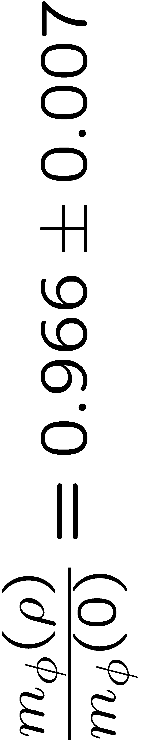
Compare Theory with Experiment
Sum Rules + Experiment
Not consistent?
Experiment
Lattice QCD

Slide 14
However…
New physical point lattice QCD results for σ_{sN} have become available recently:
S. Durr et al. (BMW Collaboration), arXiv:1510.08013 [hep-lat].
??
Y.-B. Yang et al. (χQCD Collaboration), arXiv:1511.09089 [hep-lat].
A. Abdel-Rehim et al. (ETM Collaboration), arXiv:1601.01624 [hep-lat].

Slide 15
Issues with Borel sum rules
Details of the spectral function cannot be studied (e.g. width)
Higher order OPE terms are always present (e.g. four-quark condensates at dimension 6)
Use a model to compute the complete spectral function
Use moments to probe specific condensates

Slide 16

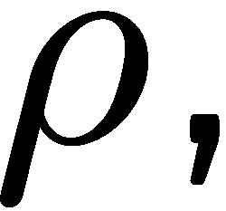
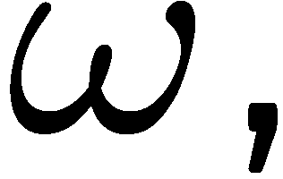
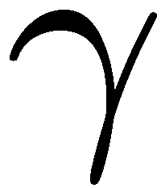
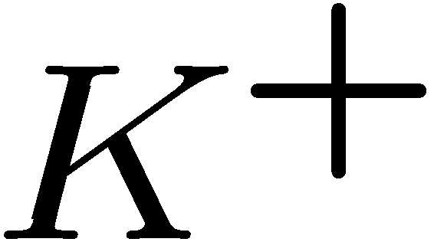
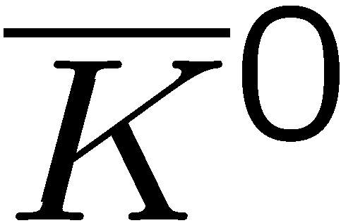
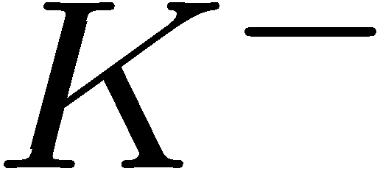
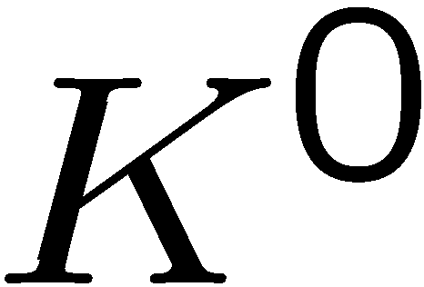
Method
Vector meson dominance model:
Kaon-loops introduce self-energy corrections to the φ-meson propagator

Slide 17
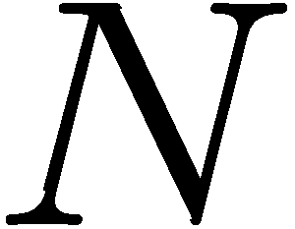
What happens in nuclear matter?
Forward KN (or KN) scattering amplitude
If working at linear order in density, the free scattering amplitudes can be used

Slide 18
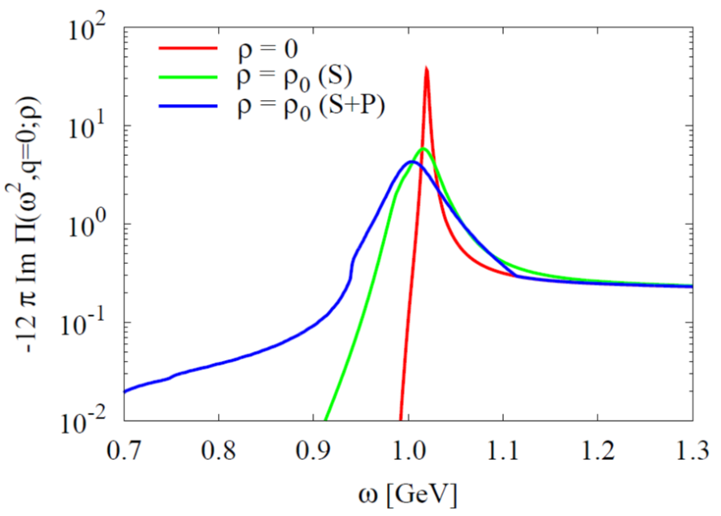
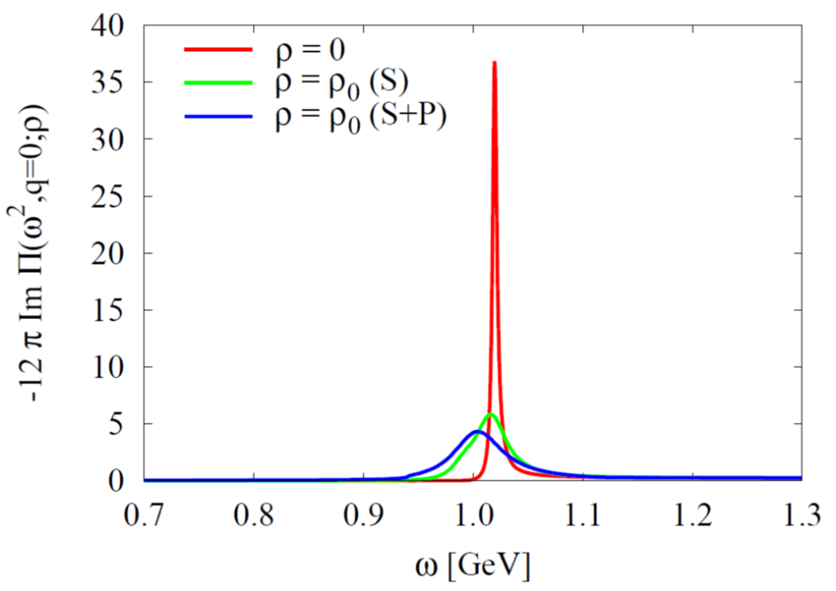
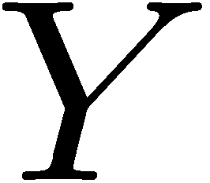
Results (Spectral Density)
Asymmetric modification of the spectrum. → Not necessarily parametrizable by a simple Breit-Wigner peak!
→ Important message for future E16 experiment at J-PARC
Takes into account further KN-interactions with intermediate hyperons, such as:

Slide 19
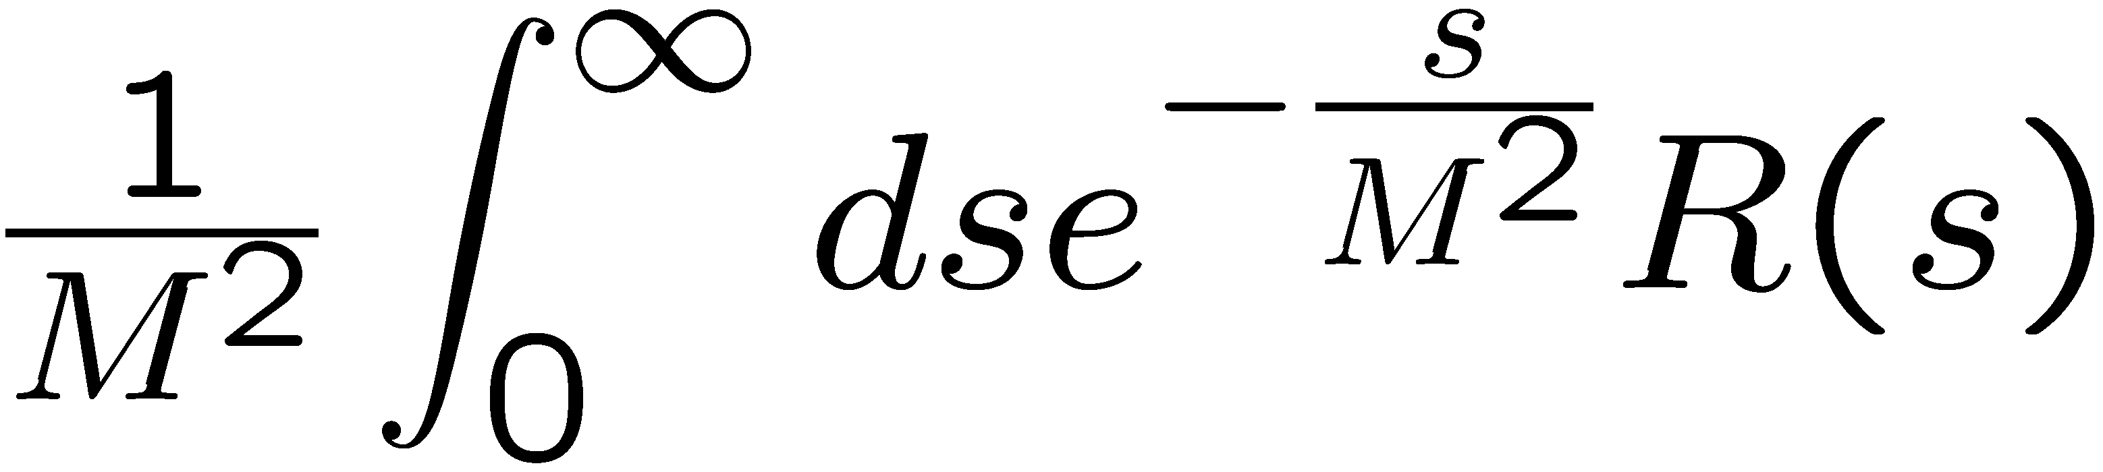
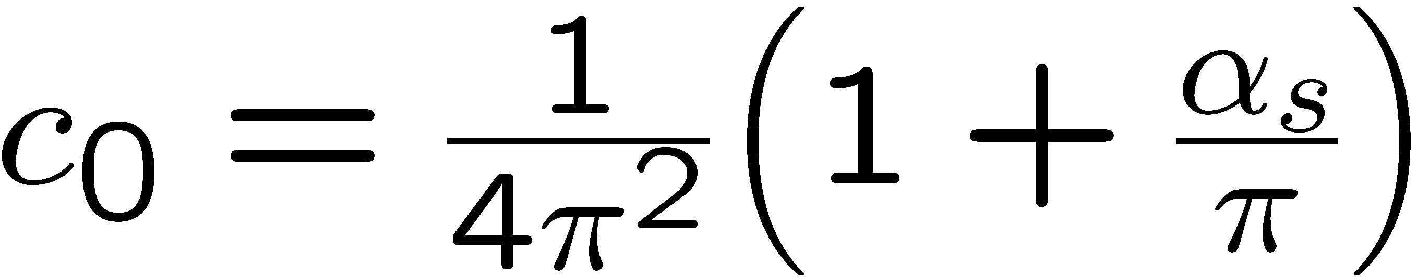
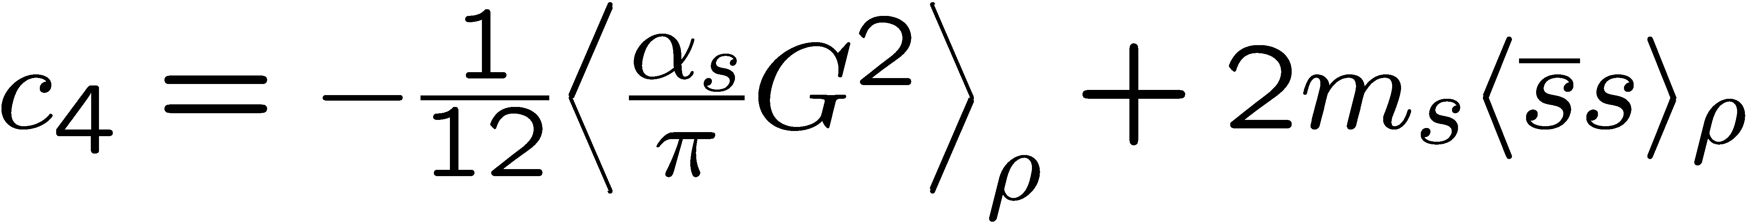
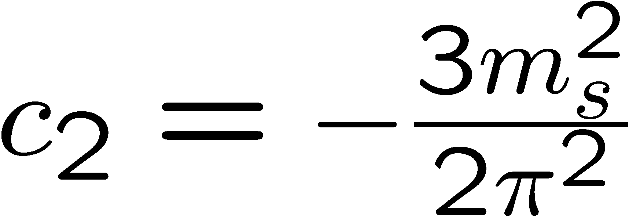



Moment analysis of obtained spectral functions
Starting point: Borel-type QCD sum rules
Large M limit
Finite-energy sum rules

Slide 20


Consistency check
(Vacuum)
Are the zeroth and first momentum sum rules consistent with our phenomenological spectral density?
Zeroth Moment
First Moment
Consistent!

Slide 21




Consistency check
(Nuclear matter)
Are the zeroth and first momentum sum rules consistent with our phenomenological spectral density?
Zeroth Moment
First Moment
Consistent!

Slide 22


What about the chiral condensate?
At finite density:
πN-σ term
Newest fit to πN scattering data
(value still not well known)
Recent lattice QCD determination at physical quark masses
M. Hoferichter, J. Ruiz de Elvira, B. Kubis and U.-G. Meißner,
Phys. Rev. Lett. 115, 092301 (2015).
S. Durr et al., (BMW Collaboration),
arXiv:1510.08013 [hep-lat].

Slide 23






D-meson in nuclear matter
The sum rules we use:

Slide 24



Results
K. Suzuki, P. Gubler and M. Oka, arXiv:1511.04513 [hep-ph].

Slide 25


Results
increase!
To be measured at the CBM (Compressed Baryon Matter) experiment at FAIR, GSI?
Possible explanation within a quark model:
A. Park, P. Gubler, M. Harada, S.H. Lee, C. Nonaka and W. Park, arXiv:1601.01250 [nucl-th].
And/or at J-PARC??

Slide 26
Summary
The φ-meson mass shift in nuclear matter constrains the strangeness content of the nucleon.
  Consistency check between experiment, lattice QCD and sum rules
Heavy-light mesons (e.g. D-mesons) in nuclear matter are unique probes for partial restauration of chiral symmetry
  πN-sigma term determines magnitude of mass shifts
Outlook
Further improve the sum rule computation
Complete OPE up to operators of mass dimension 6
Consider finite momentum
Make predictions for the E16 experiment at J-PARC

Slide 27
Backup slides

Slide 28

In-nucleus decay fractions for E325 kinematics
Taken from: R.S. Hayano and T. Hatsuda, Rev. Mod. Phys. 82, 2949 (2010).

Slide 29








Other experimental results
There are some more experimental results on the φ-meson width in nuclear matter, based on the measurement of the transparency ratio T:
Measured at SPring-8 (LEPS)
Measured at COSY-ANKE
T. Ishikawa et al, Phys. Lett. B 608, 215 (2005).
A. Polyanskiy et al, Phys. Lett. B 695, 74 (2011).

Slide 30

Results of test-analysis (using MEM)
P. Gubler and K. Ohtani, Phys. Rev. D 90, 094002 (2014).

Slide 31


The strangeness content of the nucleon: results from lattice QCD
Taken from M. Gong et al. (χQCD Collaboration), arXiv:1304.1194 [hep-ph].
Still large systematic uncertainties?
y ~ 0.04

Slide 32




Starting point:
Rewrite using hadronic degrees of freedom
Kaon loops

Slide 33


Vacuum spectrum
(Vacuum)
How is this spectrum modified in nuclear matter?
Is the (modified) spectral function consistent with QCD sum rules?
Data from
J.P. Lees et al. (BABAR Collaboration), Phys. Rev. D 88, 032013 (2013).

Slide 34

More on the free KN and KN scattering amplitudes
For KN:
Approximate by a real constant (↔ repulsion)
T. Waas, N. Kaiser and W. Weise, Phys. Lett. B 379, 34 (1996).
For KN:
Use the latest fit based on SU(3) chiral effective field theory, coupled channels and recent experimental results (↔ attraction)
Y. Ikeda, T. Hyodo and W. Weise, Nucl. Phys. A 881, 98 (2012).
K⁻p scattering length obtained from kaonic hydrogen (SIDDHARTA Collaboration)

Slide 35




Ratios of moments
Vacuum:
Nuclear Matter:
(S-Wave)
(S- and P-Wave)
Interesting to measure in actual experiments?

Slide 36



Second moment sum rule
Factorization hypothesis
Strongly violated?

Slide 37


Why does the D meson mass increase at finite density?
A possible explanation from a simple quark model:
replace with 1/p and minimize E
Increasing mass for sufficiently small constituent quark masses!

Slide 38


Comparison with more accurate quark model calculation:
Wave function

