Slide 1
An effective field theory for dense nuclear matter
Chang Ho Hyun
Panagiota Papakonstantinou,
Yeunhwan Lim,
Young-Ho Song,
Tae-Sun Park
31th Reimei Workshop, Tokai, Japan
January 18, 2016

Slide 2
Contents
Introduction
Old wisdom
Strategy
Results
Summary and outlook

Slide 3
1. Introduction
EFT for few-nucleon systems at low energies
- Pionful: pion exchanges, heavier mesons integrated out
- Pionless: pions treated as massive degrees. all interactions in point form
- 2N, 3N interactions
- External probes

Slide 4
EFT for dilute many-body systems: V_{lowk}, pionful theory, pionless theory
(Semi) EFT for dense many-body systems: density matrix expansion, expansion of Skyrme forces in powers of momentum
In this work, results obtained in 1960’s and 1970’s are revived in the light of EFT

Slide 5
2. Old wisdom
Low-density expansion for the ground-state energy per particle of a dilute Fermi gas
M. Ya. Amusia, V. N. Efimov, Ann. Phys. (NY) 47 (1968)
G. A. Baker, Rev. Mod. Phys. 43 (1971)
R. F. Bishop, Ann. Phys. (NY) 77 (1973)
Pionless EFT confirmed old wisdom
H.-W. Hammer, R. J. Furnstahl, Nucl. Phys. A 678 (2000)

Slide 6
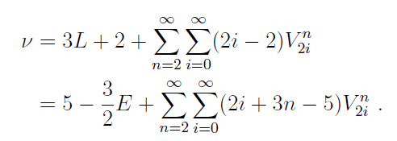
Pionless EFT
- Lagrangian
- Potential
- Counting rule: expansion in powers ν of k/Λ
L: # of loops
E: # of external nucleon lines
V^{n}_{2i}: # of n body vertices with 2i derivatives

Slide 7
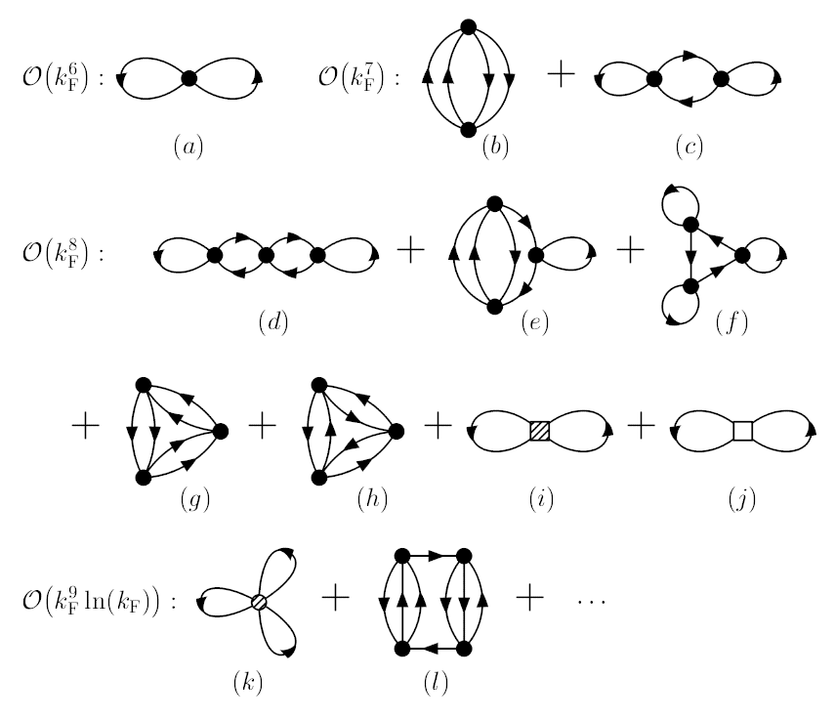
- Hugenholtz diagrams
Thanks to the counting rules, ordering the diagrams is well organized and systematic

Slide 8
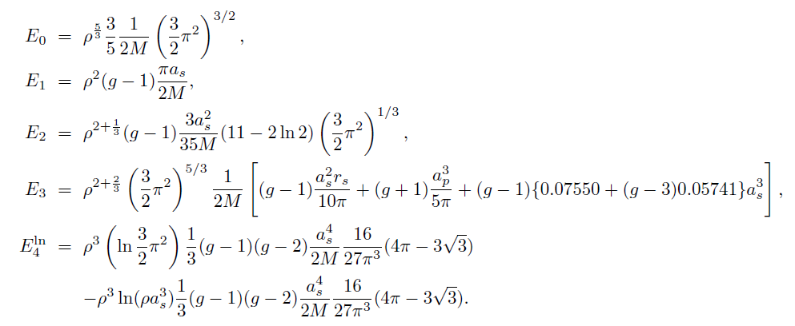
- Energy per particle in terms of density from pionless EFT
- Skyrme force energy density functional
Choice of α: 1 or 1/3

Slide 9
3. Strategy
Pionless EFT and Skyrme force+EDF are independent
In terms of powers of the density, two are very similar
Success of Skyrme force+EDF makes one apply EFT to dense nuclear matter and heavy nuclei
Mapping to dense nuclear matter: new scale
- Lightest degree in dilute system: pion
- Relativistic mean field model: sigma, omega, rho, …

Slide 10
Assume rho-meson mass m_{ρ} the lightest scale
Expand amplitudes (Feynman diagrams) in powers of k_{F}/m_{ρ}
Then the counting rules for the dense nuclear matter are the same as those in the dilute system
We can import the functional form obtained in the dilute system
Compatibility with measurement
Check convergence
Identify range of validity

Slide 11
General form and fitting
- α_{k}: fitted to saturation properties of symmetric matter
- β_{k}: fitted to pure neutron matter EoS
symmetric matter properties: saturation density, binding energy, compression modulus
pure neutron matter EoS: chiral perturbation two- and three-nucleon calculation
C. Drischler, V. Soma, A. Schwenk, Phys. Rev. C 89 (2014) (DSS)
S. Gandolfi, J. Carlson, S. Reddy, Phys. Rev. C 85 (2012) (GCR)

Slide 12
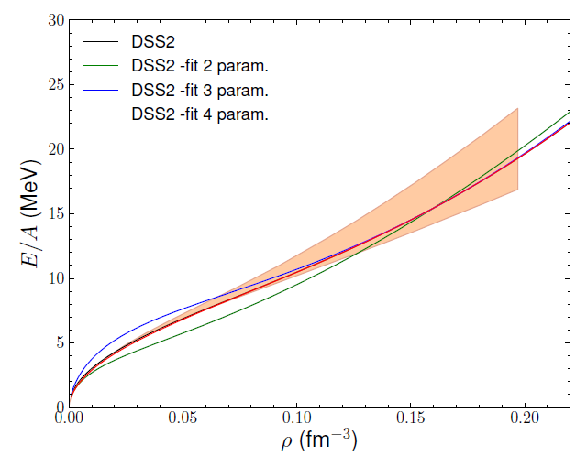
4. Preliminary results
Pure neutron matter: DSS2
2 param.: c₀, c₁
3 param.: c₀-c₂
4 param.: c₀-c₃
Fitting conditions
E/A at ρ₀
E/A at 2ρ₀
Pressure at ρ₀
Incompressibility at ρ₀

Slide 13
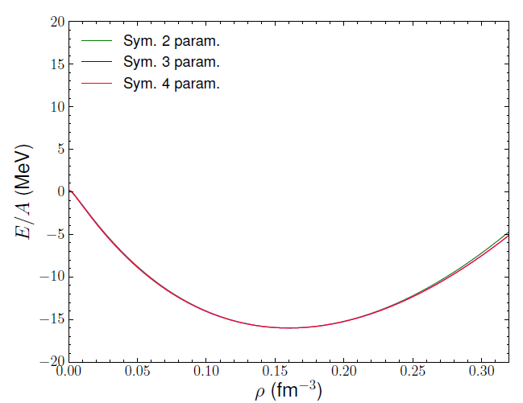
Symmetric nuclear matter
Fitting conditions
ρ₀
Binding energy
Incompressibility
Derivative of incompressibility

Slide 14
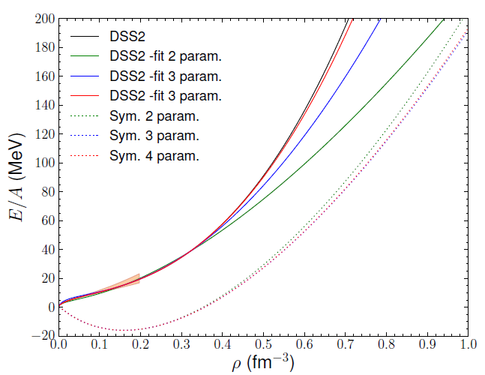
Extrapolation to high density: DSS2

Slide 15
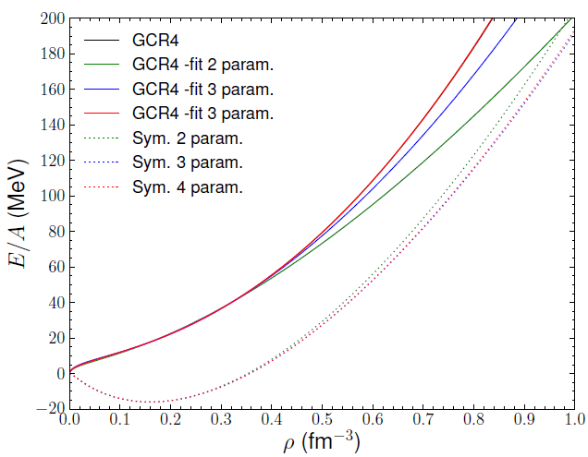
Extrapolation to high density: GCR4

Slide 16
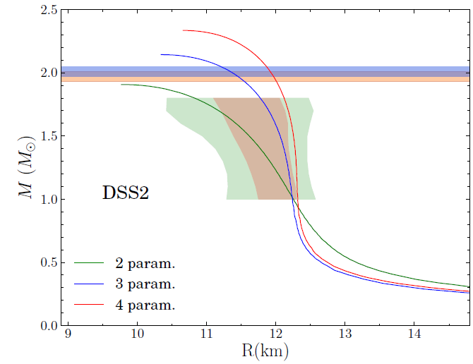
Neutron star mass-radius: DSS2

Slide 17
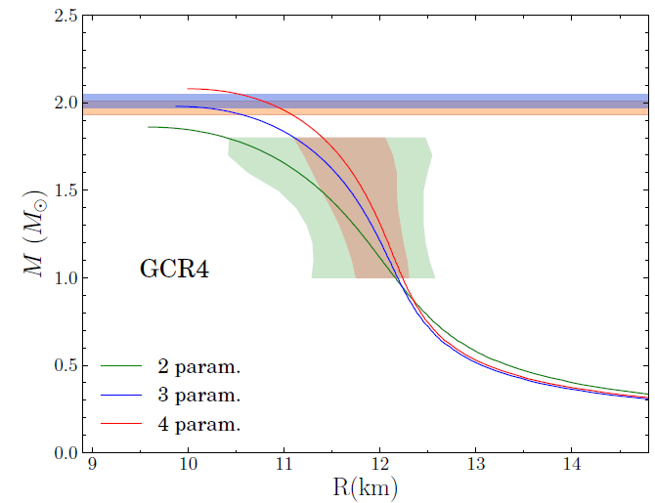
Neutron star mass-radius: GCR4

Slide 18
5. Summary and outlook
Pionless EFT for dilute Fermi system adapted to dense nuclear matter
Parameters fitted to pure neutron matter and symmetric nuclear matter EoSs
Improvement and convergence with higher orders
Up to N³LO, extrapolation to low and high densities agrees well with ‘real data regardless of what the real data are’
Consistent with neutron star mass observation

Slide 19
Role and implication of the log-term in dense matter
Dependence on the input data and fitting procedure
Contribution of higher orders
Application to nuclei: extension of Skyrme force

