Slide 1
Recalling AGS -- Heavy Ion Programs
Hideki Hamagaki
(hamagaki_hideki@pilot.nias.ac.jp)
Institute for Innovative Science and Technology
Nagasaki Institute of Applied Science

Slide 2
Contents
Introduction
Strangeness Production
Baryon Stopping
Collective Behavior
Summary & some comments

Slide 3
Introduction

Slide 4
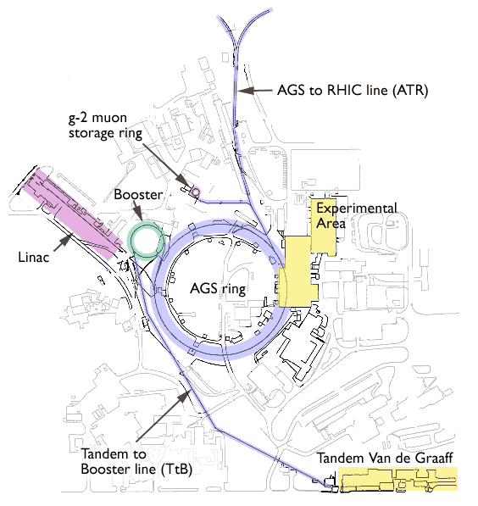
Alternating Gradient Synchrotron
The first accelerator utilizing strong-focusing principle
July 29, 1960: 33 GeV was achieved
Three Nobel Prizes:
  1962: L. Lederman, M. Schwartz and J. Steinberger; discovery of the muon neutrino --> 1988 Nobel Prize
  1964: J. Cronin and V. Fitch; discovery of CP violation in Kaon decay --> 1980 Nobel Prize
  1974: S. C.C. Ting; discovery of J/ψ --> 1976 Nobel Prize
1986: AGS Complex was completed
1991: AGS Booster; more intense proton beams and heavy ions
2000~: Injector for RHIC

Slide 5
Heavy Ion Experiments at AGS
Objective: Search for a Quark-Gluon Plasma (QGP)
  Particular emphasis is on "strangeness enhancement"
  Baryon stopping, collective behaviors, HBT correlations, H di-baryon, strangelet, …
1986: AGS Complex was completed
1st generation (1986 – 1991): “not-so-heavy” ion
  ¹⁶O & ²⁸Si, E_{lab}^{max} = 14.5 A GeV
1991: AGS Booster, to have more intense proton beams and heavy ions at the AGS
2nd generation (1992 – 1994): "heavy" Au ions
  ¹⁹⁷Au, E_{lab}^{max} = 11.5A GeV

Slide 6
Heavy Ion Experiments at the AGS
Experiment | Beam | Technology | Observables
E802/E859 | Si | Single arm magnetic spectrometer | Spectra (π, p, K±), HBT
E810 |  | TPCs in magnetic field | Strangeness (K⁰_{s}, Λ)
E814 |  | Magnetic spectrometer + calorimeters | Spectra (p) + E_{t}
E864 | Au | Open magnetic spectrometer | Strangelet
E866 |  | Upgrade of E802; 2 magnetic spectrometers (TPC, TOF) | Strangeness (Kaons)
E877 |  | Upgrade of E814
E891 |  | Upgrade of E810
E895/E910 |  | EOS TPC | Spectra (π, p, K±), HBT
E896 |  | Drift chamber + neutron detector | H⁰ Di-baryon, Λ
E917 |  | Upgrade of E866

Slide 7
E802/E859/E866 Experiment
Single-arm spectrometer with good PID using TOF
For E859, 2nd level PID trigger was added
For E866, forward arm was added for measuring protons at mid-rapidity in Au+Au collisions

Slide 8
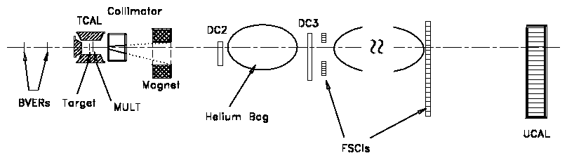
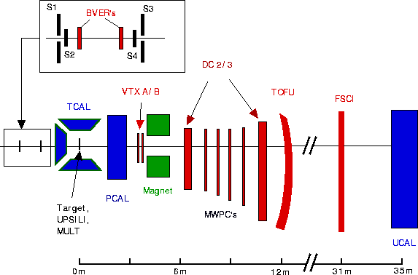
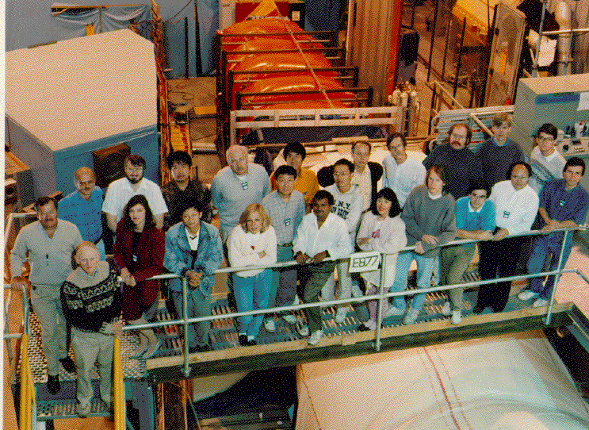
E814/E877 Experimental Setup
  Forward spectrometer
  TOF & Calorimetry

Slide 9
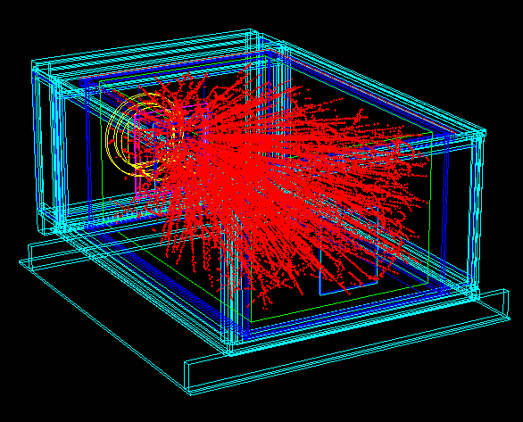
E895/E910 Experiment
EOS TPC; developed for Bevalac experiment
Spectra (, p, K), particle correlation, HBT

Slide 10
AGS E896 Experiment
Primary objective = H dibaryon search
Open forward spectrometer
  Two magnets: Sweeper (75 kG) + Analyzer (18 kG)
  DDC (distributed drift chamber): 24 set x 6 plains = 144
  TOF system
  Muffins: neutron detector
  …

Slide 11
Strangeness Production

Slide 12
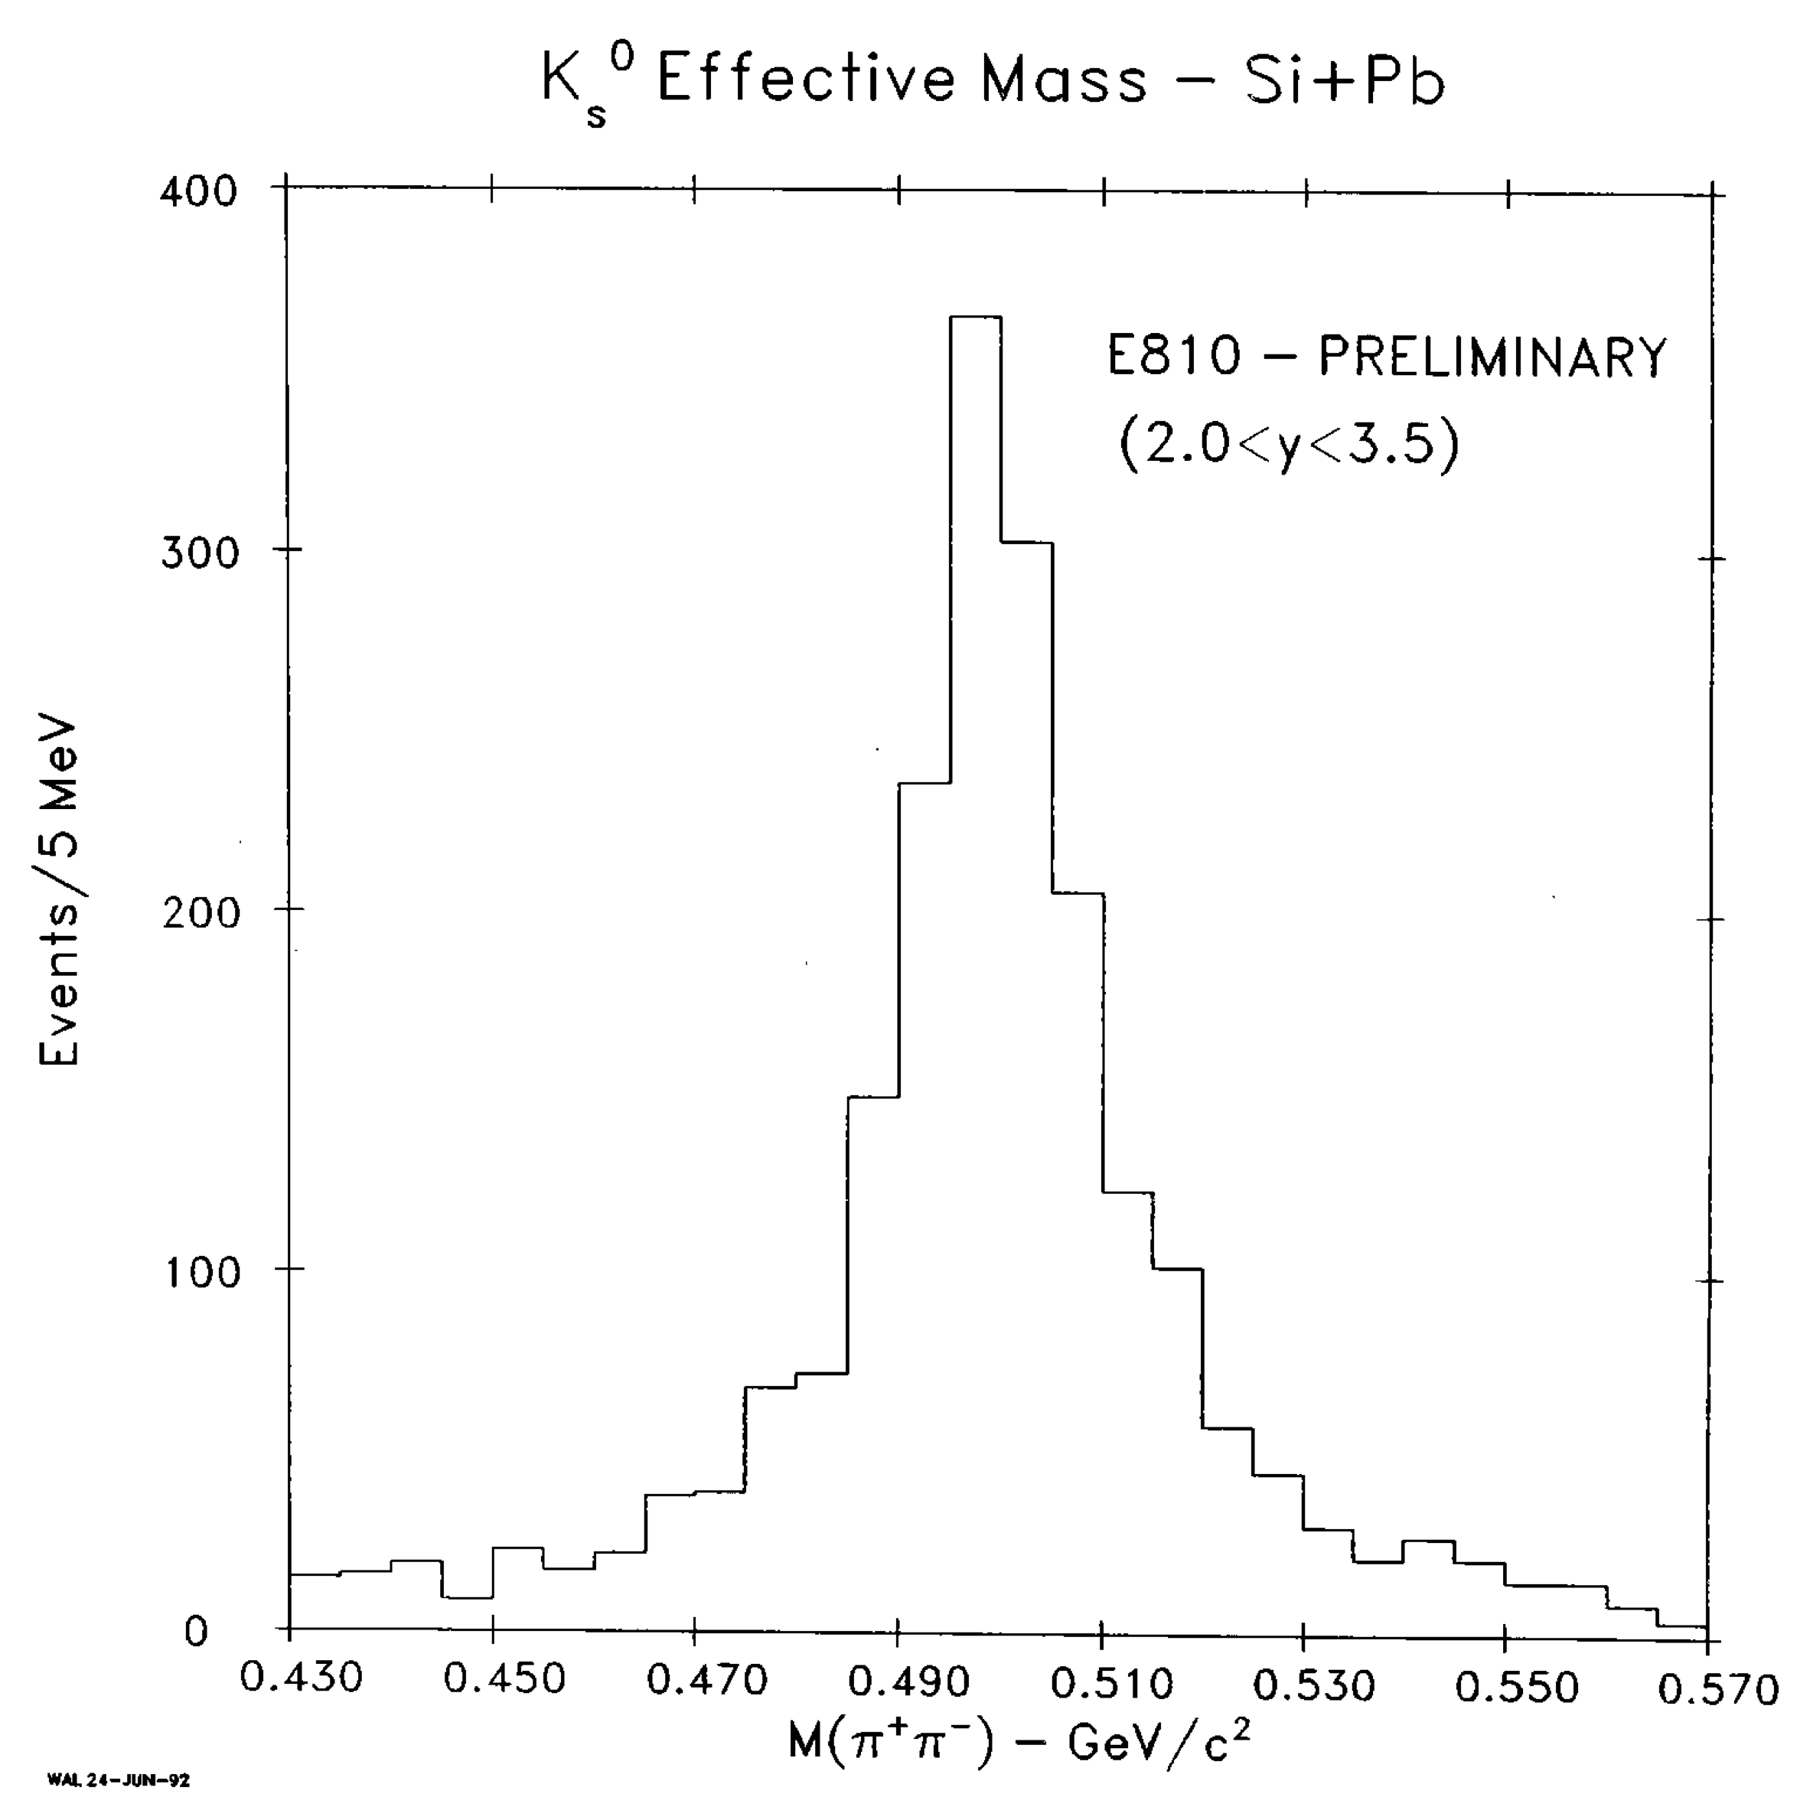
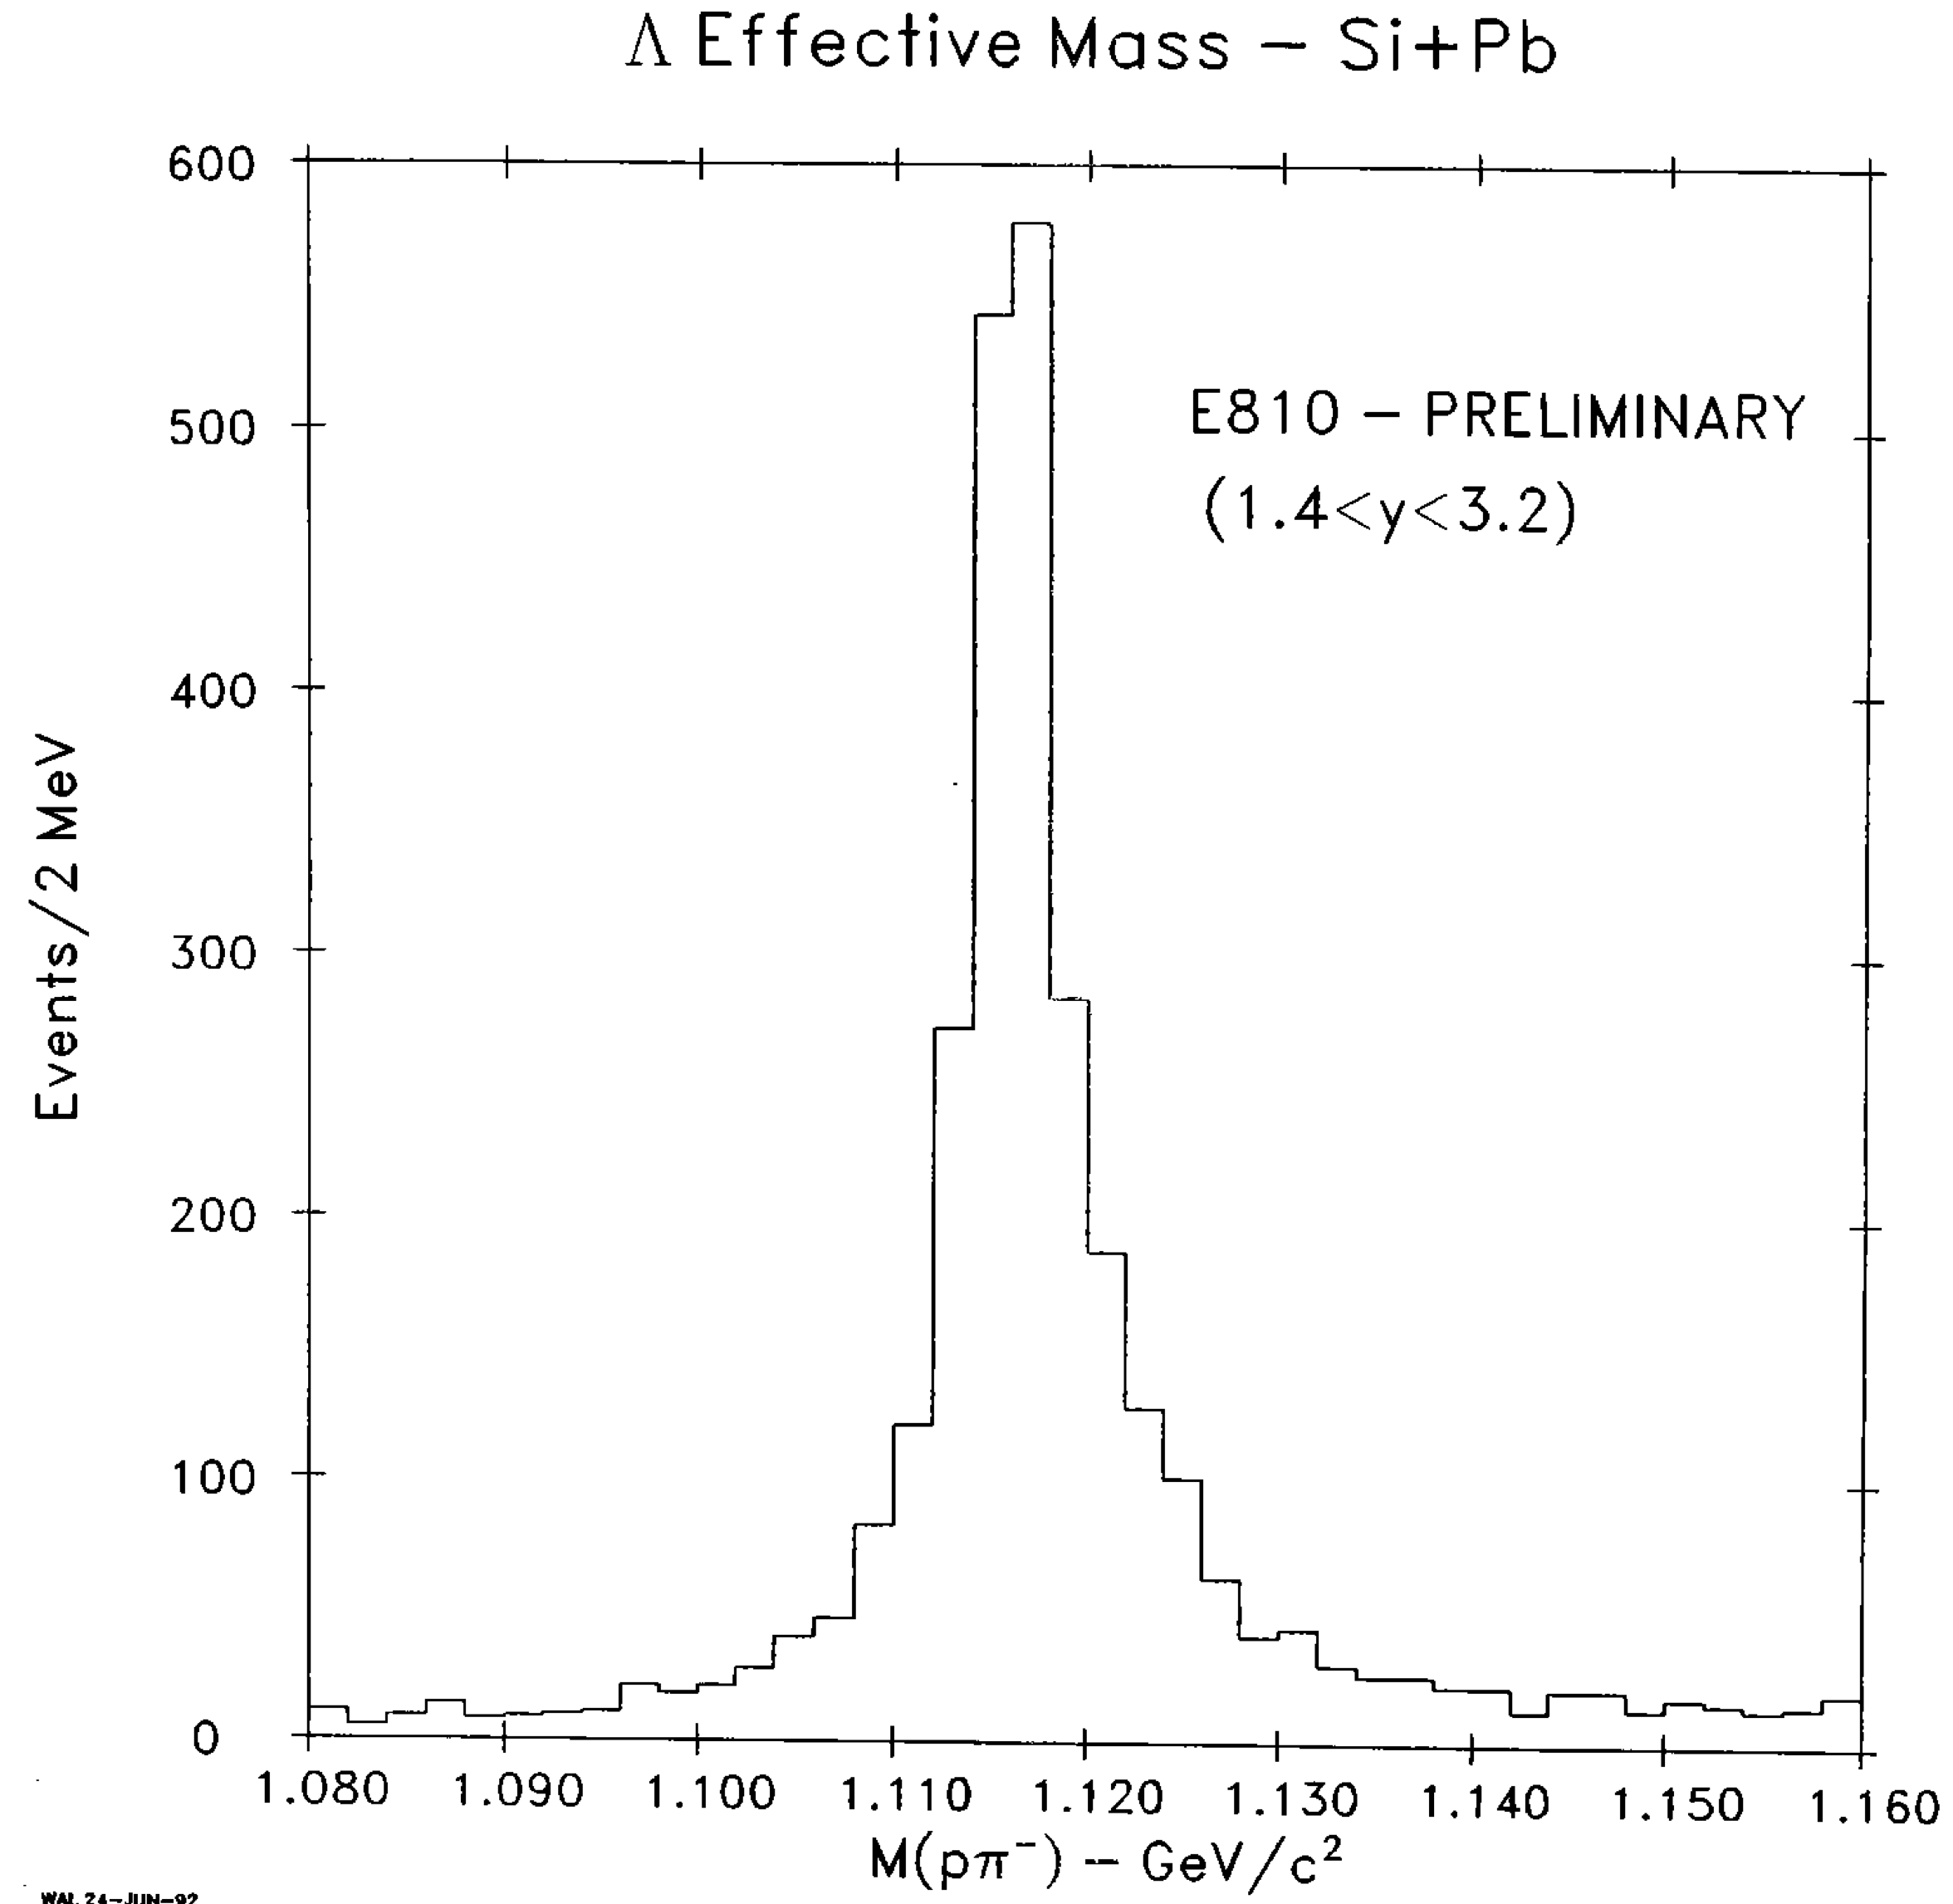
Strangeness Production
Enhancement of strangeness production has been considered as a good probe of QGP formation
Major topic of the AGS experiments
  E802/E895/E866; K and π
  E810, E895; K⁰, Λ, … (V⁰)

Slide 13
Strangeness Enhancement at AGS
Clear increase of K⁺ yield and K⁺/N_{pp} with increase of N_{pp} (number of projectile participant), in 11.6 A GeV Au+Au collisions
[Y(K⁺)/N_{pp}(max)]/Y(K+)pp
~ 0.135/0.037 = 3.6

Slide 14
Beam Energy Dependence
K/π increases with increase of s^{1/2} of Au+Au collisions
Double ratio (K/π)_{AuAu}/(K/π)_{pp} decreases with increase of s^{1/2}
  This is due to that secondary production is more important at small s^{1/2}

Slide 15
Hyperon Production
Increase in hyperon yield with increase of the number of participant
Yield enhancement of multi-strange hyperon Ξ⁻ is larger than that of single-strange hyperons Λ and Σ⁰
All strangeness data at AGS are in accord with the predictions by the RQMD calculation
* RQMD = one of the popular hadron-based transport models

Slide 16
Strangeness Production vs. (s_{NN})^{1/2}
Peak-like structure in the K⁺/π⁺ ratio at beam energies of 20-30A GeV will need confirmation by an independent experiment
Excitation function of multi-strange hyperon production has to be measured with better accuracy
J-PARC energy may not be enough to be competitive in this study

Slide 17
Baryon Stopping

Slide 18
Baryon Stopping
Baryon stopping in general reflects what fraction of colliding energy is spent for particle production
  Rapidity shift δy of baryons has been used to quantify the baryon stopping
  In p-p collisions, rapidity shift δy ~ 1 is a ballpark number
At the AGS energies, it has a particular importance, since a state with maximum baryon density is expected to be achieved

Slide 19
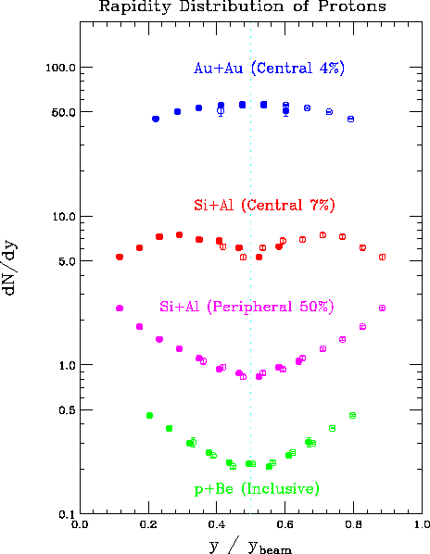
Stopping at the AGS
(dN/dy)_{p} were measured in the E802/E859/E866 experiments
y_{BT} (= y_{beam} – y_{target})
  3.43 -- 14.6 AGeV/c p & Si
  3.2 -- 11.6 AGeV/c Au
(dN/dy)_{p}[Si-Al peripheral] is very similar in shape with (dN/dy)_{p}[p-Be] (~ (dN/dy)_{proton}[p-p])
Two bumps in (dN/dy)_{p} in Si + Al central collisions
Single bump at mid-rapidity in Au + Au central collisions

Slide 20
How Complete is the Stopping
(dN/dy)_{p} and inverse slope T are compared with (1) thermal model (Boltzman distribution), and (2) RQMD
Wide (dN/dy)_{p} distribution may be interpreted as a manifestation of incomplete stopping or strong longitudinal (collective) expansion

Slide 21
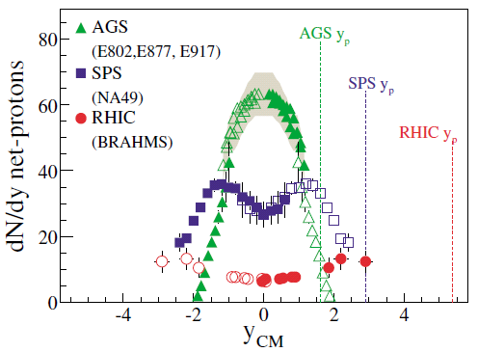
Baryon Stopping vs. y_{beam}
Large net-baryon density at mid-rapidity at AGS
Rapidity shift of baryons δy increases linearly with y_{beam} at low energy, but the trend is different at RHIC & LHC (scaling regime)

Slide 22
Collective Behavior

Slide 23
Directed Flow = Possible
Signature of QGP
Ideal hydro calculations predict the appearance of anti-flow in central collisions around the first order phase transition, due to softening of EOS (in the vicinity of the 1st order phase transition region)
Directed flow of protons p_{x}(y) develops a negative slope around mid-rapidity
Possible collapse of flow at beam energies of E_{Lab} ≈ 8 A·GeV

Slide 24
Energy Dependence of Directed Flow
Experimental v₁ data did not show an expected sudden change
Comparison with the transport models – not good agreement
A linear extrapolation of the AGS data suggest that a collapse of the directed proton flow might occur at E_{Lab} ≈ 30 A·GeV

Slide 25
Direct Flow at SPS
Directed flow v₁ and elliptic flow v₂ of protons in 40 AGeV Pb + Pb collisions (NA49), are indicating the collapse of proton flow
  The results are compared with the transport models,
  3-fluid hydro model with a hadronic EoS (solid line) overestimates both the slope of v1 and the strength of v2 for non-central collisions.
J-PARC energy may not be enough to be competitive in this study

Slide 26
Elliptic Flow versus. E_{lab}
Boltzmann-equation model
BUU model
Crossover from squeeze-out to in-plane at ~4 AGeV
  Relevance to the change of stiffness of EoS?
CAVEAT: Strength of the collective flow depends not only on the nuclear EOS, but also on the in-medium nucleon-nucleon cross sections, and on momentum-dependent interactions

Slide 27
Summary

Slide 28
Summary
Several topics at AGS are visited
  Strangeness production
  Baryon stopping
  Collective behavior
  Several important topics, such as HBT, are omitted
Lesson: Comparison with the hadron transport calculations is a method to be taken to describe the space-time evolution of the colliding system at this energy region
In the following is my wishing list at J-PARC
  EoS
  Multi-hyperon correlation & resonance
  Low mass lepton pair

Slide 29
EoS at finite baryon density
HI collisions at J-PARC might provide unique opportunity to study EoS at finite baryon density
CAVEAT: Strength of the collective flow of protons depends not only on the nuclear EOS, but also on the in-medium nucleon-nucleon cross sections, and on momentum-dependent interactions --> interpretation is ambiguous without proper implementation
Multi-strange hyperon will add new information on EoS at finite densities
  Yield of multi-strange hyperons is sensitive to the density, and, hence on the compressibility of baryonic matter
  Excitation function of the yield and the collective flow

Slide 30
Multi-hyperon correlation & resonances
J-PARC might provide good opportunity of studying multi-hyperon correlation, and searching new resonances
Its expected high intensity make this study very unique and interesting
Extension of di-baryon search at AGS
Valuable information on possible strange matter (strangelet)
May have relevance to "multi-Kaonic nuclei"

Slide 31


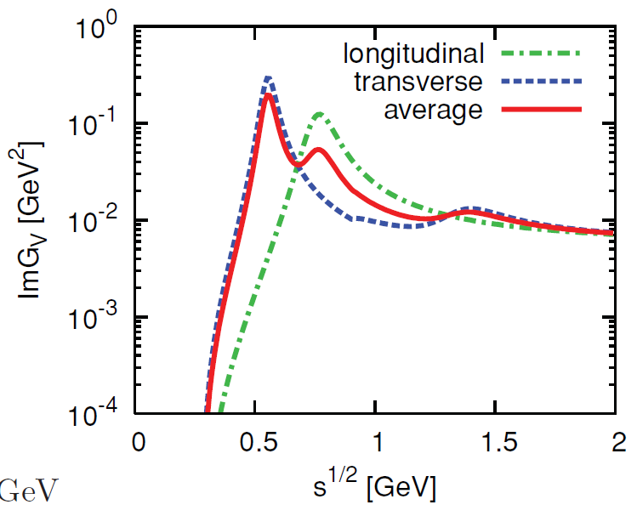
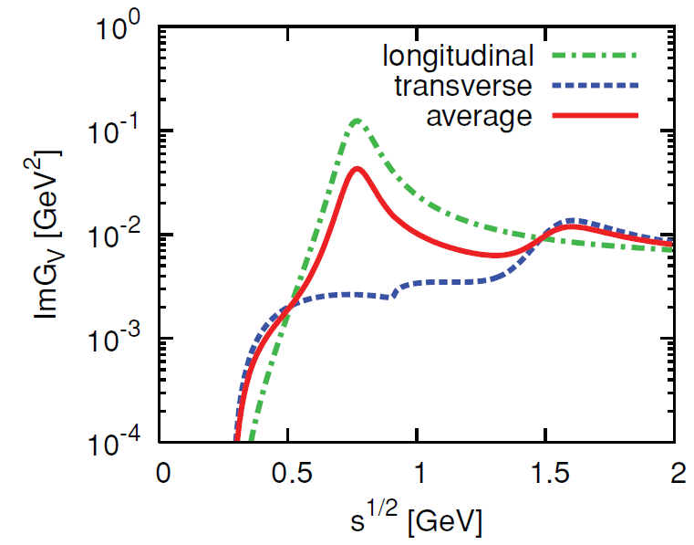
Low-mass pair
Physics emphasis is on the Chiral symmetry restoration
Extremely precise measurement is needed in order to address comfortably the mixing of chiral partners; ρ and a₁ – Just another measurement shall be avoided
Close collaboration with theorists will be demanding
Will J-PARC beam energy be optimum for this study?

Slide 32
Backup Slides

Slide 33
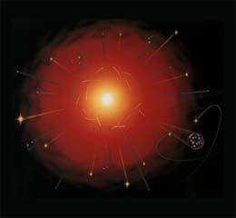
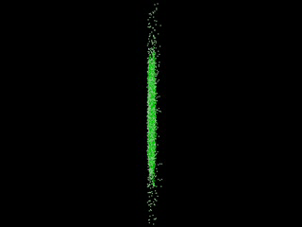
QCD Matter
Realization of hot matter in early universe, by smashing heavy nuclei together
Big Bang
Quark Gluon Plasma (QGP)
Temperature
partonic d.o.f
Confinement of quarks
Chiral symmetry
Neutron star
Quark star
Color
superconductivity
Hadronic matter
Baryon density
Notes:
33

Slide 34
Participant-Spectator Picture
Classical description with impact parameter
  Small de Broglie wave length → classical trajectory
  Large longitudinal momentum → trajectory is straight
Clear separation of participant and spectator region
Spectator -- projectile fragment
Participant
Spectator – projectile fragment

Slide 35
Alternating Gradient Synchrotron
The first accelerator based on strong-focusing principle
July 29, 1960: Design energy of 33 GeV achieved
Three Nobel Prizes:
  1962: L. Lederman, M. Schwartz and J. Steinberger; discovery of the muon neutrino --> 1988 Nobel Prize
  1964: J. Cronin and V. Fitch; discovery of CP violation by experimenting with Kaons --> 1980 Nobel Prize
  1974: S. C.C. Ting; discovery of J/ψ --> 1976 Nobel Prize
1986: AGS Complex was completed
  Beam transfer line from Tandem Van de Graaff to AGS
1991: AGS Booster, to have more intense proton beams and heavy ions
2000~: Injector for RHIC

Slide 36
AGS Heavy Ion Complex

Slide 37
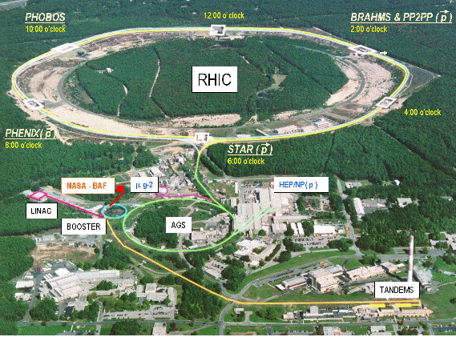

Slide 38
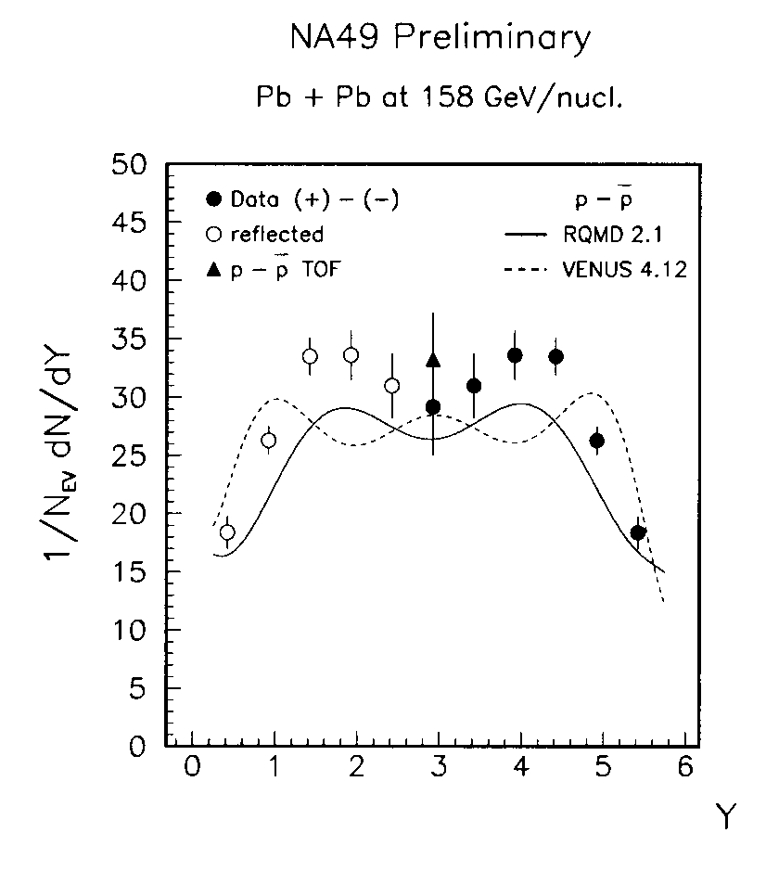
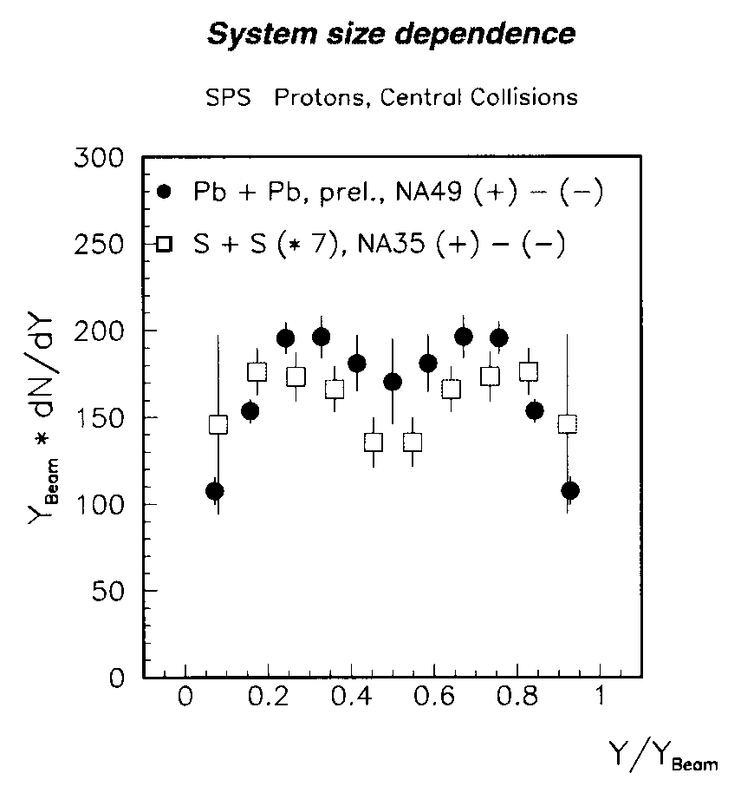
Stopping at CERN-SPS
y_{B} – y_{T} ~ 6
Large rapidity loss, ~2 was observed
Pb + Pb and S + S
Smaller width in Pb+ Pb

Slide 39
Net Baryon Density vs Colliding Energy
AGS, SPS & RHIC: dN/dy of net-proton was measured
At LHC, calorimetric energy measurement was used

Slide 40
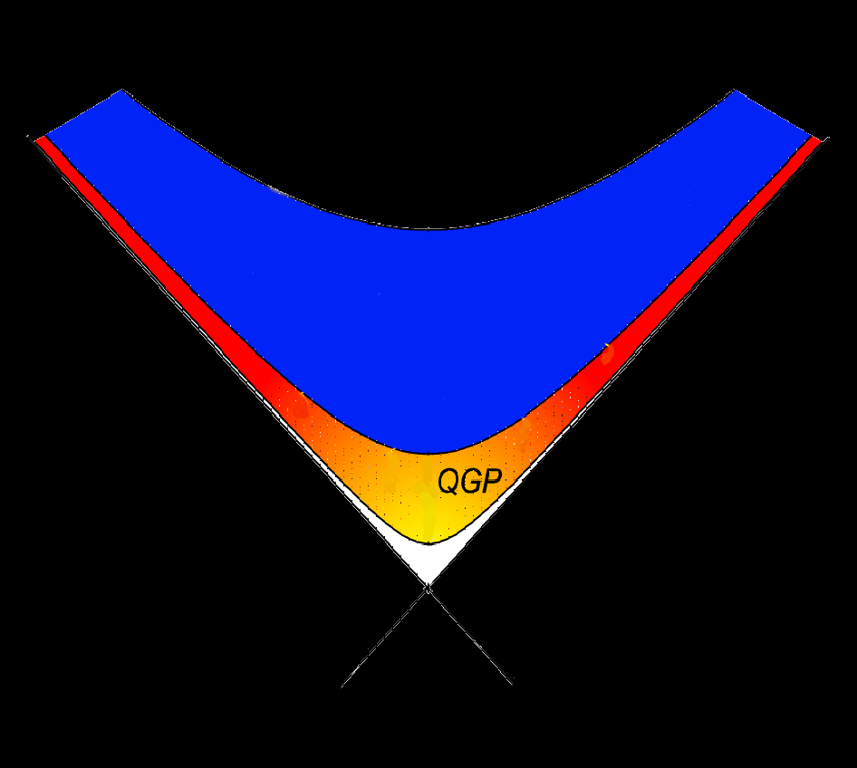
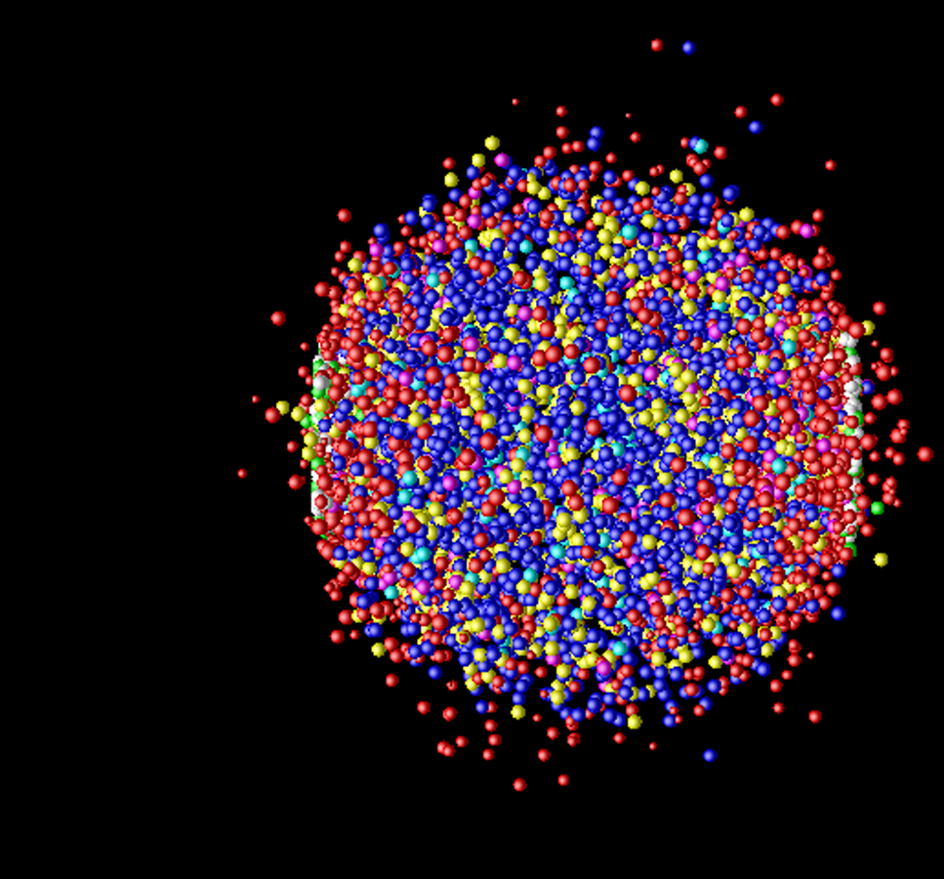
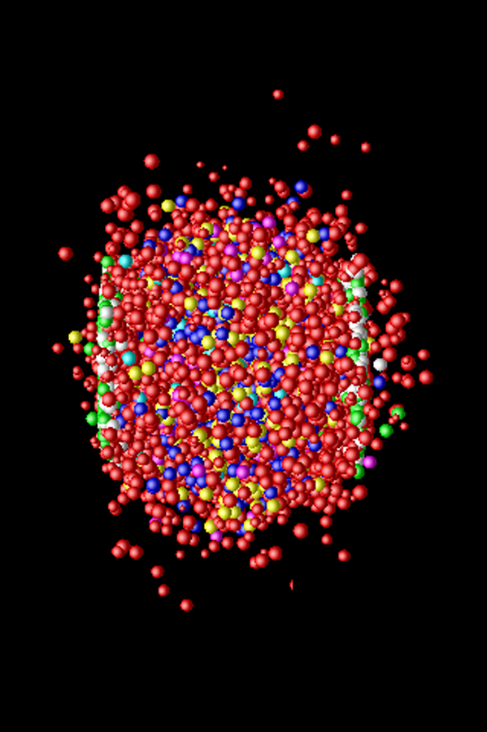
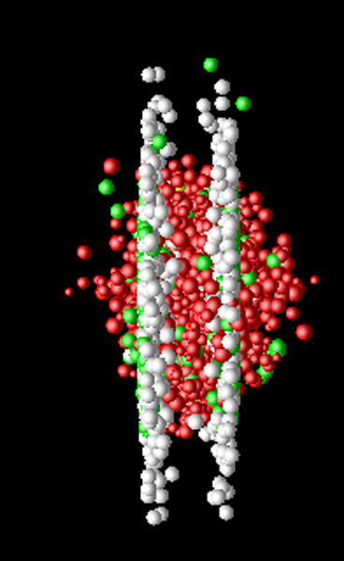
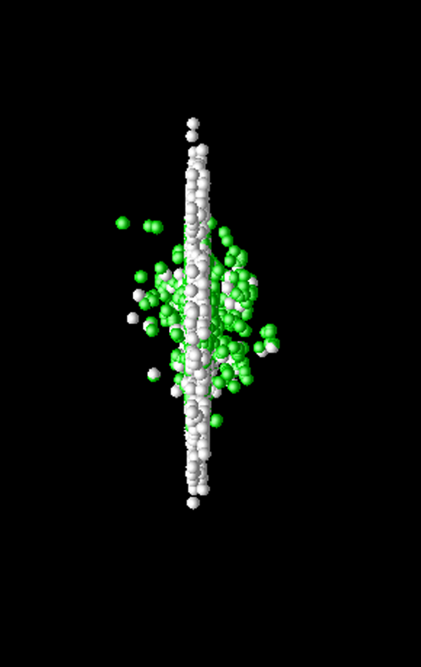
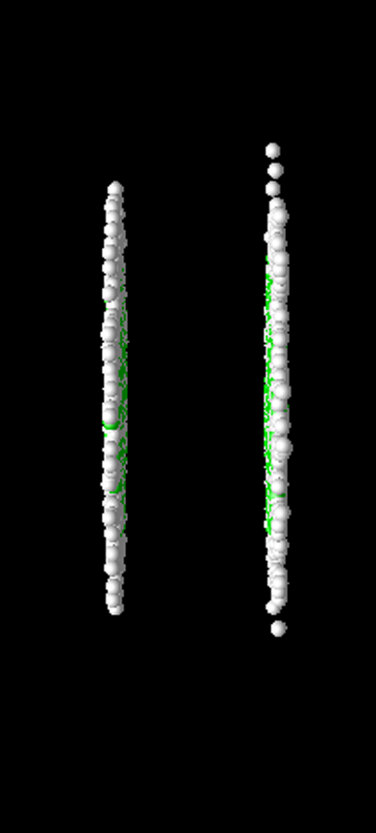
Space-time Evolution of Collisions
time
Freeze-out
→ Expansion →
Hadronization
QGP
Thermaliztion
Hard Scattering
space
Au
Au

Slide 41
Space-Time Evolution at AGS Energy
time
A picture in the right, good for RHIC/LHC, is not applicable at AGS energies
  At RHIC/LHC (scaling regime), differentiation between initial collisions and later hydro-dynamical space-time evolution holds well
At AGS (stopping regime)
  No sharp cut between initial collisions and successive occurrences
space

Slide 42
Stopping Regime
E_{Lab} < several x 10 AGeV
High net baryon density in the mid-rapidity region
Rough estimation of Initial Baryon Density & Energy Density
At BNL-AGS
E_{lab} = 14.5 GeV/c γ_{CM} = 2.87
ρ_{B} = 5.7 ρ₀ ε = 2.1 GeV/fm³
Monte Carlo simulation provides 1.5 ~ 2 times higher baryon density

Slide 43
Collective Behavior – Radial Expansion -

Slide 44
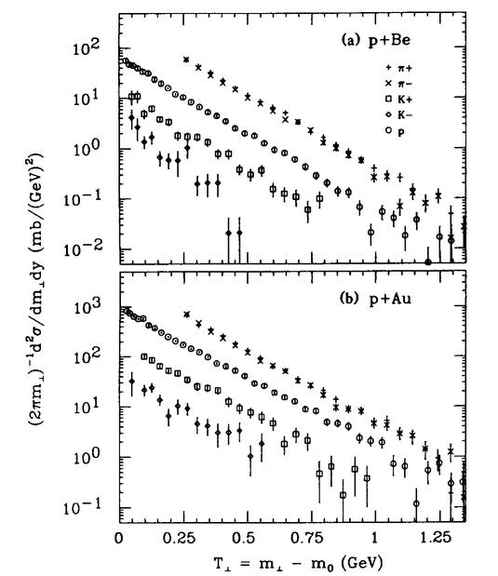
m_{T} scaling
Hadron spectra at low p_{T} in p-p & p-A collisions are very similar in shape independent of the particle species
They can be represented by an exponential function of m_{T} with the same inverse slope parameter T
Mass ordering appears in HI collisions, due to collective radial expansion of the system
BNL-AGS E802 Exp.

Slide 45
A Radial Flow Model
Isotropic thermal source with raidus R
β_{f}
p
Isotropic Flow Model
---- K.S. Lee and U. Heinz, Z. Phys. C 43 (1989) 425.
proton
pion
Kaon

Slide 46
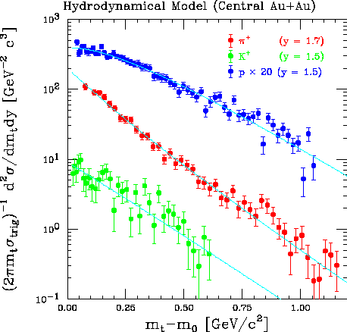
Hadron Spectra at AGS
Spectral shape of p, K & π were fitted well simultaneously with the radial flow model calculation
  β_{S} = 0.69 (0.03)
  n = 0.5 (0.1)
  T = 91.2 (2.6) MeV
Spectral shape of proton and pion are sensitive to the velocity profile parameter n
Proton spectrum shows a non-exponential shape, which was a new finding
E866 exp. at 11.6 AGeV Au+Au central collision

Slide 47
Direct & Elliptic Flow Measurement
10.8 A GeV/c Au+Au collisions
Proton & pion behave differently
RQMD does not reproduce the trend

Slide 48
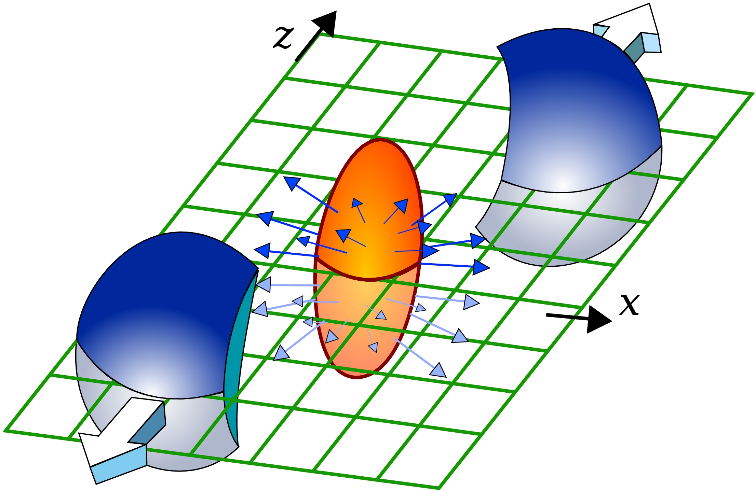

Elliptic Flow and Thermalization
short mfp
Conversion of spatial anisotropy
to momentum anisotropy
Non-central collisions produce hot region with elliptical shape
The resultant magnitude of azimuthal anisotropy is a sensitive probe of thermalization and property of matter (P, η/s)
long mfp

Slide 49
A Caveat on Hydro.
ALICE: arxiv1606.06057v1
> Hydro works very well at RHIC & LHC, but advanced models are hybrid of hydro and a hadron cascade
> An event-by-event VISHNU model; hybrid of "(2+1)d viscous hydro" and "hadron cascade (UrQMD)"
  with fluctuating initial conditions generated with AMPT
  the initial time of hydro evolution; τ₀ = 0.4 fm/c
  Transition from hydro to hadron cascade at T = 165 MeV
  η/s = 0.08 (~1/4π)
The hydro models for RHIC & LHC may
not be used for the AGS results

Slide 50
Beam Energy Dependence of v₂
Positive at very low energy
  bouncing off of the colliding nuclei
Negative at low energy
  blocking of particle emission in the transverse direction by the spectator nucleons
Crossover region from negative to positive
Positive at higher energy
  Gradual increase with s^{1/2}
  Trend continues to LHC
  Larger pressure at higher s^{1/2}

Slide 51
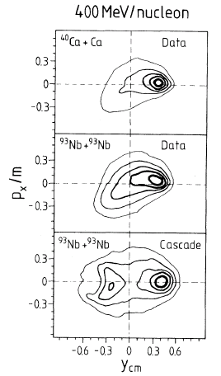
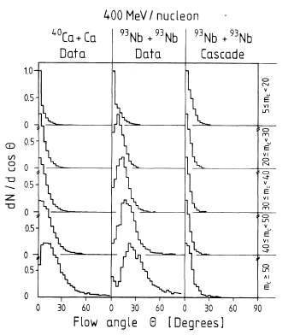
Flow at Bevalac
Bounce-off of projectile fragments in non-central collisions
Side splash of mid-rapidity particles in central collisions
Phys. Rev. Lett. 52, 1590 (1984)
H. A. Gustafsson, et al.

Slide 52
Low-mass Pair Measurement
A proposal was made to measure low-mass electron-pairs in the central Au+Au collisions at the AGS (1986〜1989)
Gang of Four
  H-G. Ritter (LBL), G.R. Young (ORNL), O. Hansen (BNL), H.H
The proposal was rejected at the PAC, partly because of objection by J.D. Bjorken
Regarded as THE missing experiment at the AGS
Opportunity was lost to study pair production under the maximum baryon density

Slide 53
Directed Flow Measurement at AGS
a

