Slide 1
Modifications of meson spectral functions in nuclear matter
Philipp Gubler, Yonsei University, Seoul
P. Gubler and K. Ohtani, Phys. Rev. D 90, 094002 (2014). P. Gubler and W. Weise, Phys. Lett. B 751, 396 (2015).
K. Suzuki, P. Gubler and M. Oka, Phys. Rev. C 93, 045209 (2016).
P. Gubler and W. Weise, Nucl. Phys. A 954, 125 (2016).
Talk at the 34th Reimei workshop “Physics of Heavy-Ion Collisions at J-PARC”
Tokai, Japan
9. August, 2016
Collaborators:
Keisuke Ohtani (Tokyo Tech)
Wolfram Weise (TUM)
Kei Suzuki (Yonsei Univ.)
Makoto Oka (Tokyo Tech)

Slide 2
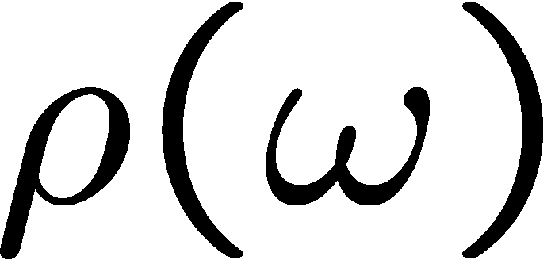
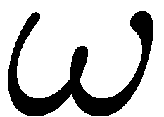
Introduction
Spectral functions at finite density
How is this complicated behavior related to partial restauration of chiral symmetry?
modification at finite density
coupling to nucleon resonances?
broadening?
mass/threshold shifts?

Slide 3


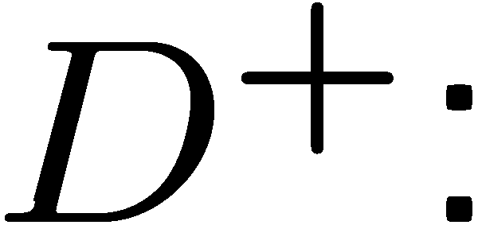


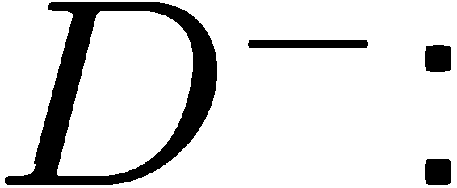

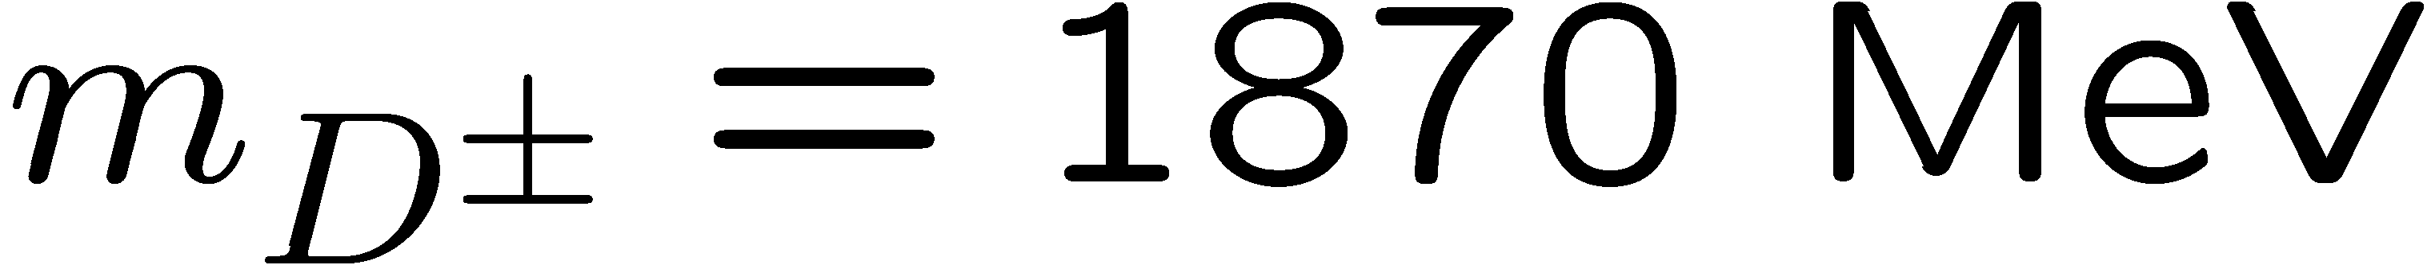


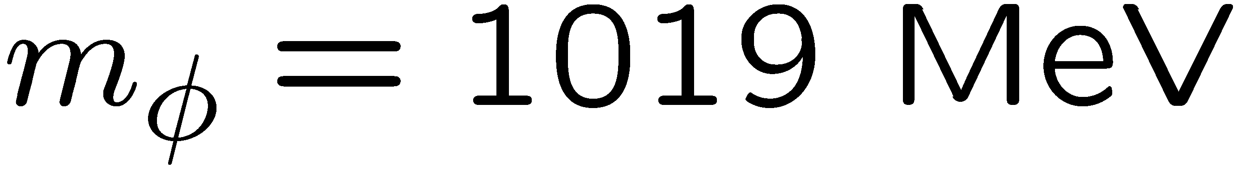
Introduction
D mesons
φ meson

Slide 4
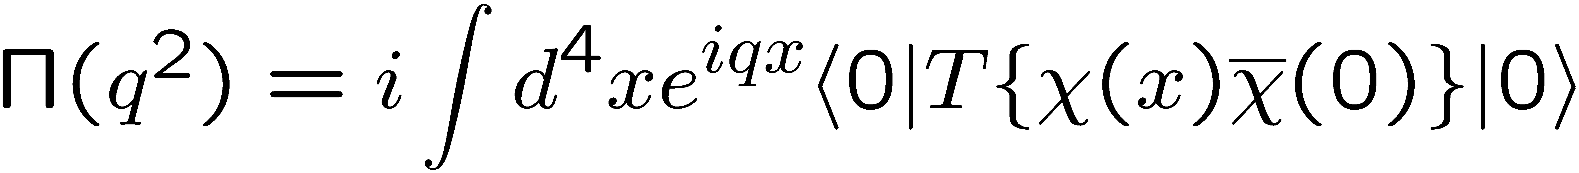
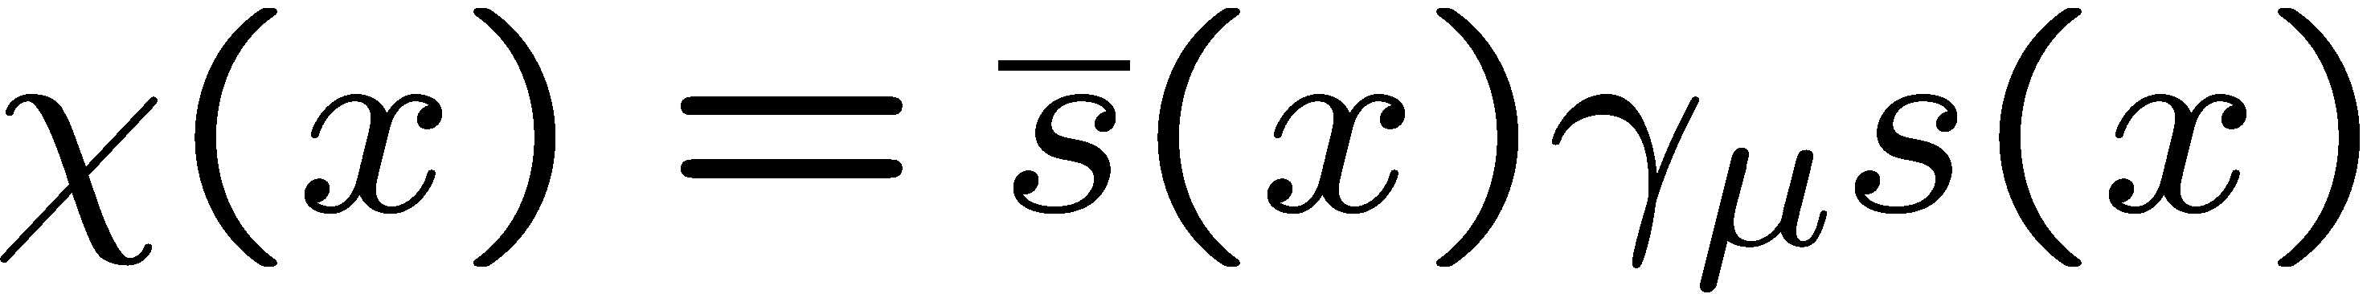
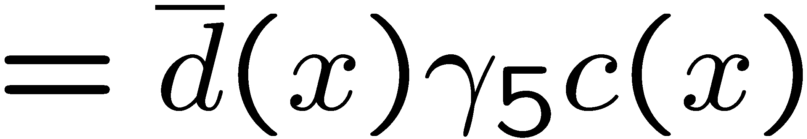
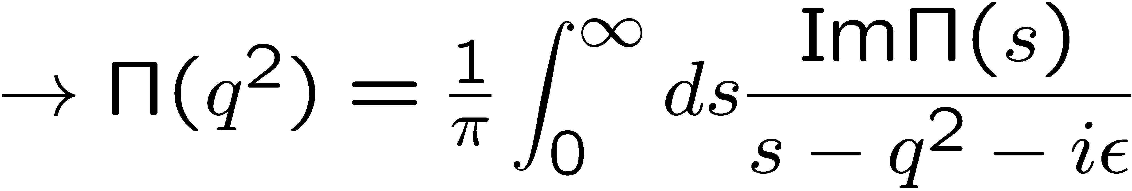
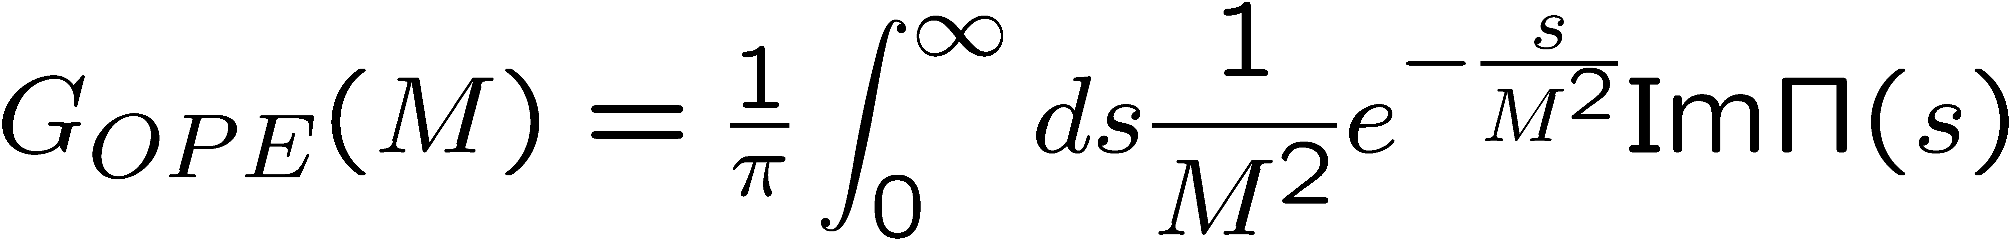
QCD sum rules
M.A. Shifman, A.I. Vainshtein and V.I. Zakharov, Nucl. Phys. B147, 385 (1979); B147, 448 (1979).
Makes use of the analytic properties of the correlation function:
q²
is calculated
“perturbatively”,
using OPE
spectral function
of the operator χ
After the Borel transformation:

Slide 5
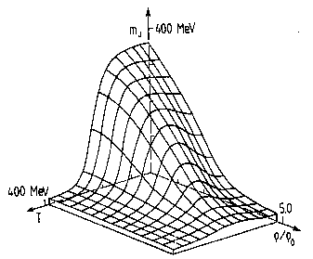
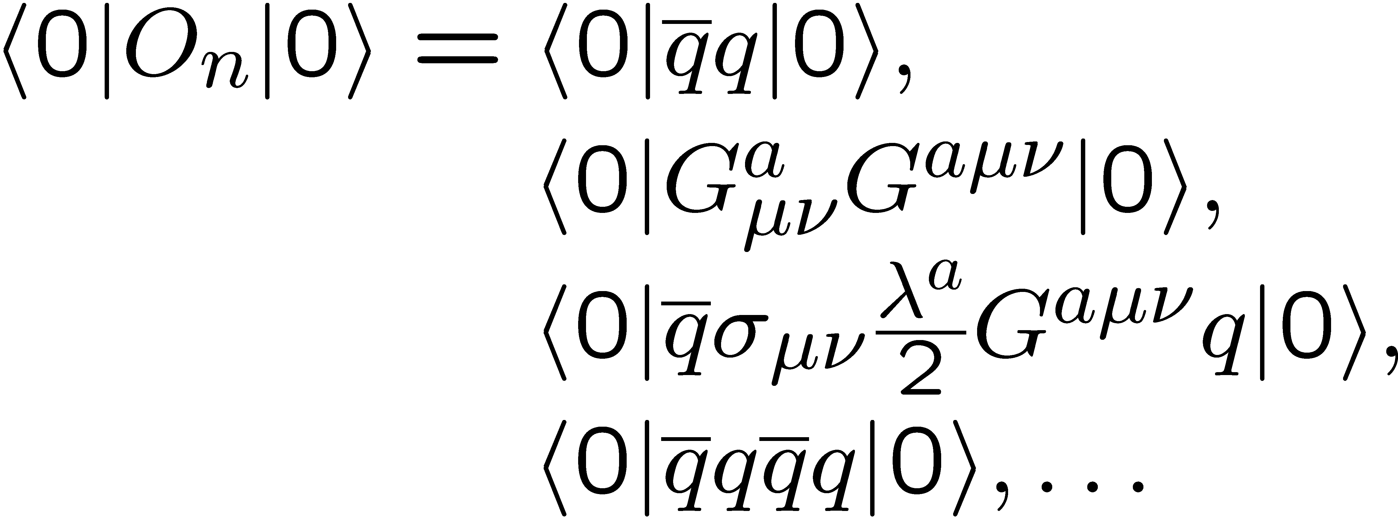
More on the OPE in matter
non-perturbative condensates
perturbative Wilson coefficients
Change in hot or dense matter!

Slide 6
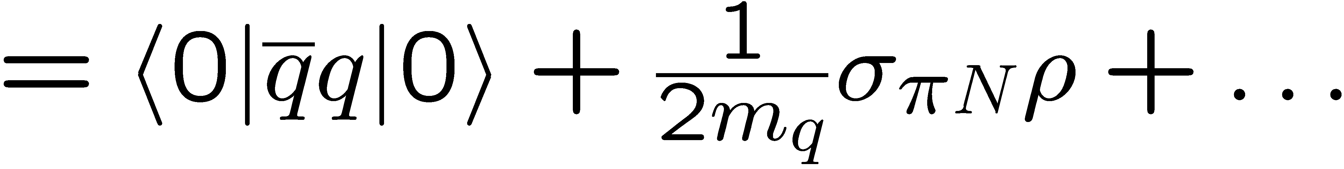
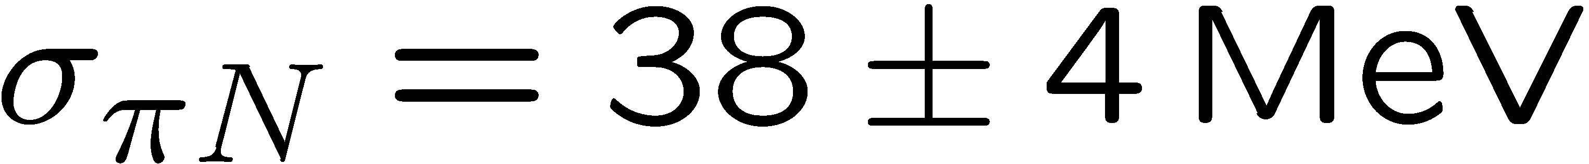
What about the chiral condensate?
At finite density:
πN-σ term
Newest fit to πN scattering data
(value still not well known)
Recent lattice QCD determination at physical quark masses
M. Hoferichter, J. Ruiz de Elvira, B. Kubis and U.-G. Meißner,
Phys. Rev. Lett. 115, 092301 (2015).
S. Durr et al., (BMW Collaboration),
Phys. Rev. Lett. 116, 172001 (2016).

Slide 7
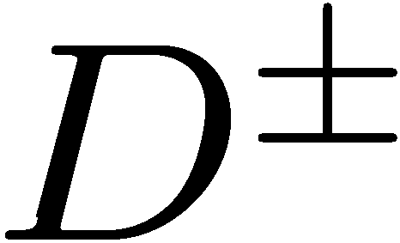
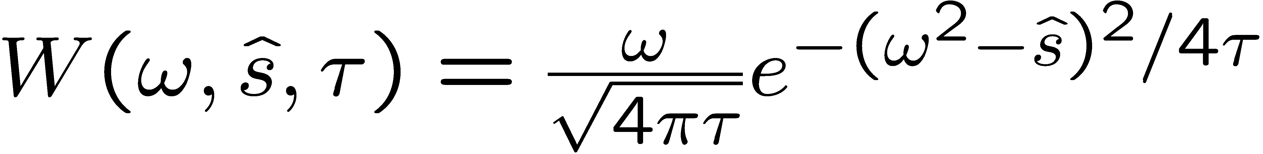
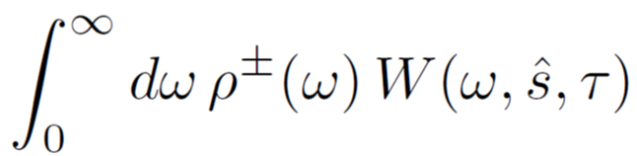
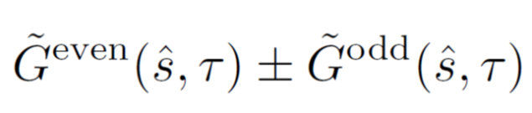
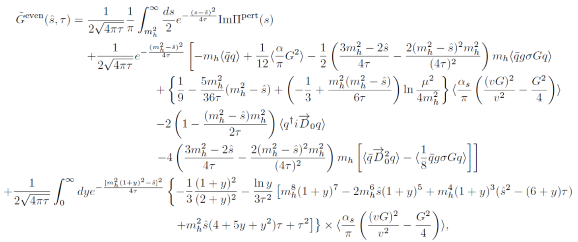
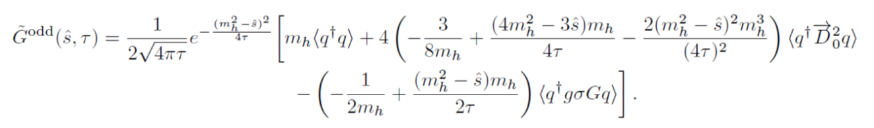
D-meson in nuclear matter
The sum rules we use:

Slide 8
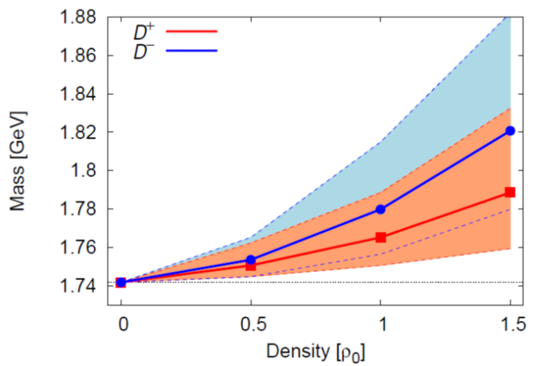
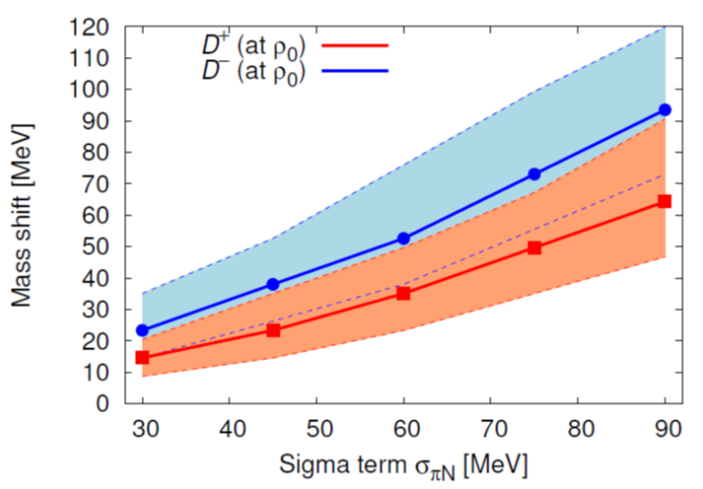
Results
increase!
To be measured at the CBM (Compressed Baryon Matter) experiment at FAIR, GSI?
Possible explanation within a quark model:
A. Park, P. Gubler, M. Harada, S.H. Lee, C. Nonaka and W. Park, Phys. Rev. D 93, 054035 (2016).
And/or at J-PARC??

Slide 9
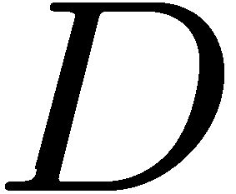
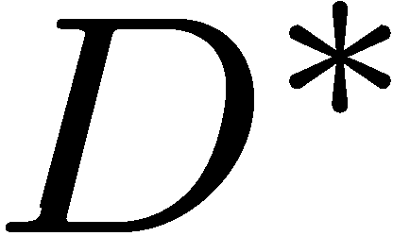
Why does the D meson mass increase at finite density?
Chiral partners that approach each other?
modification at finite density

Slide 10
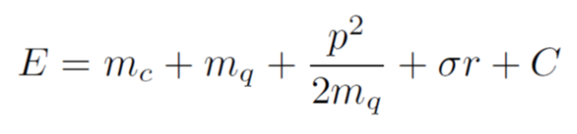
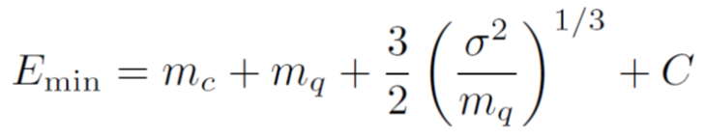
Why does the D meson mass increase at finite density?
A possible explanation from a simple quark model:
replace r by 1/p and minimize E
A. Park, P. Gubler, M. Harada, S.H. Lee, C. Nonaka and W. Park, Phys. Rev. D 93, 054035 (2016).
Increasing mass for sufficiently small constituent quark masses!

Slide 11
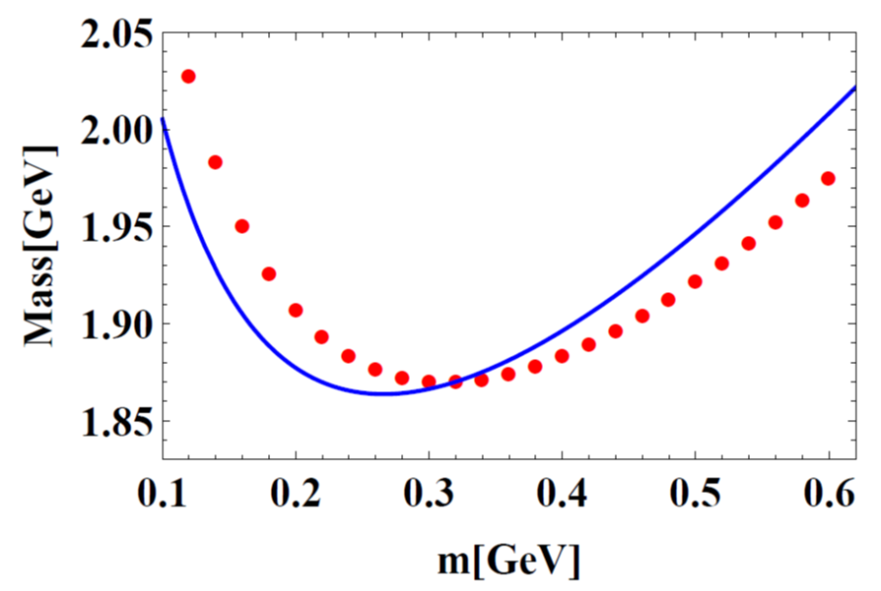
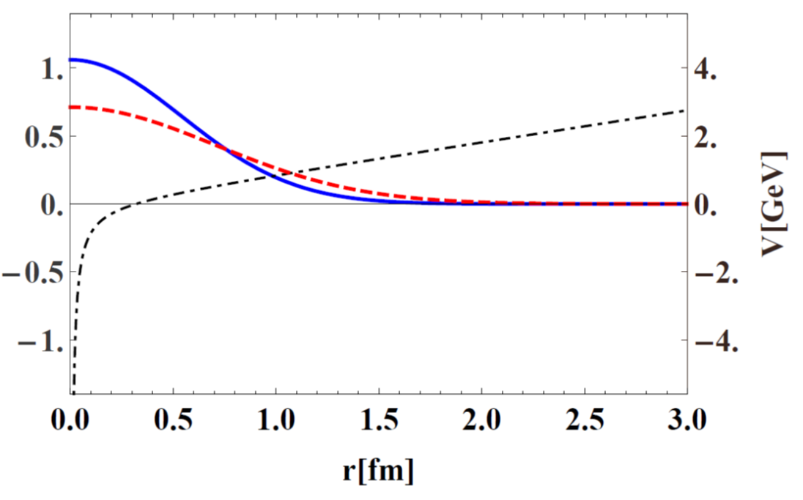
Comparison with more accurate quark model calculation:
increase!
Wave function
A. Park, P. Gubler, M. Harada, S.H. Lee, C. Nonaka and W. Park, Phys. Rev. D 93, 054035 (2016).
Combined effect of chiral restauration and confinement!

Slide 12
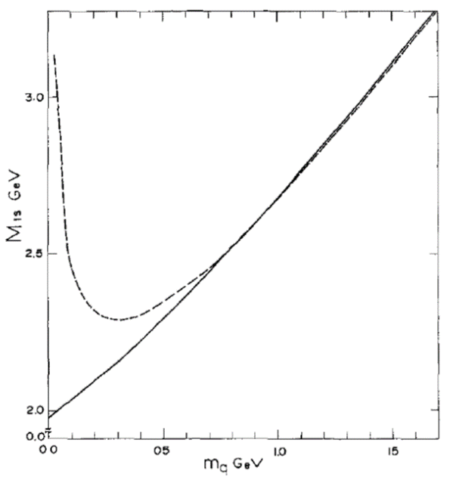
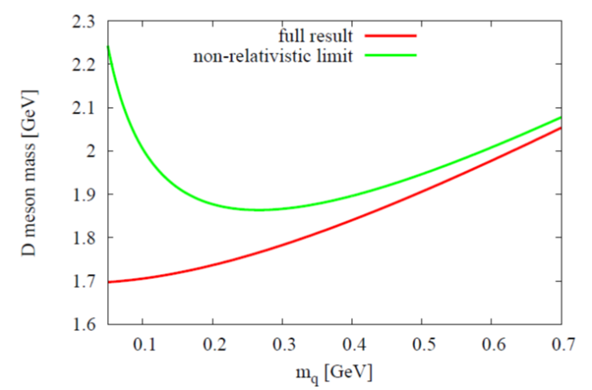
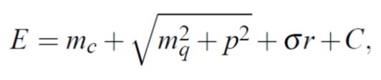
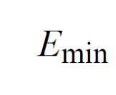
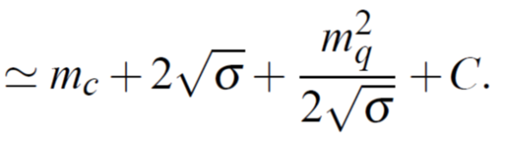
How about relativistic effects?
non-relativistic calculation
most naïve relativistic extension
replace r by 1/p and minimize E
relativistic calculation
M. Kaburagi et. al, Z. Phys. C 9, 213 (1981).
Relativistic quark model cannot explain increasing D meson mass in nuclear matter.

Slide 13
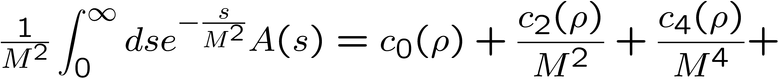
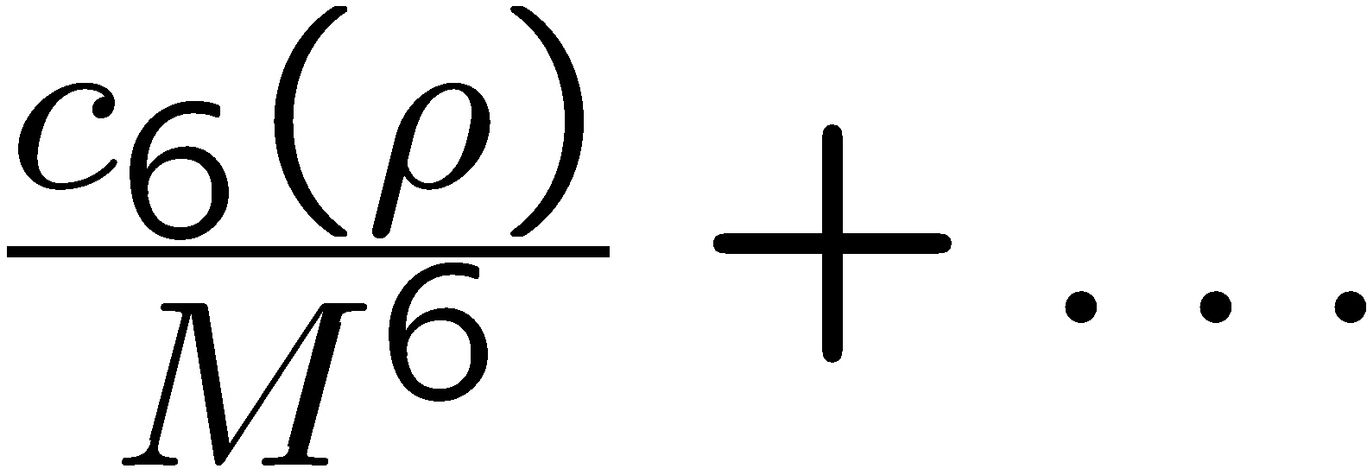
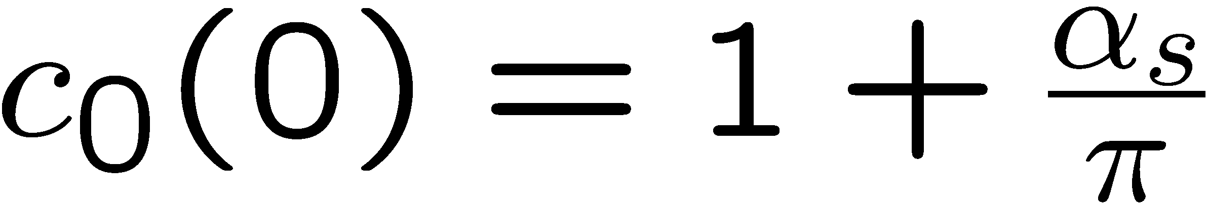
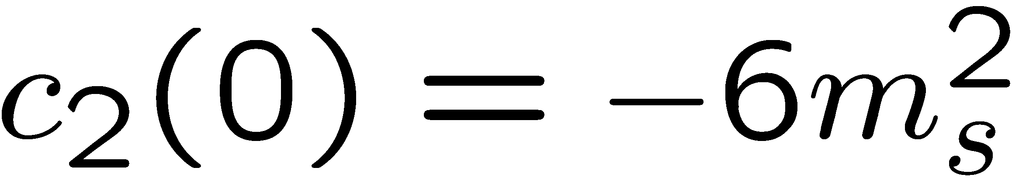
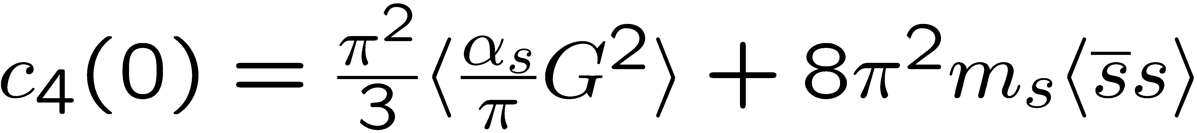
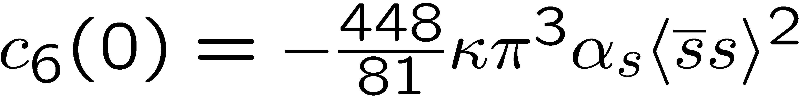
Structure of QCD sum rules for the phi meson
In Vacuum
Dim. 0:
Dim. 2:
Dim. 4:
Dim. 6:

Slide 14
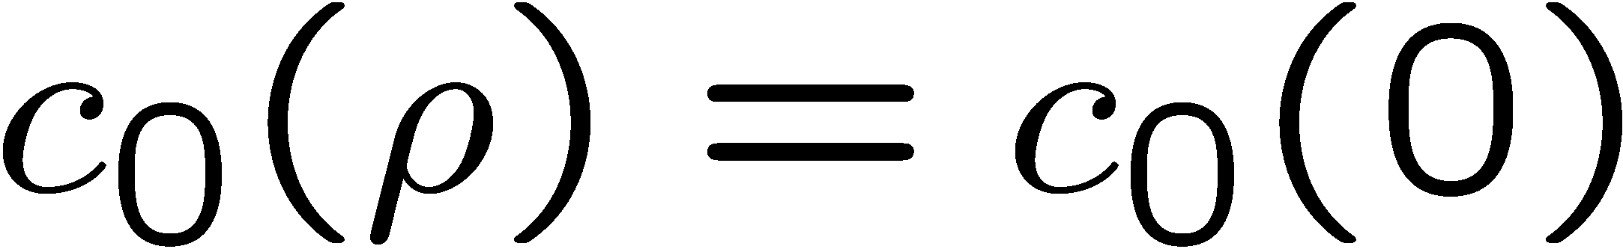
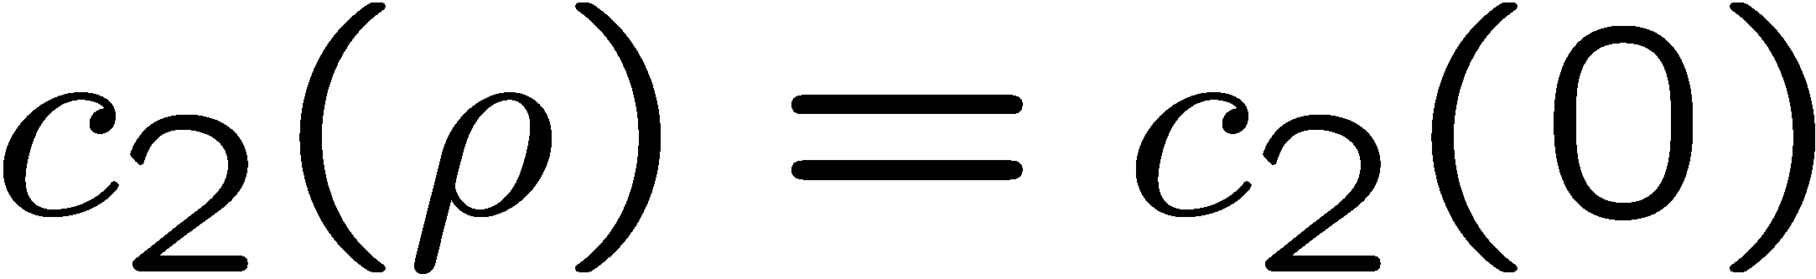
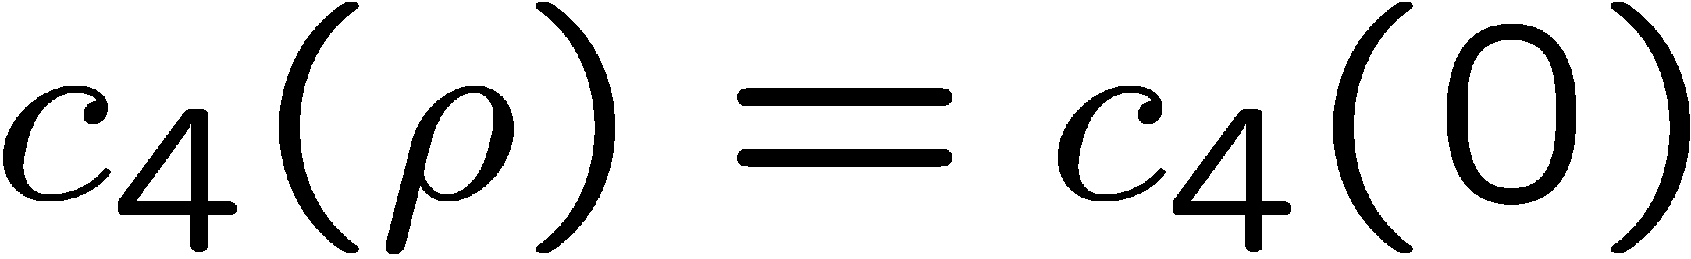
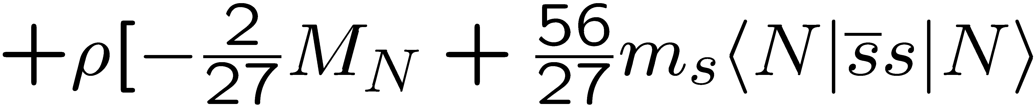
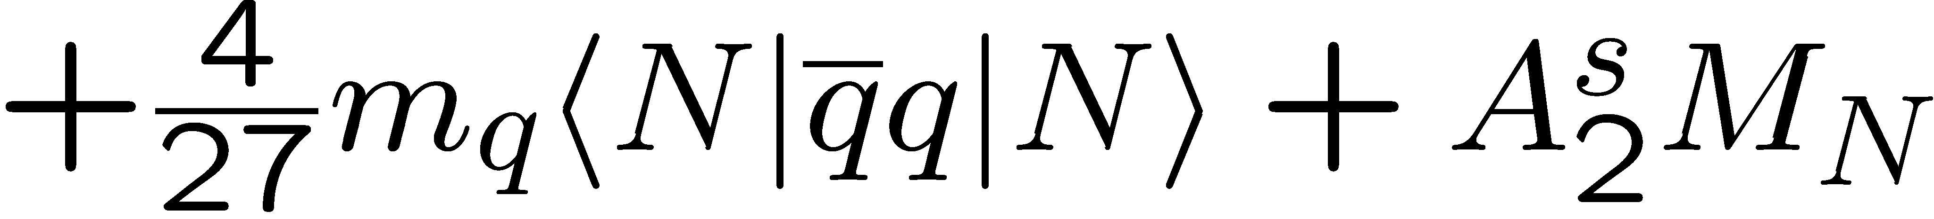
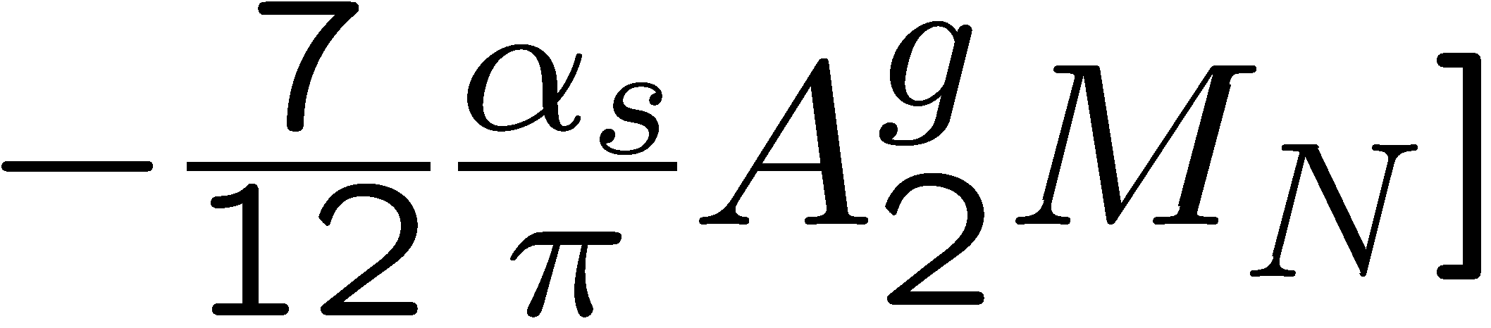
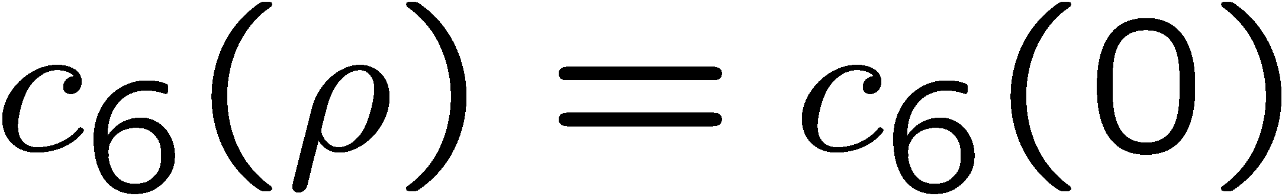
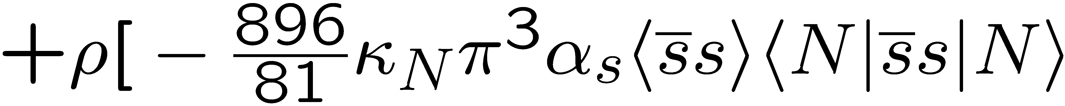
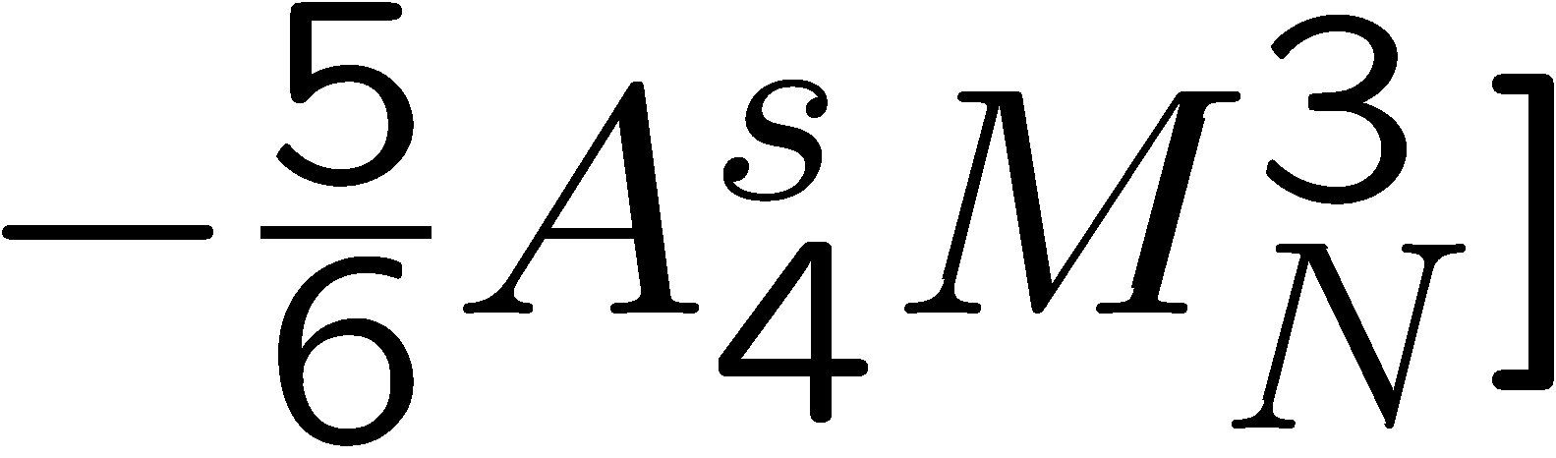
Structure of QCD sum rules for the phi meson
In Nuclear Matter
Dim. 0:
Dim. 2:
Dim. 4:
Dim. 6:

Slide 15
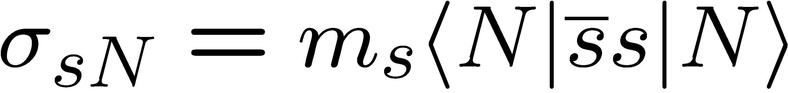




The strangeness content of the nucleon: results from lattice QCD
S. Durr et al. (BMW Collaboration), Phys. Rev. Lett. 116, 172001 (2016).
(Feynman-Hellmann)
Y.-B. Yang et al. (χQCD Collaboration), arXiv:1511.09089 [hep-lat].
(Direct)
A. Abdel-Rehim et al. (ETM Collaboration), Phys. Rev. Lett. 116, 252001 (2016).
(Direct)
G.S. Bali et al. (RQCD Collaboration), Phys. Rev. D 93, 094504 (2016).
(Direct)

Slide 16

Results for the φ meson mass
Most important parameter, that
determines the behavior of the φ meson mass at finite density:
Strangeness content of the nucleon
P. Gubler and K. Ohtani, Phys. Rev. D 90, 094002 (2014).

Slide 17




Experimental results from the E325 experiment (KEK)
R. Muto et al, Phys. Rev. Lett. 98, 042501 (2007).
Pole mass:
35 MeV negative mass shift at normal nuclear matter density
Pole width:
Increased width to 15 MeV at normal nuclear matter density
Caution!
Fit to experimental data is performed with a simple Breit-Wigner parametrization
Too simple!?

Slide 18


Compare Theory with Experiment
Sum Rules + Experiment
Not consistent?
Experiment
Lattice QCD

Slide 19
BMW version:
Sum Rules + Experiment
?
Experiment
Lattice QCD

Slide 20
χQCD version:
Sum Rules + Experiment
??
Experiment
Lattice QCD

Slide 21
Issues with Borel sum rules
Details of the spectral function cannot be studied (e.g. width)
Higher order OPE terms are always present (e.g. four-quark condensates at dimension 6)
Use a model to compute the complete spectral function
Use moments to probe specific condensates

Slide 22








Method
Vector meson dominance model:
Kaon-loops introduce self-energy corrections to the φ-meson propagator

Slide 23



What happens in nuclear matter?
P
N
N
P
Recent fit based on SU(3) chiral effective field theory
Forward KN (or KN) scattering amplitude
If working at linear order in density, the free scattering amplitudes can be used
Y. Ikeda, T. Hyodo and W. Weise, Nucl. Phys. A 881, 98 (2012).

Slide 24



Results (Spectral Density)
Asymmetric modification of the spectrum. → Not necessarily parametrizable by a simple Breit-Wigner peak!
→ Important message for future E16 experiment at J-PARC
Takes into account further KN-interactions with intermediate hyperons, such as:

Slide 25







Moment analysis of obtained spectral functions
Starting point: Borel-type QCD sum rules
Large M limit
Finite-energy sum rules

Slide 26




Summary and Conclusions
QCD sum rule calculations suggest that the D meson mass increases with increasing density:
most important parameter:
The φ-meson mass shift in nuclear matter constrains the strangeness content of the nucleon:
  Increasing φ-meson mass in nuclear matter
  Decreasing φ-meson mass in nuclear matter
We have computed the φ meson spectral density in vacuum and nuclear matter based on an effective vector dominance model and the latest experimental constraints
Non-symmetric behavior of peak in nuclear matter
Moments provide direct links between QCD condensates and experimentally measurable quantities

Slide 27
Backup slides

Slide 28


Use moments to constrain the strange sigma term

Slide 29



Results
K. Suzuki, P. Gubler and M. Oka, Phys. Rev. C 93, 045209 (2016).

Slide 30


Consistency check
(Vacuum)
Are the zeroth and first momentum sum rules consistent with our phenomenological spectral density?
Zeroth Moment
First Moment
Consistent!

Slide 31




Consistency check
(Nuclear matter)
Are the zeroth and first momentum sum rules consistent with our phenomenological spectral density?
Zeroth Moment
First Moment
Consistent!

Slide 32
φ meson in nuclear matter: experimental results
The E325 Experiment (KEK)
Slowly moving φ mesons are produced in 12 GeV p+A reactions and are measured through di-leptons.
e
e
p
e
p
φ
φ
e
outside decay
inside decay
No effect (only vacuum)
Di-lepton spectrum reflects the modified φ-meson

Slide 33

In-nucleus decay fractions for E325 kinematics
Taken from: R.S. Hayano and T. Hatsuda, Rev. Mod. Phys. 82, 2949 (2010).

Slide 34








Other experimental results
There are some more experimental results on the φ-meson width in nuclear matter, based on the measurement of the transparency ratio T:
Measured at SPring-8 (LEPS)
Measured at COSY-ANKE
T. Ishikawa et al, Phys. Lett. B 608, 215 (2005).
A. Polyanskiy et al, Phys. Lett. B 695, 74 (2011).

Slide 35




The strangeness content of the nucleon:
Important parameter for dark-matter searches:
Neutralino: Linear superposition of the Super-partners of the Higgs, the photon and the Z-boson
Adapted from: W. Freeman and D. Toussaint (MILC Collaboration), Phys. Rev. D 88, 054503 (2013).
most important contribution
dominates
A. Bottino, F. Donato, N. Fornengo and S. Scopel, Asropart. Phys. 18, 205 (2002).

Slide 36

Results of test-analysis (using MEM)
Peak position can be extracted, but not the width!
P. Gubler and K. Ohtani, Phys. Rev. D 90, 094002 (2014).

Slide 37

Results of test-analysis (using MEM)
P. Gubler and K. Ohtani, Phys. Rev. D 90, 094002 (2014).

Slide 38


The strangeness content of the nucleon: results from lattice QCD
Two methods
Direct measurement
Feynman-Hellmannn theorem
A. Abdel-Rehim et al. (ETM Collaboration), Phys. Rev. Lett. 116, 252001 (2016).
S. Durr et al. (BMW Collaboration), Phys. Rev. Lett. 116, 172001 (2016).

Slide 39


The strangeness content of the nucleon: results from lattice QCD
Taken from M. Gong et al. (χQCD Collaboration), arXiv:1304.1194 [hep-ph].
Still large systematic uncertainties?
y ~ 0.04

Slide 40




Starting point:
Rewrite using hadronic degrees of freedom
Kaon loops

Slide 41


Vacuum spectrum
(Vacuum)
How is this spectrum modified in nuclear matter?
Is the (modified) spectral function consistent with QCD sum rules?
Data from
J.P. Lees et al. (BABAR Collaboration), Phys. Rev. D 88, 032013 (2013).

Slide 42

More on the free KN and KN scattering amplitudes
For KN:
Approximate by a real constant (↔ repulsion)
T. Waas, N. Kaiser and W. Weise, Phys. Lett. B 379, 34 (1996).
For KN:
Use the latest fit based on SU(3) chiral effective field theory, coupled channels and recent experimental results (↔ attraction)
Y. Ikeda, T. Hyodo and W. Weise, Nucl. Phys. A 881, 98 (2012).
K⁻p scattering length obtained from kaonic hydrogen (SIDDHARTA Collaboration)

Slide 43




Ratios of moments
Vacuum:
Nuclear Matter:
(S-Wave)
(S- and P-Wave)
Interesting to measure in actual experiments?

Slide 44



Second moment sum rule
Factorization hypothesis
Strongly violated?

